Slide 1
Philanthropy is not about money

Slide 2
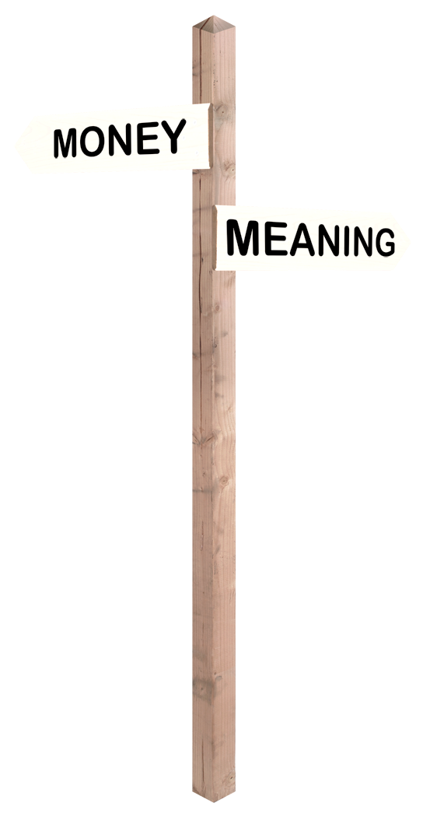

Slide 3
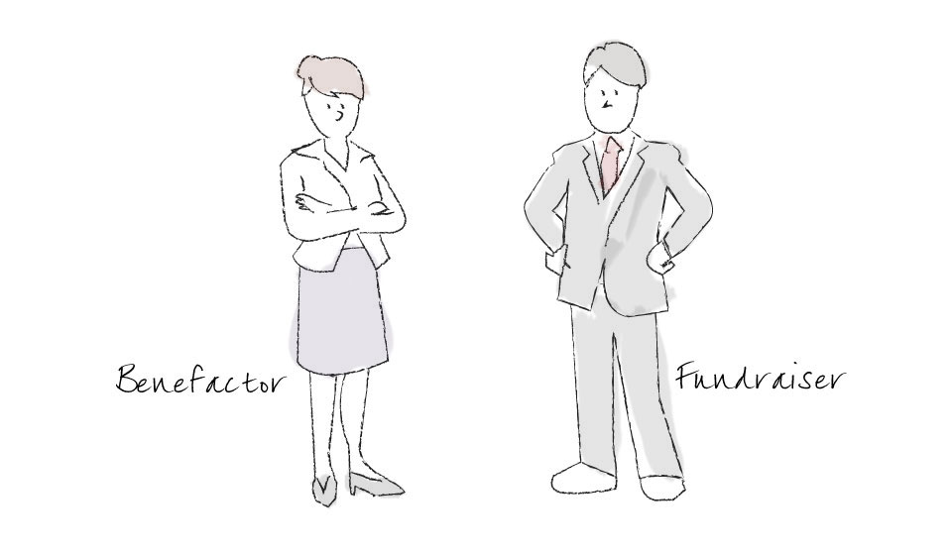
Philanthropy is not about moving money
from a benefactor’s pocket to a fundraiser’s pocket.

Slide 4
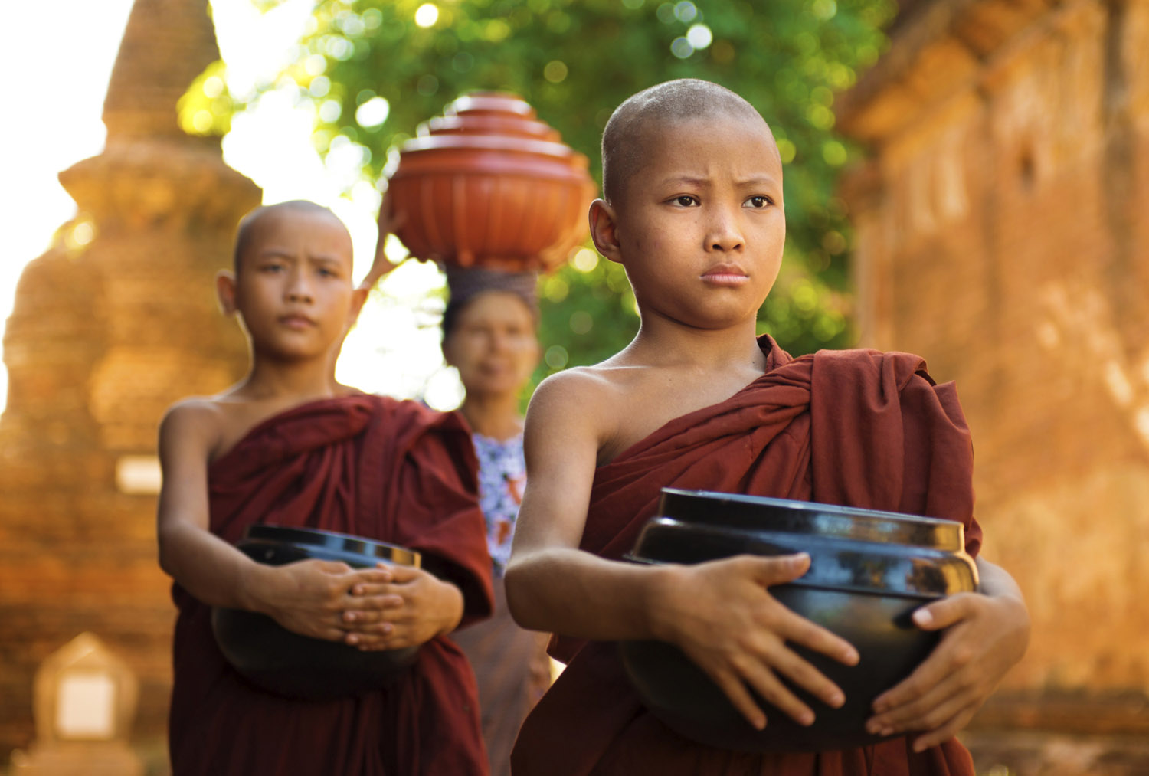
Two views of our work
… see ourselves as moral trainers providing benefactors with the opportunity to be generous and generative.”
“We can either see ourselves as mendicants or beggars, or…

Slide 5
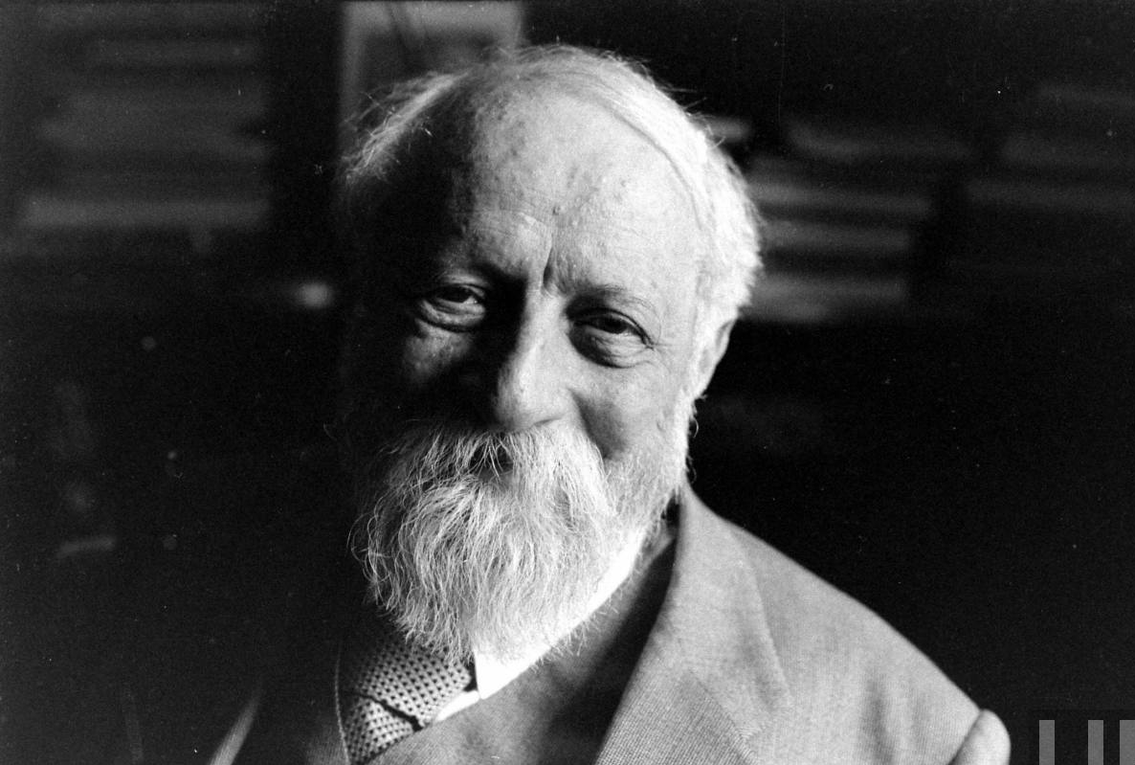
I – It
Objectification
I – Thou
Authentic existence

Slide 6
Benefactor-centric is I-Thou
We would never ask you for something that doesn’t match your values or passions
We would never surprise you with an ask
Wherever possible we will co-create a project of interest, and in some circumstances co-create the budget

Slide 7
Philanthropy is all about
the essence of generosity and giving
It has nothing to do with money and taking

Slide 8
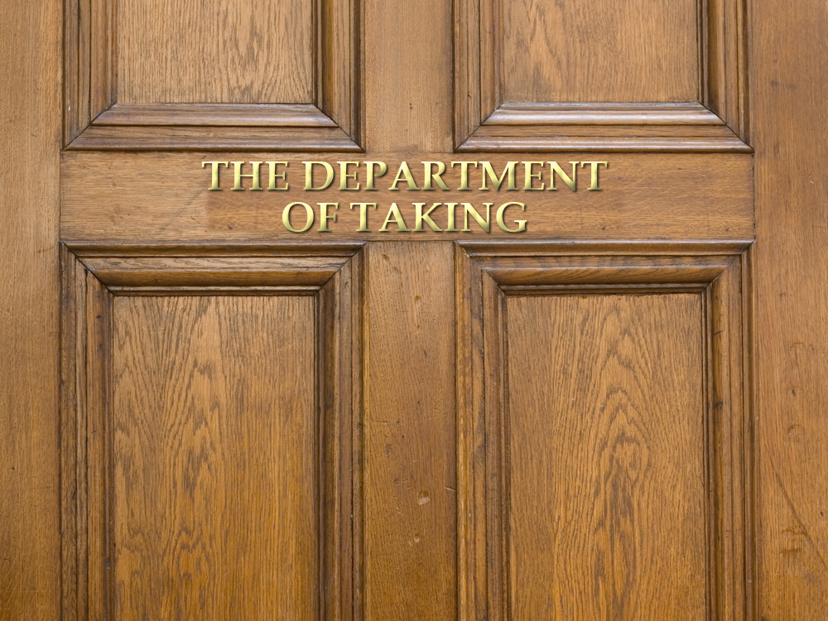

Slide 9
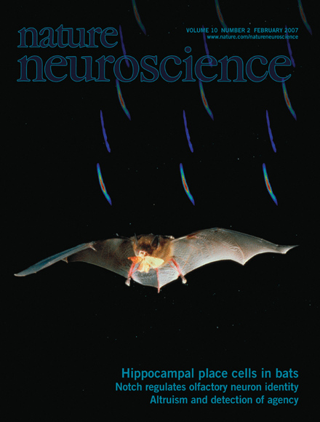
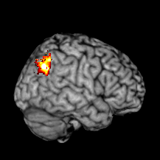
Are We Hardwired for Philanthropy? Functional MRI Studies of Altruism
Drs. Dharol Tankersley, C. Jill Stowe and Scott A. Huettel, “Altruism is associated with an increased neural response to agency,” Journal of Nature Neuroscience, 10:137-138, February 2007.

Slide 10
Four Basic Brain Drives*
Acquiring
(Things/experiences)
Defending
(Assets/family)
Learning
(Dreamers/ innovators/ entrepreneurs)
Caring/ Sharing
(Dream makers/ caretakers)
Propensity toward accumulators
Propensity toward givers/philanthropists

Slide 11
Stages of Philanthropy
Quid Pro Quo
Obligation
Gratitude
Relationship
Ownership/ Partnership
Transactions
Transitions
Transformations

Slide 12
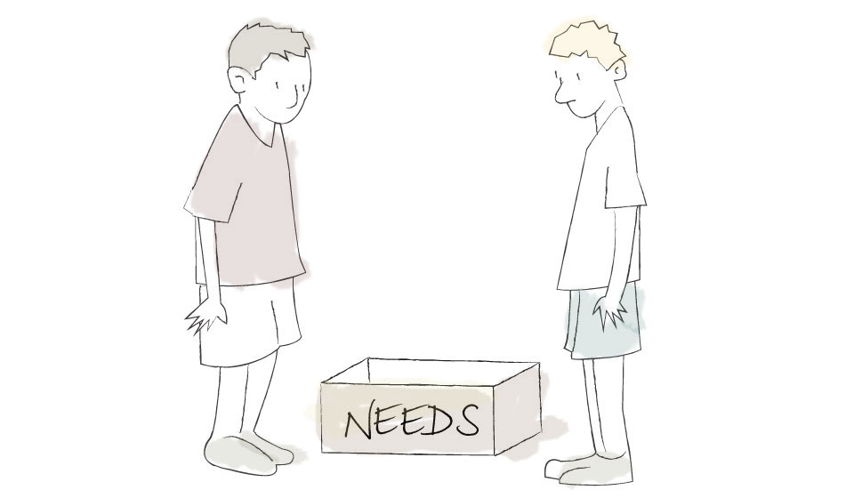

Slide 13
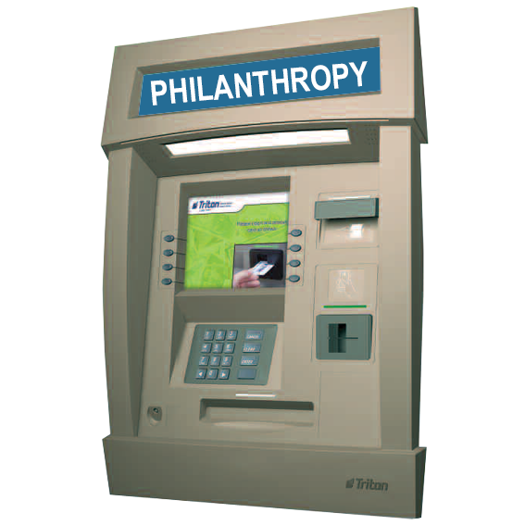

Slide 14
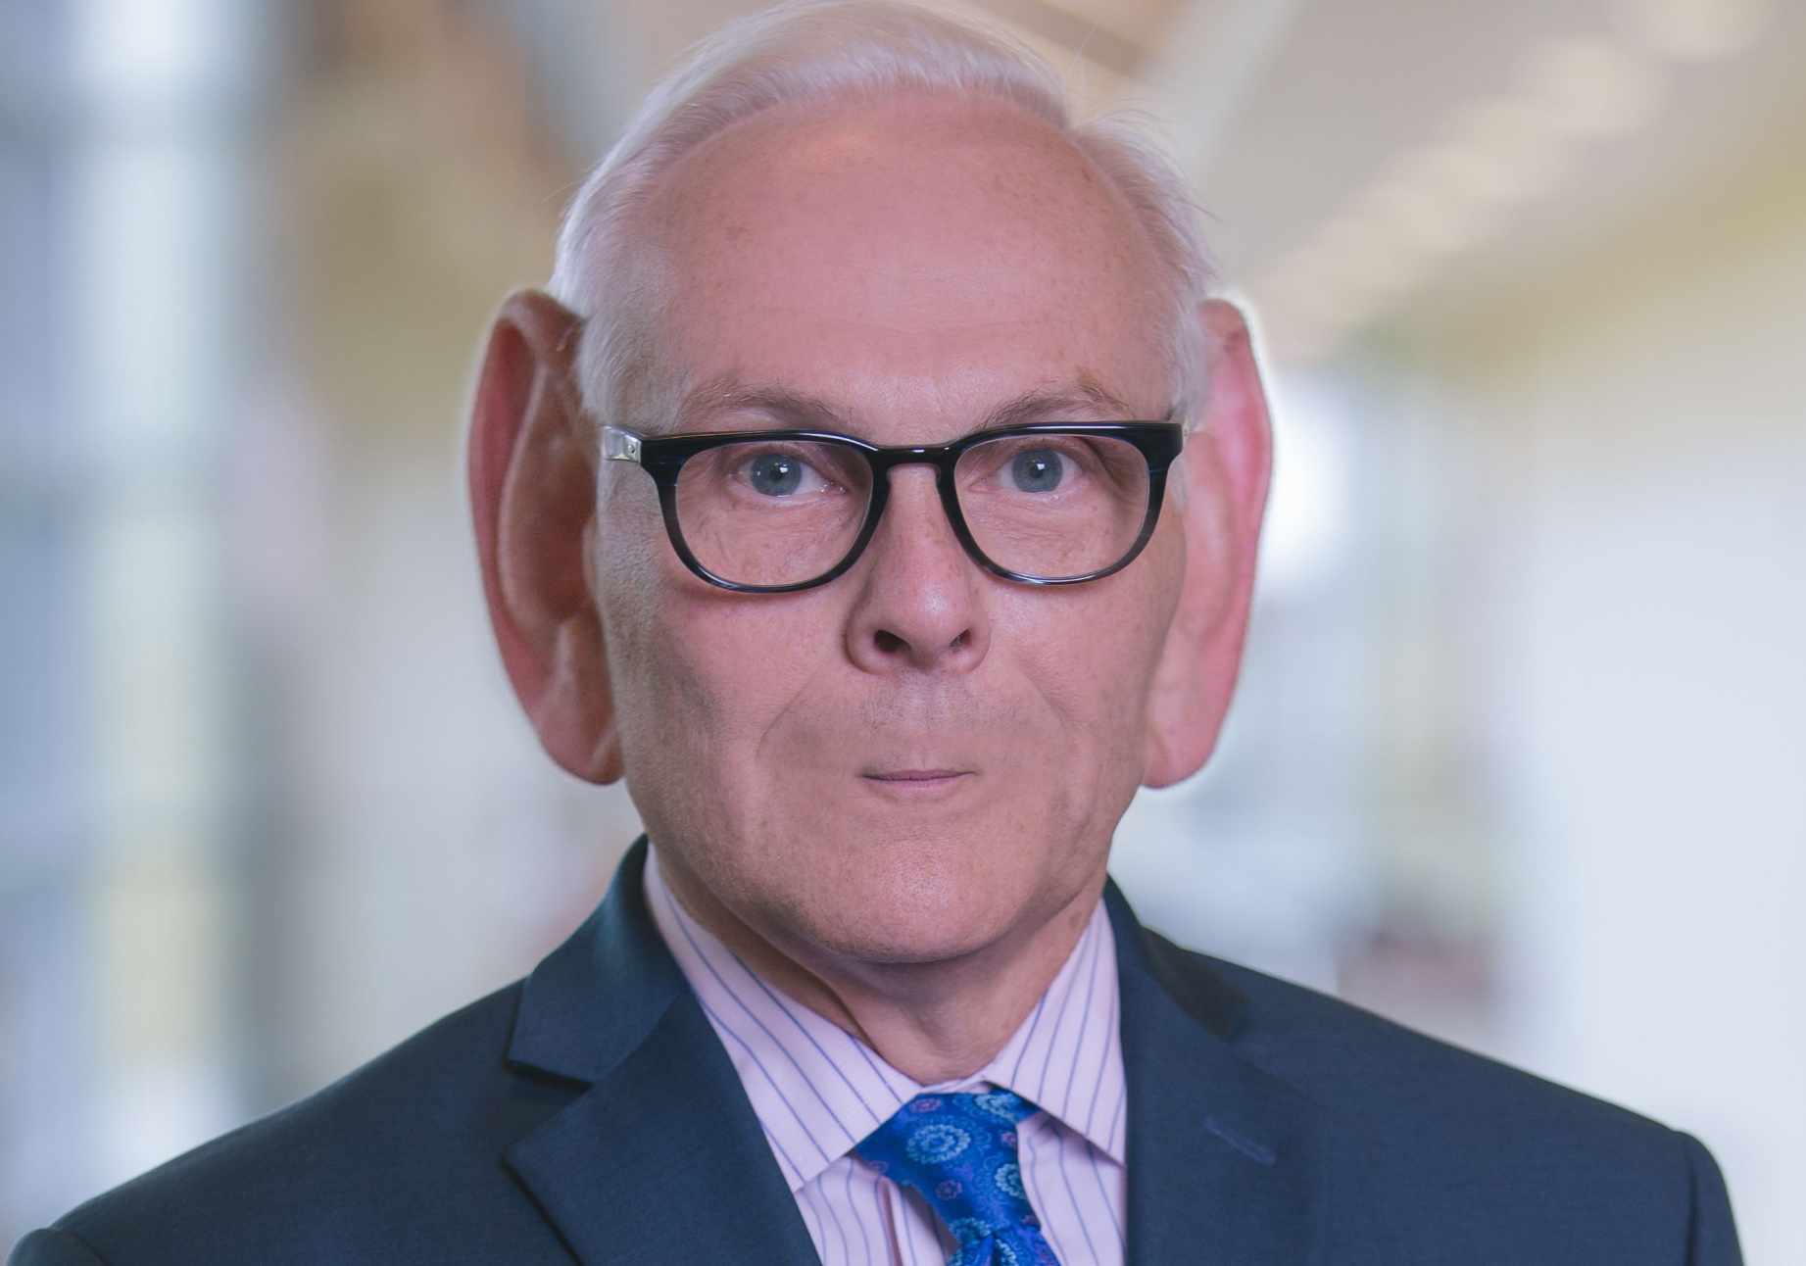
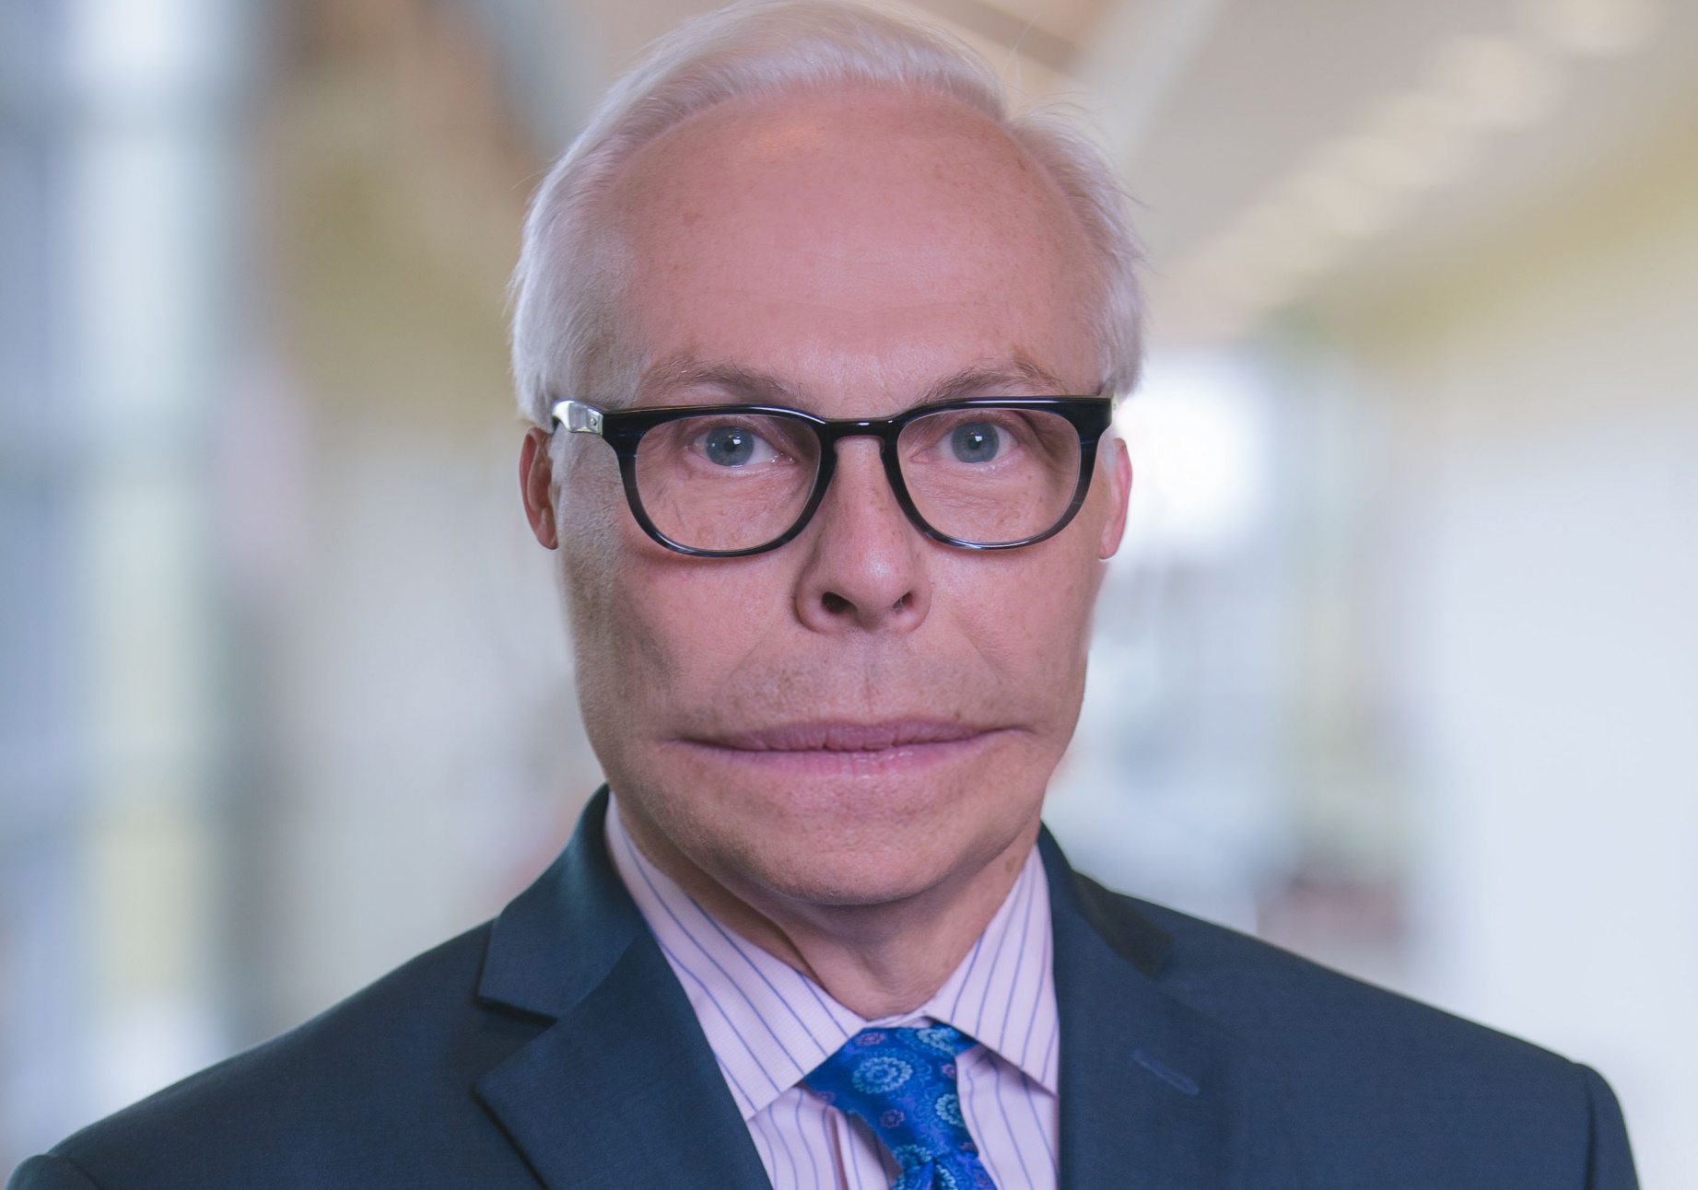
Talking, Selling, Telling

Slide 15
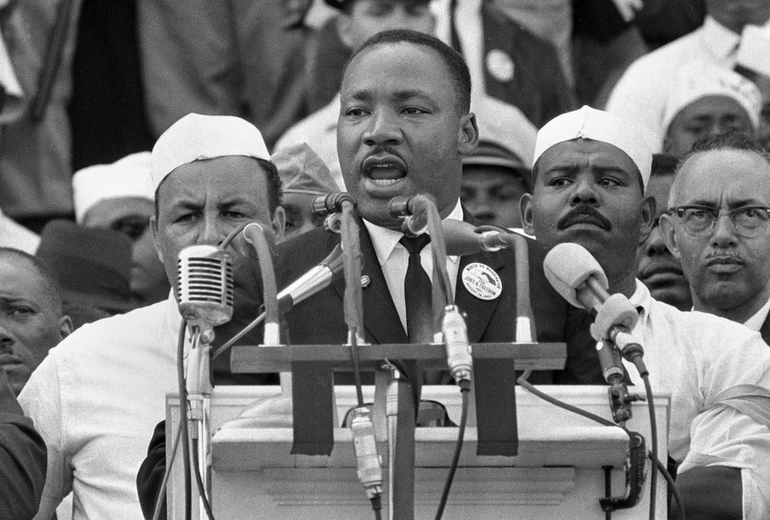
“I have a strategic plan!”
“I have a dream!”

Slide 16
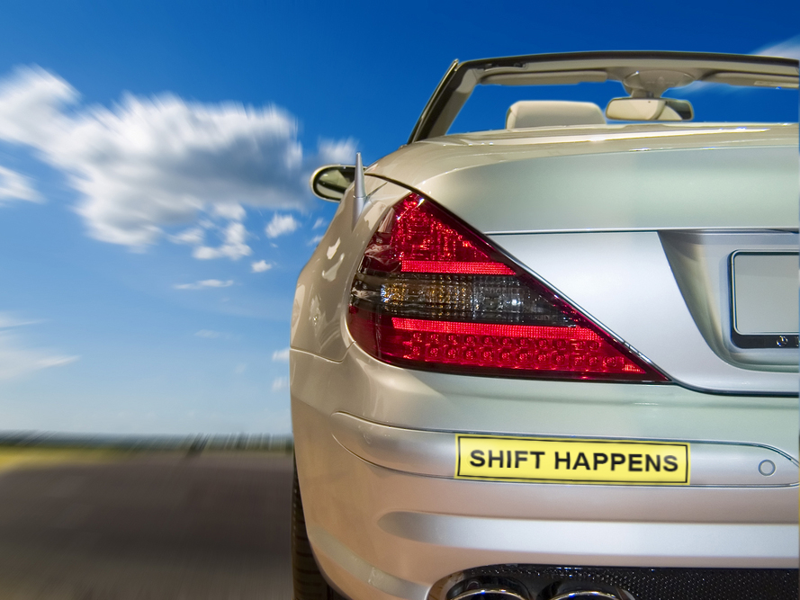

Slide 17
Shift from scheming
to dreaming

Slide 18
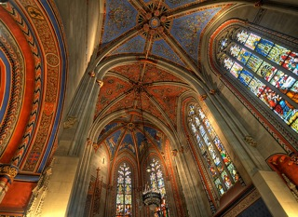
Shift from raising dollars
to raising sights

Slide 19
Shift from problems and needs to aspirations and possibilities

Slide 20
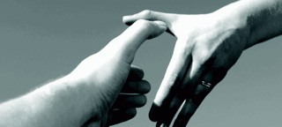
Inviting and Compelling

Slide 21
Pull
This is the lure of an attractive goal, or a strongly desired good, recognized by Plato and Aristotle as well as by many other great thinkers of the past … embodying a valued ideal.
It attracts us and calls us to put forward our greatest efforts.
The greater the ideal, the greater the power it can have in our lives.

Slide 22
Benefactor’s
Values and Aspirations
Nonprofit’s
Mission and Vision
Gifts of Significance
Development Officer’s
Integrity and Passion

Slide 23
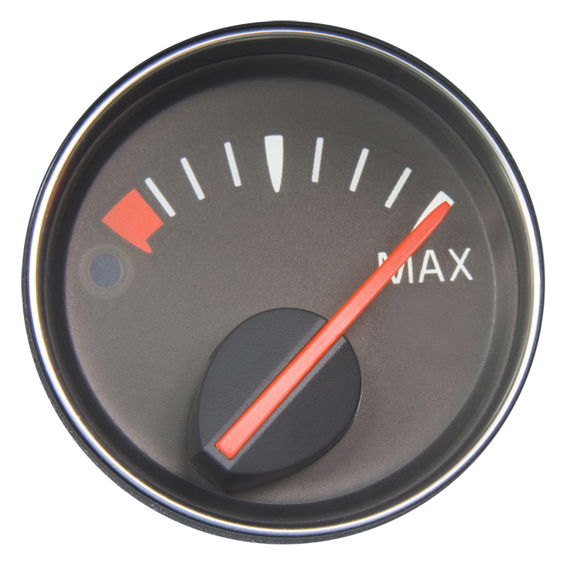
Compassion Gauge
Running on Empathy

Slide 24
DO
THINK
TANK

