Slide 1
Advancement Update
December 2022
Notes:
Thanks so much for having me today. We have a slight shift in our agenda today. We are actually going to take our break from 9:45-10:00 where we will have our CU Foundation update at 10:00.
As you might remember from the business of higher education session, my boss Annie Baccary leads the system advancement office and is also an ELP alum. Annie generally does this presentation but had a conflict today.
While you are stuck with me instead, I will share that I am always excited to talk about advancement work, which I have dedicated almost 18 years of my life to. I’m also excited for you to participate in today’s session with one of the most passionate and visionary fundraisers out there, Jim Hodge as well as a some of the most talented fundraising professionals at CU. What you are going to hear from me this morning is more about the operations of advancement at CU and more of a general overview around our giving statistics, which as leaders within CU, you should be familiar with, but the individuals like Jim, Kyle, Christian, Jason, Audra, and Tom whom you will interact with today, they do the hard but incredible work of building relationships to unlock philanthropic passion from people who love CU and see it as a good investment.
Feel free to pop questions in chat or stop me if I say something that doesn’t make sense or needs clarity. There is a lot of jargon in the advancement world.
[The Next Slide is the agenda].

Slide 2

Agenda
Advancement Overview and Introduction
Looking back: FY2022 Review
Looking forward: FY2023 and Beyond
Notes:
My goal today is to give you an overview of the advancement organization at CU so you have a good basis of understanding as my colleagues take a deeper dive into our work throughout the morning.
I’ll start with a high level overview of the organization, give you a review of fiscal year 2022
and then share with you some thoughts about this year and why my colleagues and I are cautiously optimistic as we look forward.
[next slide]

Slide 3
Advancement Overview and Introduction
Notes:
I’ll start by giving you an overview of advancement. I also will provide more clarity on my role and how I support CU a little further along in the presentation.
[next slide]

Slide 4
What is Advancement?
Advancement builds and stewards relationships with alumni, patients, businesses, foundations, faculty, staff, parents and other important constituencies.
These relationships are critically important in not only generating much-needed private philanthropic support for the institution, but in supporting a strong base of committed university advocates.
Notes:
What is advancement? There are a lot of definitions of advancement out there, but I like this one because it defines advancement at CU today.
“Advancement” refers to a set of activities that build and enhance relationships between the university and its constituents. Or you can think of it as how we “advance” the university’s mission through these strategic relationships.
This includes not only development and fundraising, but also alumni relations, which is now under the umbrella of each of the campus advancement organizations. Additionally, the Anschutz team continues to develop and grow its grateful patient program to broaden the university’s reach. Kyle Smith is one of our ELP cohort members this year and serves a leadership role on the Anschutz Advancement team and works with donors who want to help save lives and cure diseases through their philanthropy as a result of the exceptional care they received from the CU Anschutz Medical Campus.
Before, I move forward, we are going to do a little activity. Shannon is going to launch a menti like we used last month. Using Menti, I would be curious why you believe CU is a good investment for our constituents. Many of you are alums and donors, so why do you give to CU or why do you think donors should give to CU.
After results, let’s keep these examples front and center since sometimes the “why” gets lost when you start talking through the structures and operations of a program.
Examples:
major public universities like CU do things for society that no other institution can do
Whatever a donor’s passion, they can find it at CU
We are a time-tested, reliable investment for donors
Donors gifts can have a multiplier effect
We treat donors as partners and co-visionaries

Slide 5
Advancement at CU is Represented by the Following Six Areas
CU Advancement structure​
4 CU CAMPUS OFFICES​ ​ Campus Advancement offices are the primary catalysts for most fundraising and engagement activities and most frontline donor, faculty and alumni interactions. ​ ​ About 275 total staff work on CU’s Boulder, Denver, Colorado Springs and Anschutz campuses.​ ​ | CU SYSTEM ​ ​ The system office provides centralized customer support functions that benefit from consistency and economies of scale, with about 80 staff in: ​ ​ research and prospect management​ gift agreement administration​ gift planning giving​ annual giving​ marketing and communications​ data management​ business intelligence ​ technical architecture, administration and development​ project management and service delivery​ training and outreach​ operations, budget and IT​ events and stewardship ​ | CU FOUNDATION ​ ​ The CU Foundation, a separate 501c3 organization, serves as the financial portal for philanthropic giving to CU. The CU Foundation is governed by a volunteer board of directors and operates with about 25 staff who:​ ​ receive, accept and process gifts on CU’s behalf​ establish and account for current and endowed gift funds​ administer and distribute gift funds to CU programs, ensuring that donor intent is honored​ steward CU gift assets by prudently managing and investing funds ​
Notes:
Advancement at CU is quite unique structurally as it is made up of six different entities, and under six distinct leaders. There are approximately 375 of us.
Four campus offices, which lead most frontline fundraising and engagement efforts.
There is also the system or central advancement office, where I work. Alongside the foundation, we provide a number of support services to enhance advancement’s operations and provide economies of scale.
We also have the CU Foundation, which serves as the university’s bank. You will hear later from the foundation’s president and CFO, Jack Finlaw. At a high level, the foundation accepts gifts, administers gifts, and invests the university’s endowment. And they do it incredibly well. Our endowment consistently performs in the top quartile of university endowments when compared to peers.
I recall during our business of higher ed session where we did the tour when you saw the CU Foundation office and the System Advancement office there were a number of questions around the difference between the two entities. At the end of today, I hope you have more clarity about this, but feel free to post questions in chat or contact me or Saskia if you continue to have questions.
Next slide

Slide 6
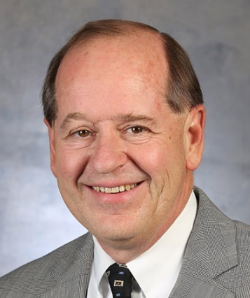
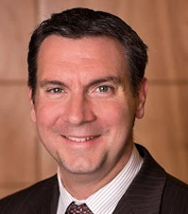
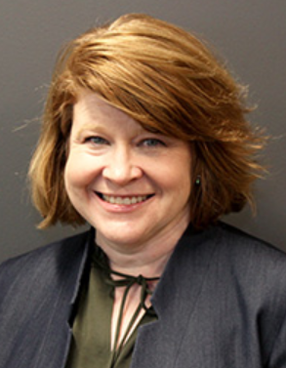
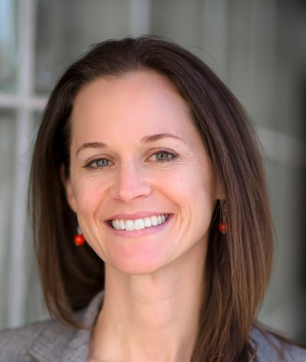
CU President
CU Chancellors
Martin Wood
UCCS VC
Scott Arthur
Anschutz VC
Melisa Baldwin
CU Denver VC
Katy Kotlarczyk
CU Boulder VC
Each campus has a Vice Chancellor of Advancement that reports to the Chancellor
Notes:
Each campus is led by a Vice Chancellor for advancement who reports directly to their respective campus chancellor.
Martin Wood, whom you met when we were in Colorado Springs has been at UCCS for over 30 years. Scott Arthur has been leading the Anschutz advancement team for eight years. Melisa Baldwin is newer to CU, having been at CU Denver for about 4 years. And, Katy Kotlarczyk is the Vice Chancellor for Advancement at CU Boulder in her second year. Katy is also an ELP alum and previously worked with me and Annie at System Advancement and has been with CU for over 12 years.
Next slide.

Slide 7
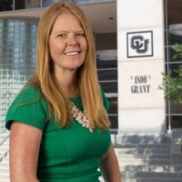
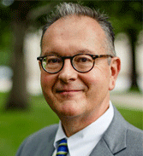
CU President
Board of Directors
Annie Baccary
Associate Vice President of System Advancement
Jack Finlaw
CU Foundation
President and CEO
Notes:
Annie Baccary is the associate vice president leading the system advancement office and a member of the President’s cabinet. Jack Finlaw is the president and CEO of the CU Foundation. He and Annie work closely together to support the campus advancement operations. Annie, Jack and the four campus vice chancellors meet twice a month to stay coordinated and work together on strategic initiatives.
Since the CU Foundation is a separate 501c3 organization, Jack reports to a separate board of directors and is responsible to them for carrying out the CU Foundation’s mission in support of CU.

Slide 8
System Advancement Units
Annual Giving
Business Intelligence (reporting)
CRM Architecture and CRM Development
Digital Marketing
Donor Communications
Events and Stewardship
Finance and Administration
Gift Agreement Administration
Gift Planning
Information Technology
Internal Communications
Prospect Development
Data Management
Research & Analytics
Training & Outreach
Service Delivery & Project Management Office
Notes:
Here are all of the 16 system advancement teams that currently work in a hybrid, remote and in-person schedule at the Grant Street office that you visited in September. Approximately 80-90 staff, depending on the day, make up these teams and our current charge is to support CU’s fundraising and engagement goals by empowering our people and strengthening our processes, data and technology.
I oversee 8 of these teams and work closely with a project team that is leading the conversion of our customer relationship management platform, which is moving from an old, dated platform, to Salesforce early next spring.

Slide 9
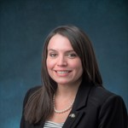
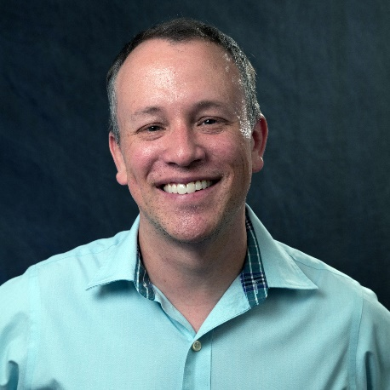
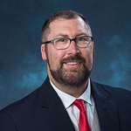
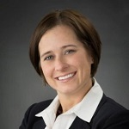
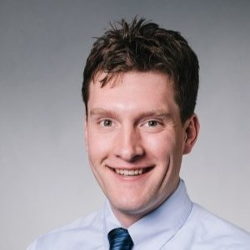
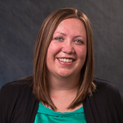
System Advancement Leadership Team & Support
Annie Baccary
Associate
Vice President
Raychel Roy
Sr. Assistant
Vice President
Tim Skillern
Assistant
Vice President
Eric Howell
Senior Director, CRM
Ann Beauvais
Director of Finance & Business Operations
Joshua Brumley
Assistant Director of Organizational Development
Stacy Eatinger
Executive Assistant and Leadership Program Coordinator
Notes:
This is the system advancement leadership team.
You may recall from Business of Higher Ed session, Annie shared she had a background raising money for private equity and hedge funds but left that industry to find one with a soul. She joined CU in 2014 and has had various progressively responsible operational roles in advancement.
Tim Skillern oversees our marketing, communications and annual giving efforts. His team is responsible for donor storytelling, internal communications and the solicitation of gifts of less than $25,000.
Eric Howell oversees the team who manages our CRM and associated technologies. He is leading the conversion of advancement’s CRM in a project called NextGen.
Ann Beauvais supports the leadership team on budget and business operations needs. Josh Brumley is our cultural ambassador and supports the leadership team on HR and org dev initiatives. Stacy is our program coordinator and scrum master as we manage our work through an agile practice.
I oversee a number of teams focused on development, data services and operations. I have been in my current role for three years and one year prior to that with CU Boulder Advancement. Prior to joining CU, I spent 14 years at Louisiana State University in various advancement roles and served a large portion of my time there leading their advancement services team, which is a smaller version of our system advancement team but with a similar composition.
I’m a Colorado native, and I’m so lucky that I get to do what I love, in a place that I love, for an organization that shares my passion for education and research. What’s even better is that almost anyone who works in advancement will share this sentiment.
[Next slide]

Slide 10
Looking Back
FY2022 Review
Notes:
Now, I will pause. Are there any questions about what I have covered so far before we take an in depth look at last fiscal year?
Before we look at the FY22 gift data, I’m curious about our higher education philanthropist in this room.
I’m going to ask you to complete this poll.
Did you make a gift to CU or other universities such as your alma matters in the last year?
Yes or No
Well so many of you are in good company, because in the last fiscal year, 4,727 current faculty and staff gave gifts totaling $5,635,468 for the benefit of CU last fiscal year, including a $1M bequest from a faculty member.
While I’m not a CU alum, I do support UCCS’s bridge forward scholarship. As a first generation college student who grew up in Colorado Springs, UCCS’s mission and commitment to making education affordable and assessable to first generation students resonate with me.
Next slide, please.

Slide 11
Generosity in 2022 was Remarkable
$377.2 million
44,489 donors
69,042 gifts
or ~$1 million per day
or 121 donors per day
or 189 gifts per day
Notes:
Fiscal year 2022 was remarkable year. UCCS and CU Boulder achieved record breaking fundraising totals last year despite a volatile market and the great resignation.
$377 million is a big number. I wanted to break that down a few ways to show how dedicated CU’s base of supporters are.
In total, more than 44,000 donors made over 69,000 gifts to CU, which equated to nearly $1M in private support each day of last year. In this last fiscal year, we had nearly 15,000 more donors give in 2022 than the previous year. It’s important to note that 93% of our gifts are less than $2,500, so it is the accumulation of a large number of smaller gifts as well as a small number of very large principal gifts that make up our annual fundraising totals.

Slide 12
Teamwork and Collaboration are Crucial
~$1,005,866 in private support
per CU Advancement employee
Notes:
I want to take a quick second to recognize the hard work done by advancement to achieve these results. Collectively, the advancement organization at CU is responsible for garnering over$1M in private support per advancement employee each year. This is an overly simplistic way to show our work because it takes a lot more of the CU community to realize these gifts, it’s the students, faculty, staff and leadership whow are inspiring our donors and also building relationships with them. Our frontline fundraisers are really stewards and facilitators of these relationships to the university.

Slide 13

We Were Very Productive
1,772 proposals went
under consideration
1,030 proposals
were granted
Notes:
And, it takes a lot of work to inspire that kind of private support. Last year, 1,772 proposals went under consideration (so these were asks to donors made my development office for philanthropic support to CU), and 1,030 were granted. Both figures are relatively flat from 2021, which is incredible considering that each campus was impacted by the great resignation and saw substantial turnover on some of their frontline teams. In addition to highlighting the incredible effort our frontline fundraisers, this also shows donors continue to be engaged and open to making major gifts to CU. The average size of the proposal was $306,000.

Slide 14




The Impact is Real
Ensure student success
$65 million
Attract bright talent
$43 million
Invest in research
$137 million
Transform health care
$180 million
Notes:
Now all of those numbers are great, but philanthropy is really about impact and the impact that donors have on lives is real. We inspire donors not to get a big number. We do it so that donors can have an enduring and significant effect on what’s important to them.
Here are some tangible ways you can look at our fundraising totals. $65 million to support outcomes related to student success like scholarships and fellowships; $137 million for funds related to research and discovery; donors invested $43 million in CU’s faculty through chairs and professorships; and with $180 million in support, health care initiatives across CU continue to be a major passion for our donors.
While not the largest category of giving last year, we are particular proud of the $65 million raised around student success. In fact, scholarships were the focus of an impact video that was shared at our Heritage Society luncheon last year. The Heritage Society is a giving society for donors who have informed us they have left CU in their estate plans. You will learn more about CU’s gift planning program in a moment when I turn things over to Jason Sprinkle our Executive Director shortly. I would like to share this three minute video with you. The students in these videos benefited from scholarships funded by some of our planned gift donors. For example the Eaton Family scholarship highlighted in this video the donors fund this scholarship through current giving and also have a large bequest to that same scholarship.
https://www.youtube.com/watch?v=Ca9M2CswhOQ&t=3
https://giftplanning.cu.edu/cu-heritage-society

Slide 15
Looking Forward
FY2023 and Beyond
Notes:
Okay, let’s spend some time looking forward.
CU’s consistent fundraising performance over the past three years (in 2021 we raised 371M and in 2020 raised 456M) aligns with the pandemic inspired and social unrest giving that lead to record breaking years for institutions across the nation since 2020. Our campuses have set aggressive fundraising goals for this year but have some concerns over inflation and the possibility of a recession and our ability to recruit and retain talent.

Slide 16
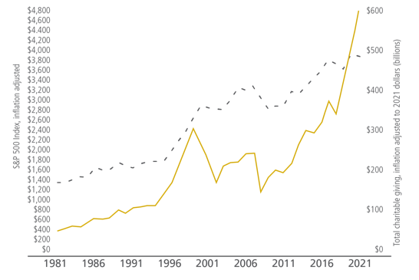

Philanthropy Mirrors the Market
Total charitable giving graphed with the Standard & Poor’s 500 Index, 1978-2018 (in inflation-adjusted dollars) via GivingUSA 2022
Notes:
Research has found a statistically significant correlation between changes in total giving and values on the Standard & Poor’s 500 Index (S&P 500). Because stock market values are an indicator of financial and economic security, households and corporations are more likely to give when the stock market is up.
In 2008, the recession impacted giving and fundraising, from a macroeconomic standpoint, was down for several years before bouncing back to its previous high around 2013. But, philanthropists are charitable people by nature, so they continue to be as generous as their means enable them to be, even in down times. Anecdotally, many of our fundraising leadership are saying that they don’t feel their donors scaling back just yet. Giving is ultimately driven by wealth and individual situations and is a very personal decision based on a lot of factors.
In a recession, the base of donors shrinks. I mentioned that 93% of our donors give less than $2,500. That group starts to give less or stops giving. We then become more reliant on principal gifts, or gifts $1M+ to achieve fundraising goals.

Slide 17
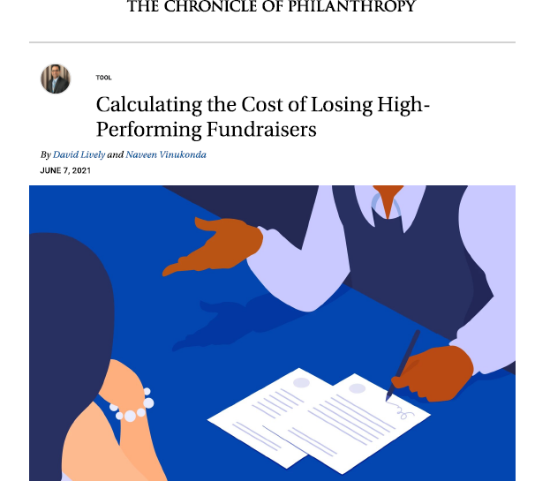
Philanthropy is a People Business
“As much as 90 percent of fundraising revenue comes from major gifts today, so high-performing frontline fundraisers are more crucial to fundraising success than ever before.”
In general, the longer the tenure of fundraiser, the more funds raised.
Notes:
Philanthropy is a people business. The great resignation or rethink continues to impact staffing at every campus and system advancement. Turnover is as high as 30%, which is in line with advancement shops across the country. Advancement is continuing to refine recruitment and retention strategies to retain our talent. It’s becoming increasingly harder to recruit to Colorado with the cost of living what it is. At system advancement, we have had to shift to having more fully remote staff.

Slide 18
Current Strategies
Advancement Staff Focused
Focus on retention of talent
Onboarding large numbers of new staff
Evolve hybrid/remote work
Focus on DEIB/DEIJ
Donor Focused
Building the pipeline of future donors
Working with donors on strategic and highly tax advantageous giving
Blended giving
Stewardship
Notes:
It’s not all doom and gloom. Advancement remains cautiously optimistic in our ability to meet our system-wide goal of $394M this year, up from $377 last year. Like many of you, we are focusing on retention of talent, onboarding new staff, evolving our hybrid remote work and putting energy and focus into DEI practices through targeted goals, trainings, new hiring practices. We are collectively focused on building our pipeline of future donors through our alumni relations teams, annual giving practices and analytics. In time of economic uncertainty our development offices begin to pivot to work with donors on strategic and highly tax advantageous giving as well as more blended giving such as outright and planned gifts to maximize the current and future impact. Most importantly, we double down on our stewardship of those loyal donors who keep CU at the top of their philanthropic priorities.

Slide 19
Questions?
Notes:
Any questions before Jason and I walk through some of our resources available online and the impact report?

