Slide 1
Board of Regents

Slide 2
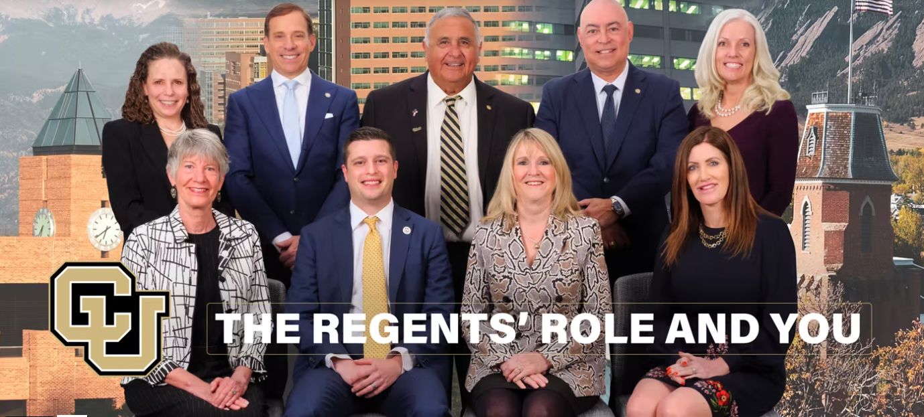

Slide 3
What is the University of Colorado?
Article VIII, Section 5 of the Colorado Constitution declares that The University is a “state institution of higher education” with three principal campuses at Boulder, Colorado Springs, and Denver.

Slide 4
Where Do Regents Come From?
There shall be nine regents of the university of Colorado who shall be elected in the manner prescribed by law for terms of six years each.
- Article IX, Section 12, Colo. Const.

Slide 5
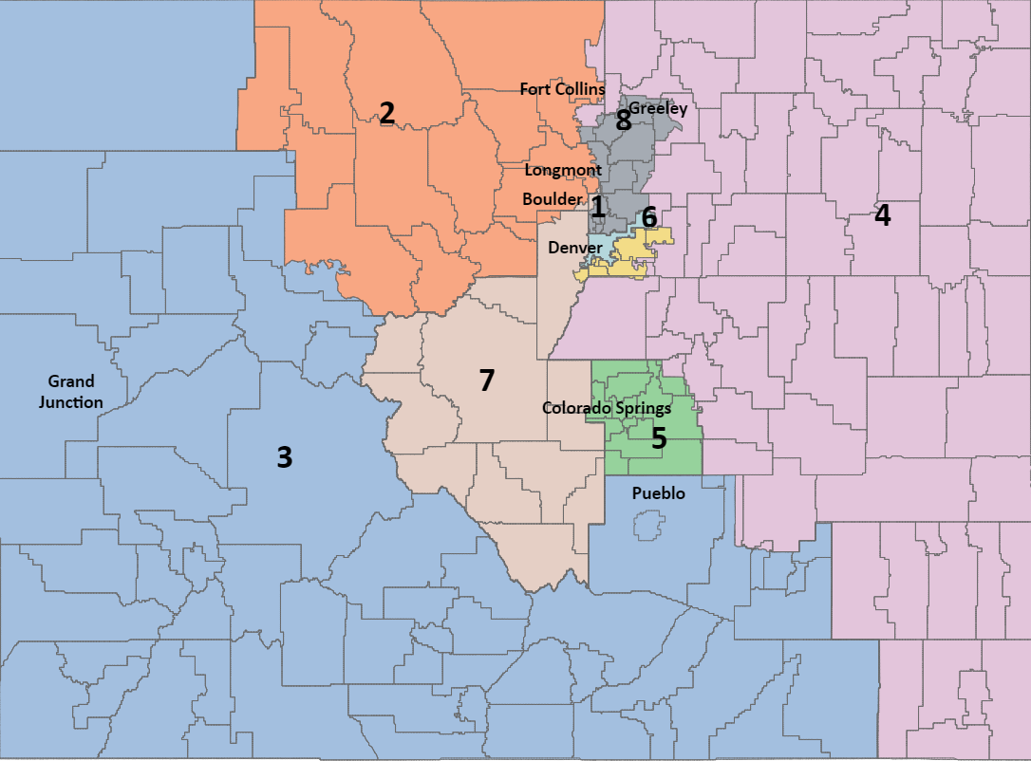

Slide 6
Unique Nature of the Board of Regents
Board of Regents is the only directly elected governing board of an institution of higher education in Colorado.
Only 4 states have directly elected governing boards (Michigan, Nebraska, Nevada)
“The Board of Regents is unique in our constitutional structure in that it exists independently of both the legislative and executive branches.”

Slide 7
Regents Constitutional Role
Article VIII, Section 5 - The Board of Regents shall have the general supervision of the university and the exclusive control and direction of all funds of and appropriations to the university, unless otherwise provided by law.
1972 Colorado Constitutional Amendments

Slide 8
Where Do Regents Come From?
Article IX, Section 12, Colo. Const. (ctd)
“Said regents shall constitute a body corporate to be known by the name and style of "The Regents of the University of Colorado". The board of regents shall select from among its members a chairman who shall conduct the meetings of the board and a vice-chairman who shall assume the duties of the chairman in case of his absence.

Slide 9
What’s a Body Corporate?
The Board can only act as a board.
Unless the Board of Regents specifically determines otherwise, no individual Regent shall have the authority to act or speak on behalf of the Board. Laws of the Regents, Article 2.A.5.(C).

Slide 10
Colorado Statutes Governing Board of Regents
C.R.S. 23-20-112 - The Board of Regents shall:
enact laws for the government of the university;
appoint the requisite number of professors and tutors and all other officers, and determine the salaries of such officers unless appointing authority has been delegated to the president or another officer;
determine the amount of tuition and fees in accordance with state laws and regulations; and
remove any officer connected with the university when in the Board of Regents judgment the good of the institution requires it

Slide 11
Delegation of Authority
Ordinarily, the Regents may delegate those powers and obligations that do not involve their central policymaking and supervisory responsibilities.

Slide 12
What are the Board’s Fiduciary Duties?
Duty of Care
Duty of Loyalty
Duty of Obedience

Slide 13
What’s the Relationship Between the Board and the President?
Article IX, Section 13 of the Colorado Constitution provides, “The Regents of the University shall elect a President of the University who shall hold his office until removed by the Board of Regents. He shall be the principal executive officer of the university and a member of the faculty thereof and shall carry out the policies and programs established by the Board of Regents.”

Slide 14
University of Colorado “Role and Mission”
C.R.S. 23-20-101(1) sets forth the role and mission of the campuses of the University of Colorado.
Each campus has a different role as anticipated by the legislature.
For example, the Denver campus is “an urban comprehensive undergraduate and graduate research university.”

Slide 15
What is Our Policy Structure?
Regent Law
Regent Policy
APS
Campus Policy
College/Unit

Slide 16
Current Board of Regent Committees
Governance
University Affairs
Finance
Audit

Slide 17
Shared Governance
Article 5- It is a guiding principle of the shared governance recognized by the Board of Regents that the faculty and the administration shall collaborate in major decisions affecting the academic welfare of the university

Slide 18
Board of Regents
President
Chancellor
Academic
Faculty Council
Faculty Assemblies
CFO
Faculty
Administrative
Provost

