Slide 1
Improving Post-Event Survey Engagement Using CVENT
How Cvent's technology enhances the day-of-event processes and post-event communications to make for a better attendee experience.
22 January 2024
Notes:
You’ll get:
- Slides – more details in the notes section, more than what I’ll speak on
- Evergreen sample post-event survey

Slide 2
Why Post-Event Survey Engagement Matters
Keep events engaging and “fresh”
Challenge: getting enough responses to help inform decisions
Collaborations + tools = substantially increase post-event survey response rates
Notes:
Keeping events engaging and “fresh” for our audience at CU Denver is a priority
One of the biggest challenges we’ve faced is getting enough feedback on our events to help inform decisions for future events
Through comms and events team collaborations, we’ve been able to substantially increase post-event survey response rates which allows us to better meet the desires and expectations of our constituents (from 3% response rate to 20%)

Slide 3
Process
The nitty-gritty of how

Slide 4
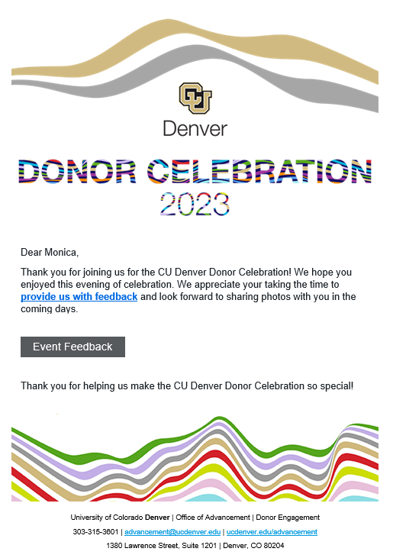
The How
COLLABORATION
Everything built-out at once including post event emails (6) and feedback survey
Staff working event is trained on importance of attendees being properly checked-in, walk-ins captured
TIMING
Game Changer: CVENT auto email sends to event participants with feedback survey
3-5 days later formal follow up emails (6) from invitation signatory with photos and giving CTA
CRITICAL: Make sure data from OnArrival app syncs prior to the conclusion of the event
Data Not Syncing? Try phone app and sync using data
Notes:
COLLABORATION
Events team makes a request of the communications team
Post event survey and all post-event emails are built out at time of full CVENT build out
Prior to event, ensure iPads are charged, log in is working, and registration list is loading
Train all staff working event on importance of attendees being properly checked in at the front because of the survey email
Check-in staff comb through remaining nametags and ensure all arrivals are checked-in and walk-ins are captured on the app before flipping the table for end-of-event, make note of anyone we need to research info on to add to formal follow up
Timing
Will show you what this looks like on the backend later on
At the conclusion of the event, CVENT auto email goes out to those checked-in with a brief message inviting them to give feedback on the event and that photos will be coming
This is our game changer because we used to wait and send the survey link with photos
3+ days later, CVENT email goes out to all those checked-in
Critical data syncs
Data not Syncing? Try opening the app and event on your phone so it can connect to phone data and sync (check-in time is correlated to sync so live-syncing is ideal for complete data)

Slide 5
What Helps us be Successful in Our Process
Office invested in two iPads
Events team created an evergreen, standardize post-events survey (will be provided in follow up)
Events, comms team, and anyone working check-in understands why checking in on the iPad is critical
Thoroughly trained staff
Notes:
Things that help us be successful in our processes

Slide 6
The Set Up
How this looks on the back-end

Slide 7
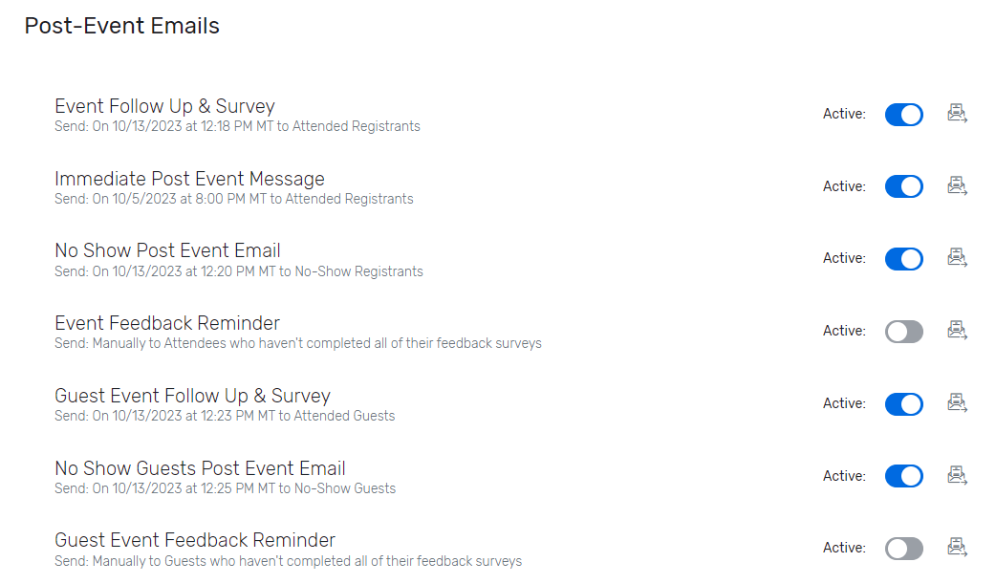
The Set Up
Notes:
Five emails
Should be 6 – immediate message isn’t going to checked-in guests
Immediate message scheduled before form is live
Formal email is dependent on photography typically – all drafted ahead though (approvals before live)

Slide 8
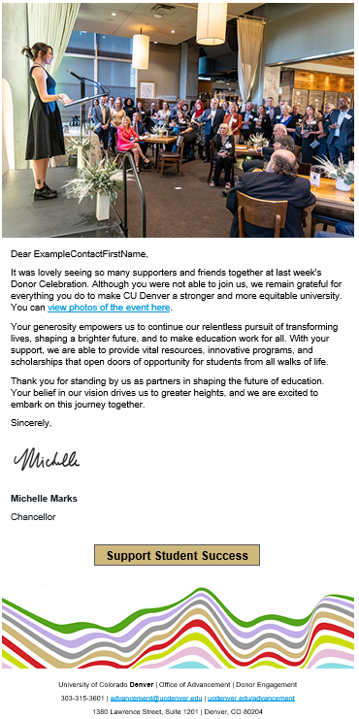
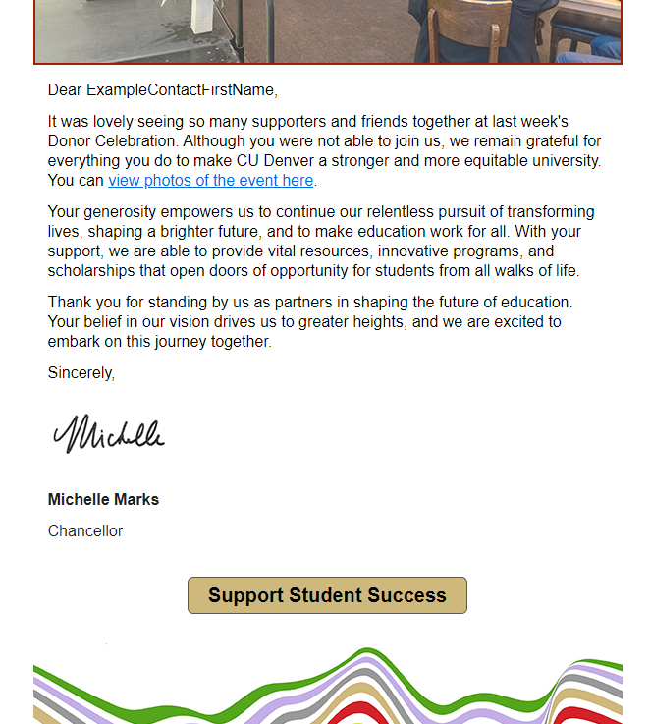
Formal Follow Up
Left email goes to event participants
Right email goes to no-shows
Email header updated with image from the event
Includes link to photos and giving CTA
Tip: use Chat GPT to help freshen your copy. Be sure to edit for voice and accuracy.
Notes:
Formal email is dependent on photography typically – all drafted ahead though (approvals before live)

Slide 9
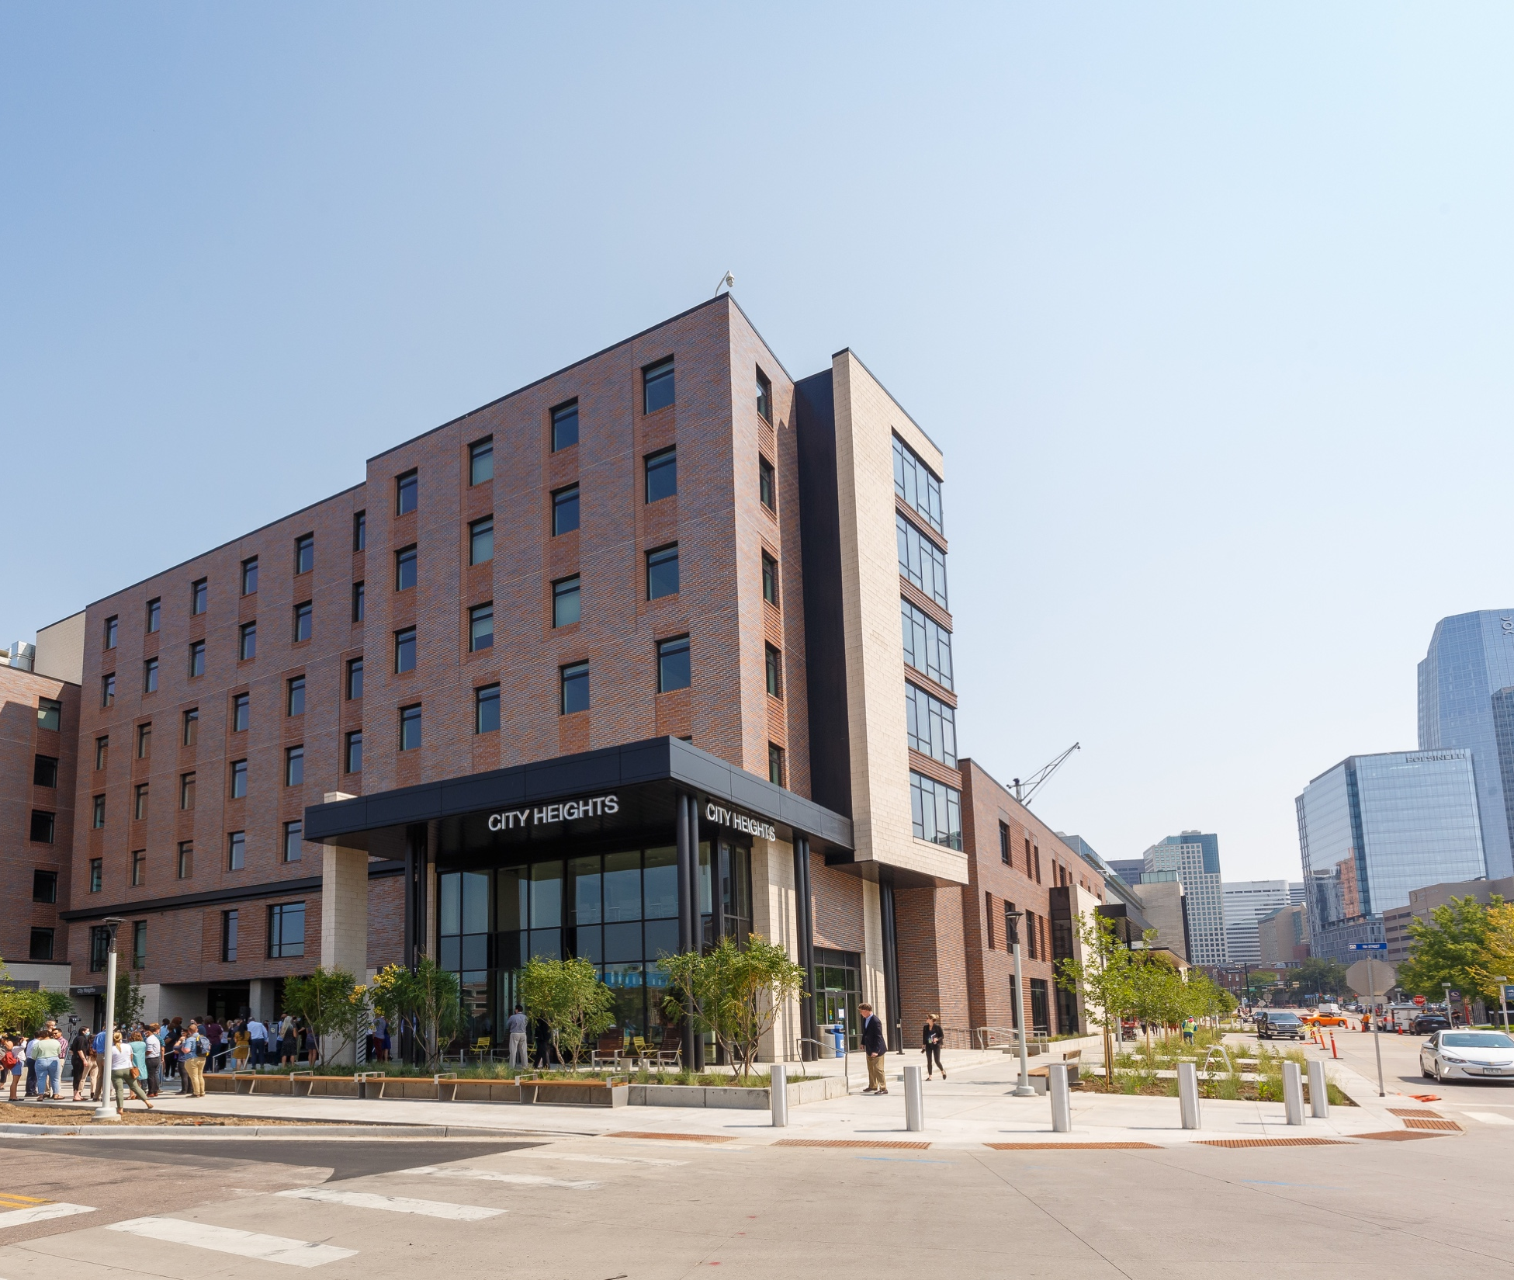
Results
The success of collaboration

Slide 10
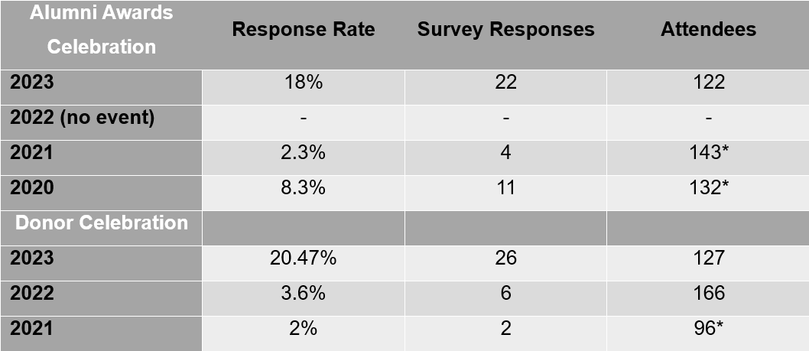
The Increase and Improvements
Post event response rates increased from 3% of attendees to 20%
Diversify responses and feedback
Able to move the needle on each measurement
Only changes are diligent check-in during event and immediate post-event email

Slide 11
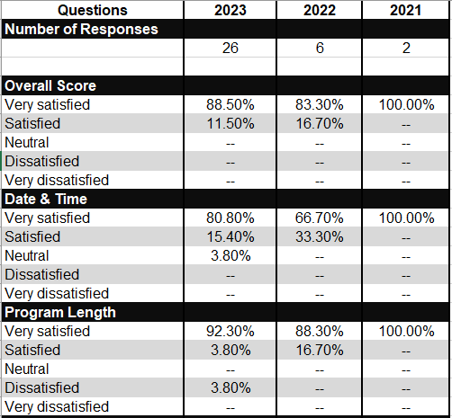
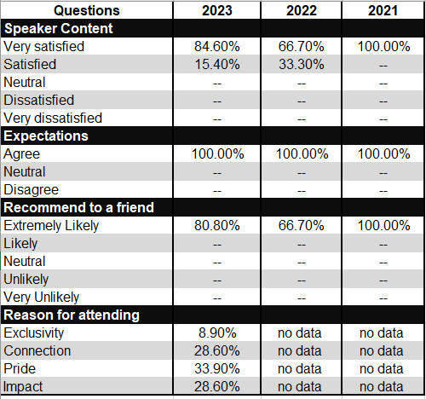
Year-Over-Year Event Feedback Comparison
Notes:
Moved the needle on every measurement
Survey results reviewed by events, comms, donor and alumni engagement, and annual giving areas

Slide 12
How we use the data
We want to do more

Slide 13
Next Steps
100% of all CU Denver Advancement events are managed in CVENT, including any events we’re partnering with other units on.
CVENT/SF Integration Report
Leadership Briefs
CASE Metrics
Now fine-tuning live-syncing and staff diligence on the check-in process to help inform:
Event Start Times
Program Start Times
Notes:
Utilize integration report – survey participation to be tracked in Ascend

Slide 14
Key Takeaways
Using CVENT’s survey tool, emails, and OnArrival app enhances day-of-event processes and post-event communications
Using CVENT technology may help to inform event program development, communications, and even start times
Try new approaches to discover what is most engaging
Success requires collaboration

Slide 15
Questions?
Happy to provide slides, email copy, or anything else you’re interested in looking at
monica.cutler@ucdenver.edu

