Slide 1

CU eComm
Town Hall Dec. 3, 2015

Slide 2
WHAT IS ECOMM?
www.cu.edu/ecomm
Initiated in 2009
Unified and powerful solution for engagement with CU constituents
Branding compliance
CAN-SPAM legislation
Efficiencies of scale
Save money
Data accuracy and currency

Slide 3




ECOMM SUITE
www.cu.edu/ecomm

Slide 4
ECOMM DATA
www.cu.edu/ecomm
HRMS
MDM
ADVANCE
SF
CS

Slide 5
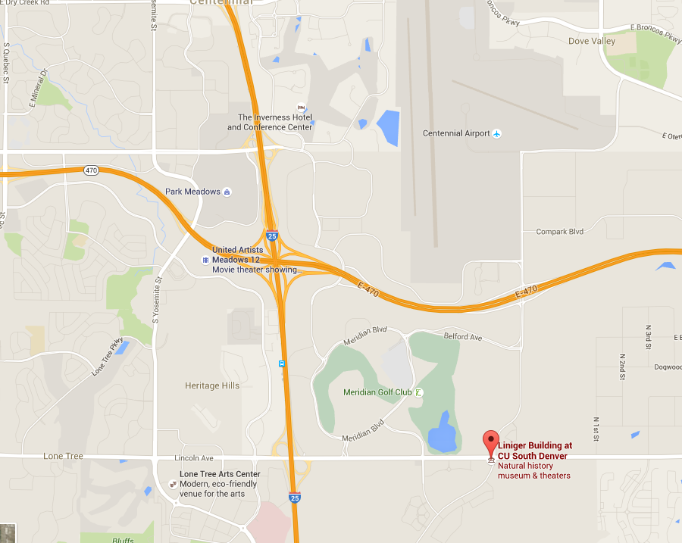


ECOMMFERENCE | FEB 2, 3 & 4
www.cu.edu/ecomm
CU South Denver
February 2, 3 or 4
Register for one of the three days
No cost, includes coffee and lunch
Campus transportation and parking available

Slide 6
ECOMMFERENCE | FEB 2, 3 & 4
www.cu.edu/ecomm
A DAY’S AGENDA
8-9 am Kickoff
9-10 am Salesforce 101
10 am-12 pm Marketing Cloud 101
12-1 pm Lunch
1-3 pm Marketing Cloud Deep Dive
3-5 Cvent
TRAINING TEAM
CU eComm Specialists
CU Salesforce Team
UIS
ACF Solutions
Vertiba
Cvent

Slide 7

WHAT TO EXPECT
www.cu.edu/ecomm

Slide 8
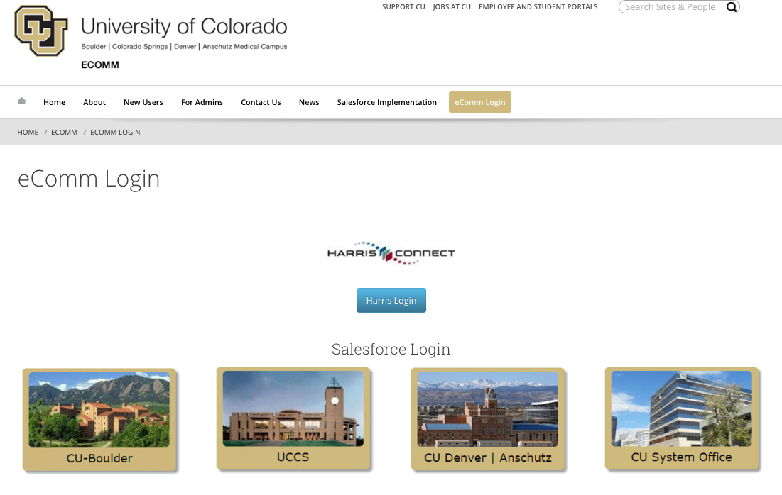
SUPPORT
www.cu.edu/ecomm
Logging in
Campus specialists
Online resources
www.cu.edu/ecomm

Slide 9
IMPORTANT DATES
FEB. 13
Ability to send emails and create forms that require payments in Harris Connect will be turned off. Data will already have been migrated and this ensures CAN-SPAM compliance.
DEC. 3
Virtual Town Hall
FEB. 2, 3 and 4
CU South Denver
DECEMBER
JANUARY
FEBRUARY

Slide 10
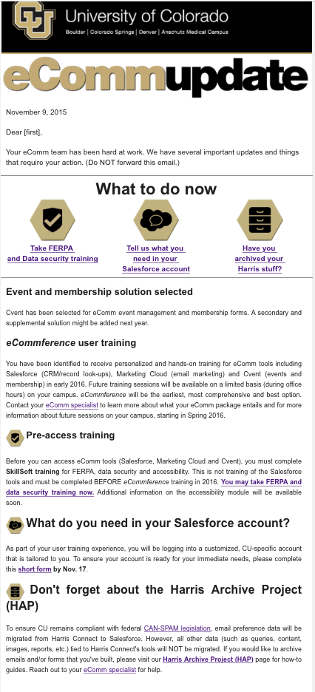
WHAT TO DO NOW
www.cu.edu/ecomm
Look for this email… (sent Nov 9)
Pre-Access Training
Data Security
Accessibility
FERPA
What do you need in your account?
Friendly from definitions
Queries
Harris Archive Project (HAP)
http://www.cu.edu/ecomm/harris-archive-project

Slide 11
ENTERPRISE SALESFORCE AT CU
www.cu.edu/ecomm
ONE CRM that supports custom applications, like eComm.
ONE CRM that shares data with CU’s Systems of Record.
ONE CRM Community that leads, shares and exceeds.
Advising
eComm
Industry
Colab.
Future
…
Enterprise CRM
Master Data Management
CS
ADV
HRMS
Notes:
How does eComm fit in?
Where do I go for more information?

Slide 12
CU SALESFORCE ACTIVITIES
www.cu.edu/ecomm
Major Accomplishments
Initial, simple application for first year academic advisors (October 2014)
CRM solution for Boulder Office of Industry Collaboration (November 2014)
Release of MyCUHub for Advisors and undergraduate students (May 2015)
Established eCRM Program, CRM Executive Committee, CRM Advisory Group
Upcoming Milestones
Boulder Advising Update Release (December 2015)
eComm – Email Marketing, and Events and Membership Management (February 2016)
Completion of CU CRM program: best practices and processes fore execution and planning of CRM projects (January 2016)
Student Success (Advising) release 2.0 (March – Sept 2016)
Question or want more info?
jon.giltner@colorado.edu or nalini.kaplan@colorado.edu
Notes:
How does eComm fit in?
Where do I go for more information?

Slide 13
Q & A and CONTACT US
www.cu.edu/ecomm
Post your questions.
Find your eComm specialist
www.cu.edu/ecomm

