Slide 1
Business Partner Meetings March 2015

Slide 3
Through their eyes

Slide 4
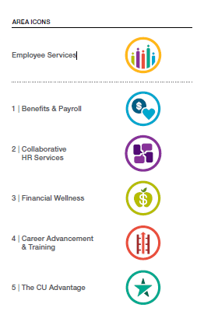
Icons will guide the way

Slide 5
Employee Services
Cross-promotion between these five areas will be extensive.

Slide 6
Collaborative HR Services
Living up to our name.
Human Resources
Business Partners
Talent Acquisition
Technologies, such as HCM, ePerformance

Slide 7
Benefits & Payroll
Making benefits more beneficial to you.
Benefits
Payroll
Leave
International Tax
Technologies
Tuition Benefit

Slide 8
Financial Wellness
Go from where you are to where you want to be.
Financial Resources
Online Assistance
Personal Consultations
Campus Workshops
Growing lineup of services

Slide 9
Career Advancement & Training
Knowledge is Power.
Employee Learning and Development (ELP, LDP, online courses, Books24x7)
Tuition Benefit
CU Careers
Technologies (such as ePerformance, Taleo)

Slide 10
The CU Advantage
Great extras for extra great people
Focus on perks, benefits and discounts that only CU can offer.
Items from ES and all CU campuses

Slide 11
What does this mean to you?
The brand represents who we are as Employee Services, what we embody and how we’ll interact with employees and business partners like you.
In the coming months, we’ll be providing business partners with new tools, resources and communications materials that will help you improve your workday and help you answer questions from employees.

Slide 12
HCM 9.2 Upgrade

Slide 13
Upcoming testing

Slide 14
Upcoming testing
System Integration Testing (ST2) – May – August 2015
This phase includes testing of all migrated development and new configuration. Testing will be done in our SP2, TST & PAY environments
Model Testing to Campus (MTC) Campus Testing Involvement starts in July 2015
This phase enables end-users an opportunity to log into the system, perform their typical tasks on the new system, verify their security access, validate their procedures and get comfortable with the new system.

Slide 15
Upcoming testing
User Acceptance testing (UAT) Campus Testing continues September – October 2015
During testing phase, the processes will be tested in the system for acceptability. It validates the end-to-end business process flows. This testing will be executed by campus power users, either by site testing or demos for our campuses. This confirms whether our HCM 9.2 PeopleSoft system upgrade meets the requirements and business processes for University of Colorado.

Slide 16
WorkCenter Overview

Slide 17
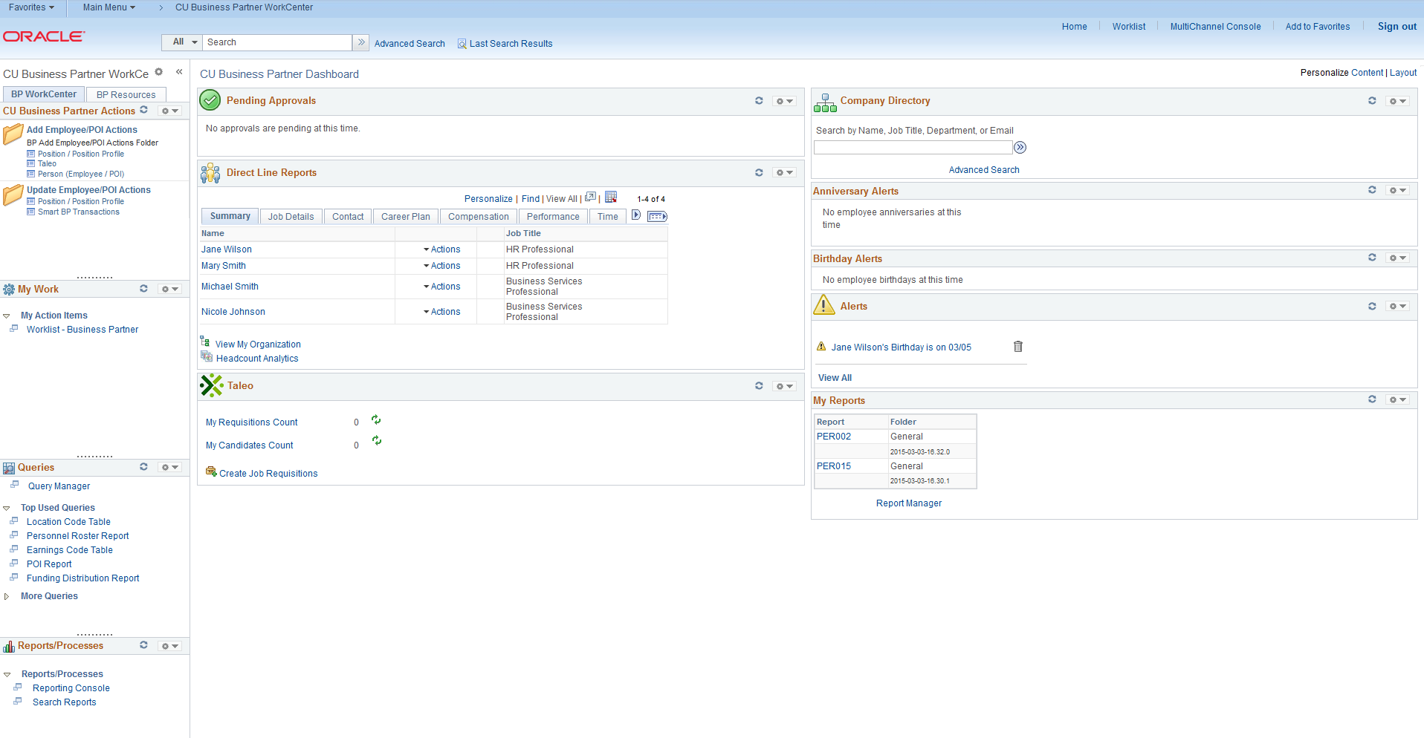
CU Business Partner WorkCenter

Slide 18
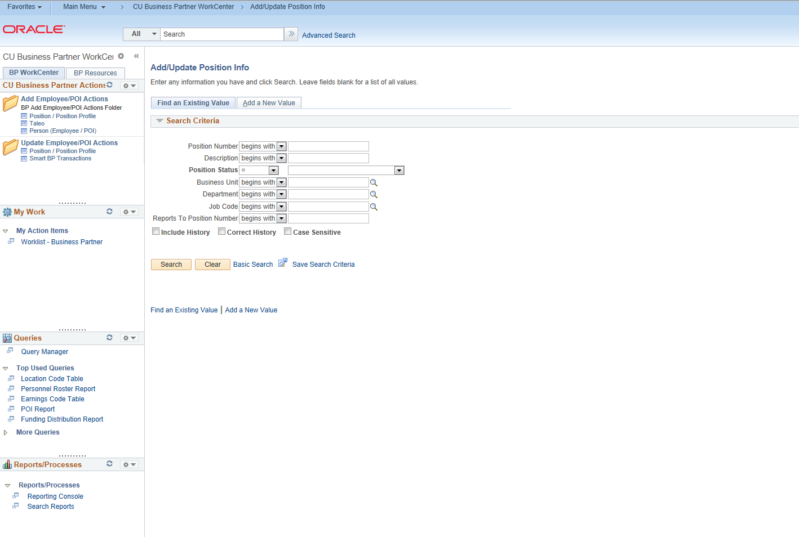
Navigation Bundles and Page Access from within WorkCenter Worklist Access

Slide 19
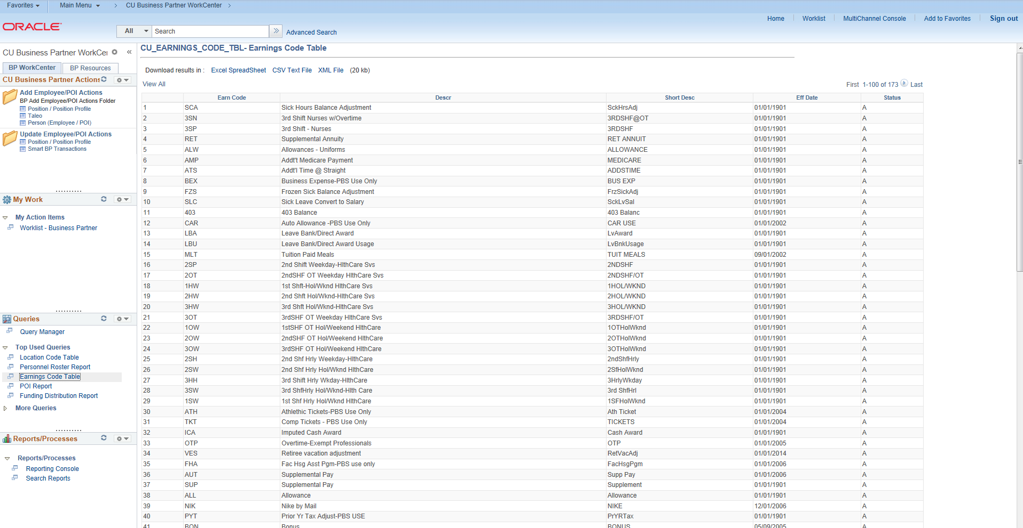
PS Query – Frequently used queries Results display in WorkCenter

Slide 20
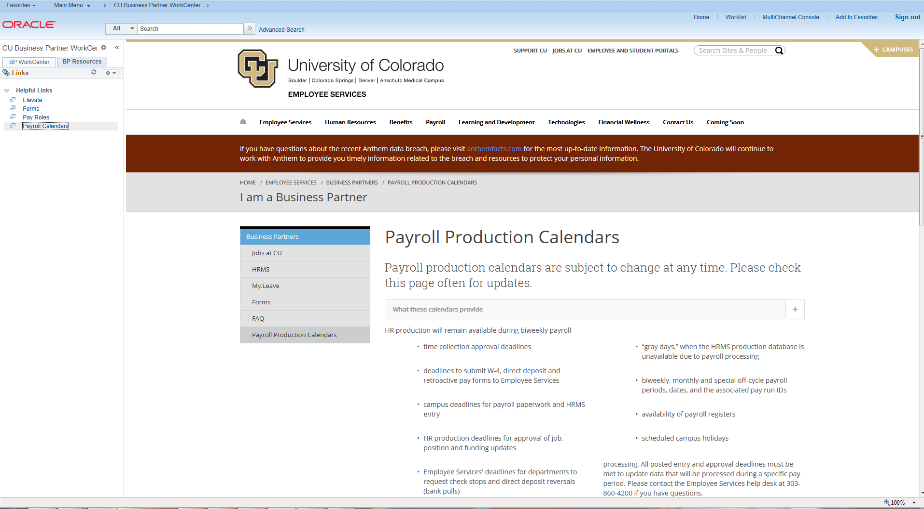
BP Resources Tab Provide helpful links that open within WorkCenter

Slide 21
ePerformance Overview

Slide 22
Agenda
Overview
Templates Built for University Staff, Classified Staff and Faculty pulling from Position Profile
Manager Self-Service
Work Centers
Approval workflow built-in
Rating History
Entering Performance Ratings for Plan Year 2015
Creating the Performance Plan
Checkpoints
Self Evaluation
Peer Review/360º Reviews
Annual Evaluation

Slide 23
ePerformance Timeline
Go Live November 1, 2015
Entering annual performance ratings for 2015 plan year
Review position profiles – building block for 2016 plans
January 1, 2016
System auto generated performance plans (going forward, managers to clone existing or for new employees)
2016 Mid-Year Checkpoint - flexible
Optional Self-Evaluation, Peer/360º Reviews
March 1, 2017 deadline for University Staff Annual Evaluation
May 1, 2017 deadline for Classified Staff Annual Evaluation

Slide 24
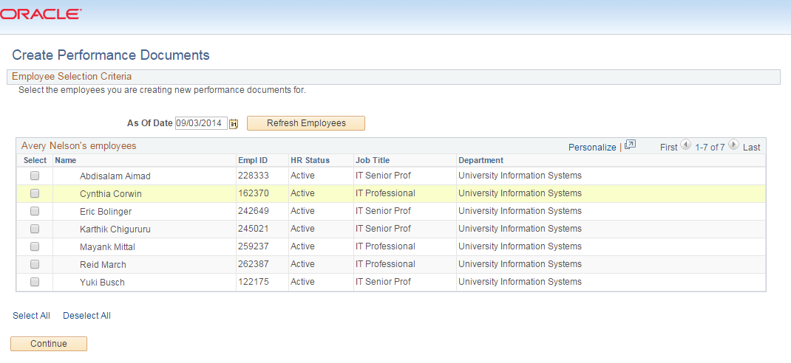
Manager Self-Service
Manager Self Service – Performance Management: displays direct reports

Slide 25
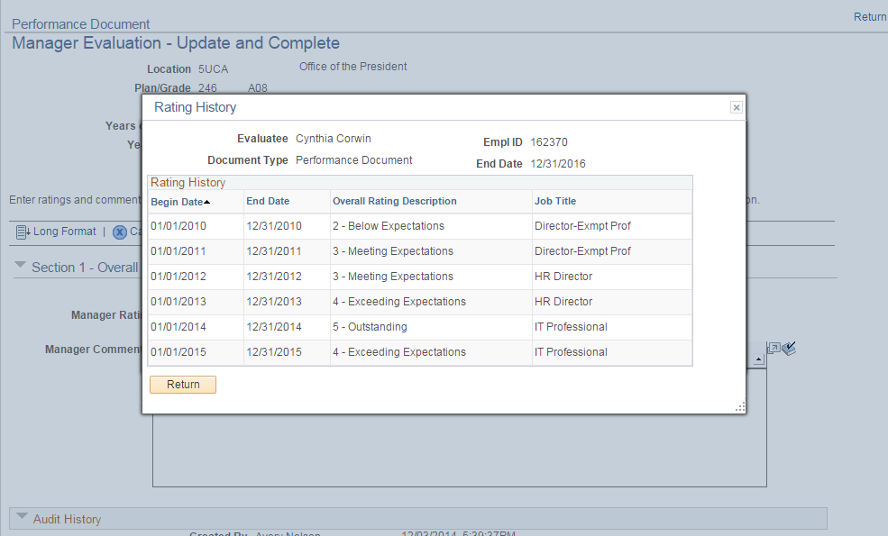
Review of Historical Ratings

Slide 26
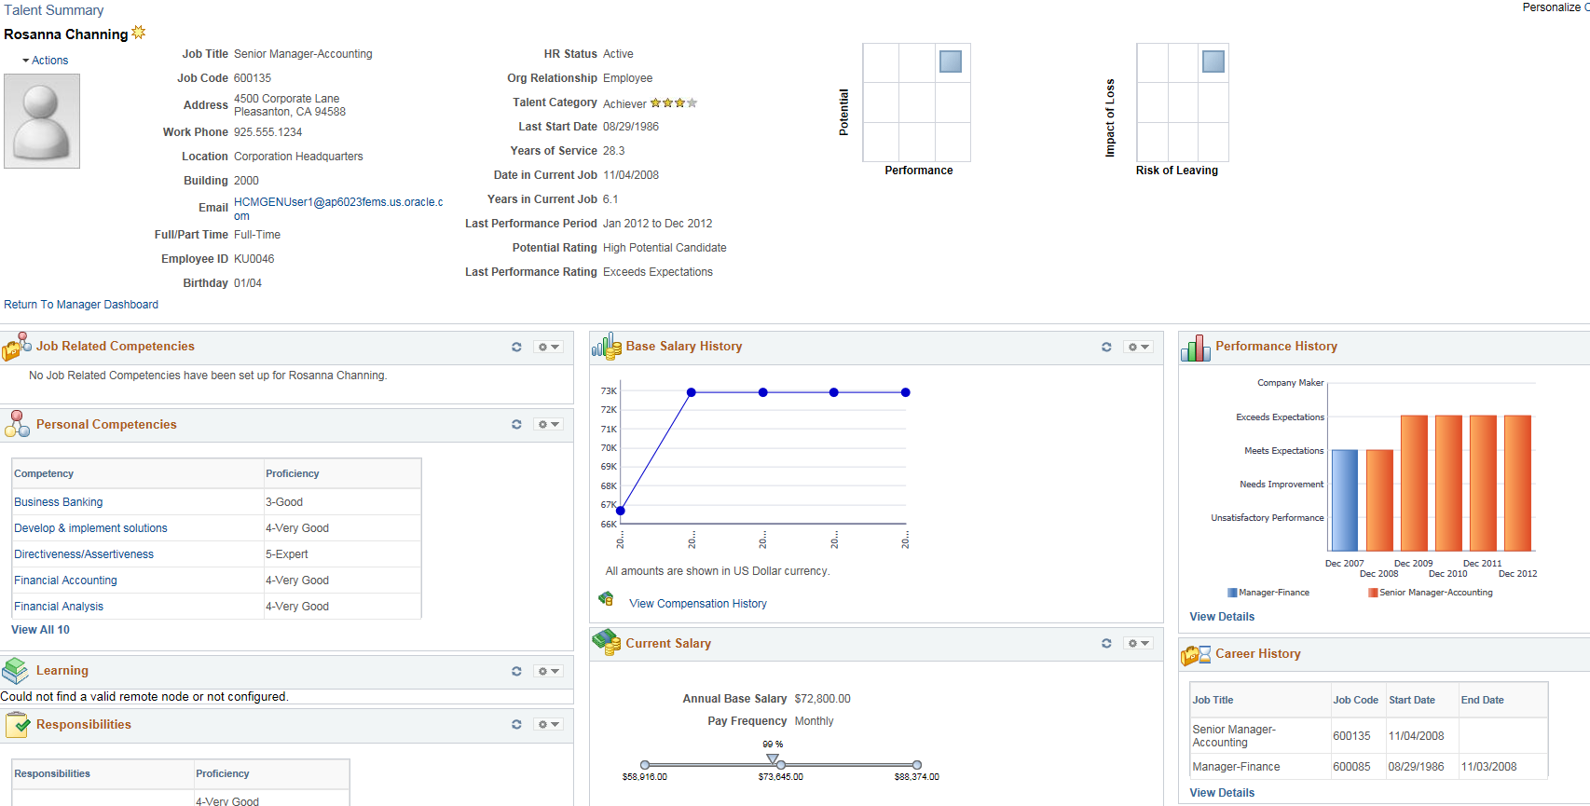
Employee Talent Summary
In the Talent Summary Page:

Slide 27
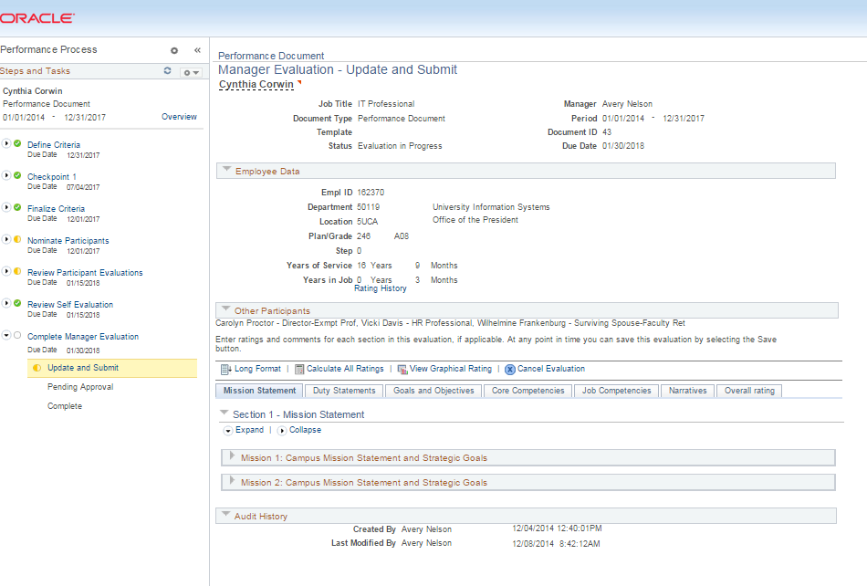
Performance Work Centers

Slide 28
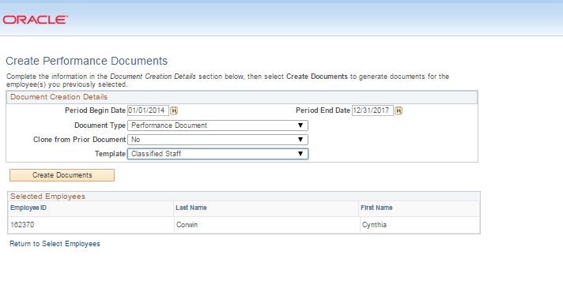
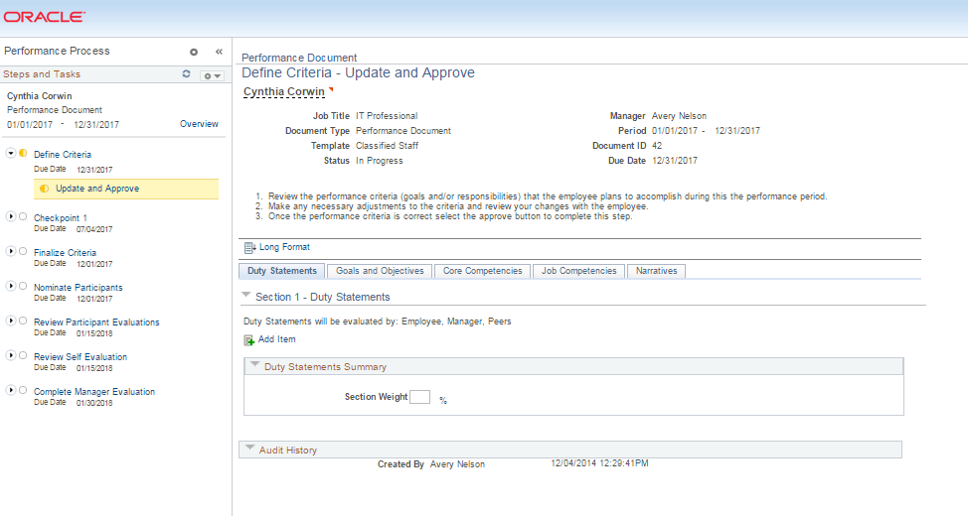
Create Performance Plan – Define Criteria

Slide 29
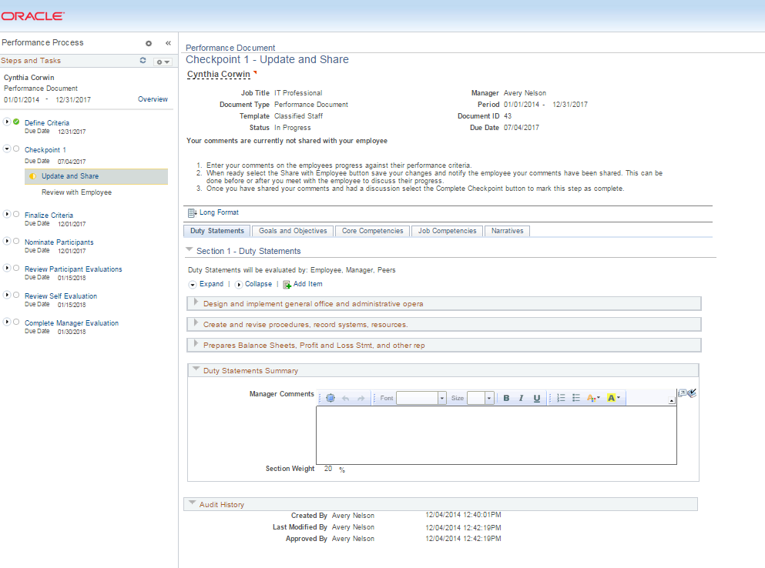
Optional Checkpoints

Slide 30
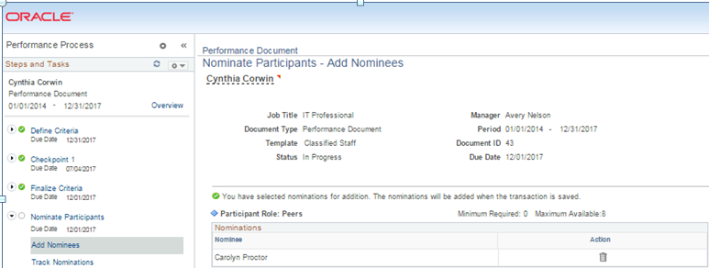
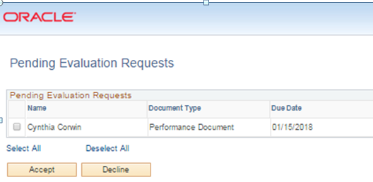
Peer Evaluation

Slide 31
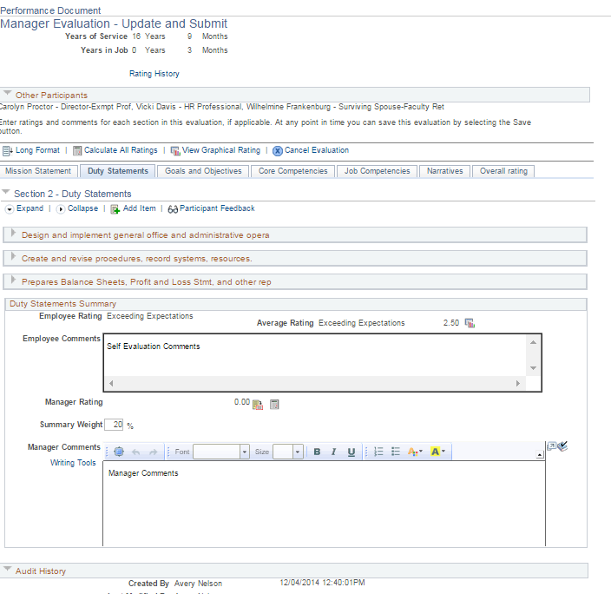
Manager/Employee Ratings

Slide 32
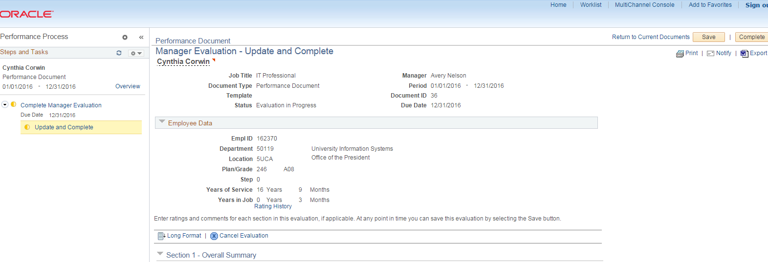
Annual Review

Slide 33
Security
We want to be sure we create the right security roles for you.
We’re examining the Business Partner Role.
Look for and participate in upcoming surveys.
We may rename roles to better represent the business process to make requesting security easier.

Slide 34
Benefits & Payroll Updates on Open Enrollment and retirement plan changes

Slide 35
Retirement Vendor Transition
Beginning on or around July 15, CU will contract with TIAA-CREF as the sole service provider for 401(a) and 403(b) plans.
PERA plans (401k and 457) are not affected in this transition.
This will include new, streamlined investment menus.
Invest in highly rated funds from numerous retirement firms, including Vanguard and Black Rock.
Attend on campus Transition Workshops or request one for your department.
FAQs, timeline and background information can be found at www.cu.edu/nestegg

Slide 36
Open Enrollment
April
May
Monday Tuesday Wednesday Thursday Friday
27
28
29
30
1
UCD Session
AMC Session
4
5
6
7
8
CU Boulder Session
System Session
UCCS Session
11
Ends at 5:00 PM

Slide 37
What’s New?
Two-week enrollment period
New plan: CU Health Plan-Extended
CU Health Plan-Access Network will no longer be offered
Pre-tax Healthcare Spending Account
Plan name change - CU Health Plan – High Deductible (HSA Compatible)
Optional Life Insurance – add or enroll by applying through The Standard

Slide 38
Enrollment
Online enrollment through the portal at my.cu.edu
New employees may need to complete two enrollments – one for 2014-15 and another for 2015-16

Slide 39
See you in May!
Save the date for the next
Business Partner Meetings
May 14-21.

