Slide 2
Agenda
Retirement Vendor Transition Preview
Open Enrollment wrap up
Affordable Care Act
Payroll Update
Leave sweeps
Fiscal year end, PET deadlines
Salary Uploads
HCM Summer Training Schedule preview
CU Careers demo

Slide 3
Retirement Vendor Transition
May Activities
Transition guides mailed to homes.
Email will be sent to employees notifying them when the guide is available.
Articles in CU Connections and ES’ Work/Life newsletter.
Welcome kits mailed to homes.
FAQs, timeline and background information can be found at www.cu.edu/nestegg
Notes:
Transition guides will direct you on how the transition is going to happen. Announcements regarding the transition guides will be emailed and their will be articles in Connections and ES’ Work/Life newsletter. In the latter part of May, employees will receive a welcome kit. This will assist employees with setting up their accounts online with TIAA.

Slide 4
What is the estimated initial cost-savings plan participants (collectively) stand to save under the 401(a)?
$2.5 million
$3 million
$4 million
$1.50

Slide 5
Open Enrollment
Review your Benefits Summary in the portal.
enter the effective date 7-1-2015
New health, dental, HSA, FSA cards will arrive by July 1.
Pharmacy changes for new plan year – work through transition now.
HSA accounts set up and welcome packets will arrive in late June.
Must have exhausted your FSA account, if enrolled this year.
Notes:
Review your selections through the portal's Benefits Summary. It's located directly above the Benefits Enrollment link. To view your new elections, enter the effective date of your benefits enrollment (7-1-205) in the date field and press the "Go" button. Watch your mail, there is going to be mailings based on what you enrolled in for the new year. If employees have a prescription that is not on the new formulary, you can work on getting refills for your current medications, getting authorization now for 7-1. Work with your physician and Anthem. NEW HSA accounts will be set up.

Slide 6
Are you required to be enrolled in CU Health Plan – High Deductible in order to be in an HSA?
True
False
Notes:
Answer: No, you can be enrolled in any HSA qualified high deductible plan

Slide 7
Affordable Care Act
Hourly Employees
Look-back period was May 2014 – April 2015.
These employees will be offered health benefits in June to begin July 1.
These employees can keep the health benefits for one year as long as they remain employed.

Slide 8
Affordable Care Act
Monthly Employees
Beginning in June, Employee Services will check the percent of time recorded in HRMS for all employees paid monthly.
Anyone (who is not already benefits eligible) who is 75% or greater will be offered health benefits to start the next month.
It is critical that the percent of time in HRMS is reflective of the work being accomplished.
It is up to each department to decide how to calculate percent of time. It must be calculated consistently across the department!

Slide 9
Affordable Care Act
Credit hours per semester | Calculated hours per week | Percent of time
3 credit hours | 9 hours per week | 22.5% appointment
4 credit hours | 12 hours per week | 30% appointment
5 credit hours | 15 hours per week | 37.5% appointment
6 credit hours | 18 hours per week | 45% appointment
7 credit hours | 21 hours per week | 52.5% appointment
8 credit hours | 24 hours per week | 60% appointment
9 credit hours | 27 hours per week | 67.5% appointment
10 credit hours | 30 hours per week | 75% appointment

Slide 10
What does PPACA stand for?
Patient Pay After Care Act
People Pay Accounting Costs Again
Patient Protection and Affordable Care Act
Picky Patient Affordable Can Act

Slide 11
Payroll updates
Students moving?
Update addresses in the portal
Enroll and/or update your direct deposit and/or W-4 information in the portal.
Pre-hires and future dated hires can take care of initial employment paperwork in the portal before their first day on the job.
Notes:
New employees can now do this prior to their start date

Slide 12
What was the first Federal Minimum Wage?
25 cents
83 cents
53 cents
$1.02

Slide 13
Leave Sweep Reports
Leave sweep reports help you identify employees on your team who have exceeded or are nearing CU’s limit on accruing vacation.
Use these reports to either correct leave report errors in HRMS, or notify affected employees of their leave status, and urge them to use or donate their time (if allowed) before June 30, 2015.

Slide 14
Leave Sweep Reports
When will you receive reports?
ES mailed the first report in early April.
Additional reports will be sent in May and June following payroll processing.
Employee Services will run a full sweep of leave records after running the July 2015 payroll.

Slide 15
Fiscal Year End
Faculty Pay Election Form
Due to ES by June 30, 2015.
PET Deadline
Fiscal Year End payroll processing deadline

Slide 16
Salary Uploads
Classified Staff
Increases for Classified Staff
Changes to salary ranges
Faculty/University Staff
Salary Planning page is available for entries.
Salary Planning entries for July 1 increases must be entered into HRMS by close of business Monday, June 29.*
Salary Planning entries for AY contract faculty must be in HRMS by close of business on Friday, July 31.*
* ES deadlines. Campus deadlines may vary.

Slide 17
Upload Dates
Salary upload for Classified Staff, University Staff, 12-month faculty, and Medical Residents will take place on Tuesday, June 30.
Salary upload for AY contract faculty will take place on Monday, Aug. 3.
HRMS will be in inquiry-only mode during the uploads.

Slide 18
HCM Summer Training Preview
Training dates: July 7-Dec. 3
Training topics:
HCM Overview
Position Profiles and Job Description
CU Careers
HCM Transactions
Paying People
HCM Review and Reports
Structured Computer Lab Sessions
Open Labs
Web: www.cu.edu/elevate/hcm-training

Slide 19
HCM 9.2 Upgrade CU Careers preview

Slide 20
What is CU Careers and what does it mean to me?

Slide 21
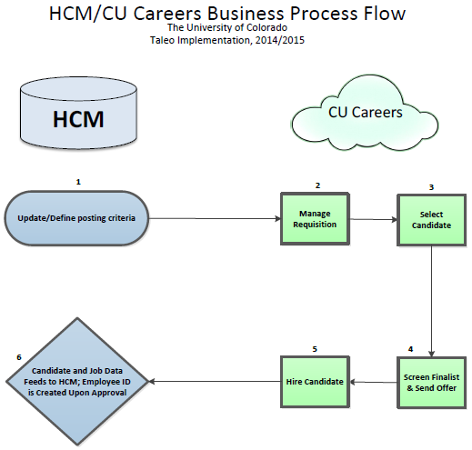

Slide 22
Top 10 Features
HCM integration
Welcome dashboard
Attachment preview
Campus specific templates
Interview scheduling
Background check integration
E-Offer
Candidate experience
Simplified Candidate Selection Workflow (CSW)
Reporting and Dashboards

Slide 23
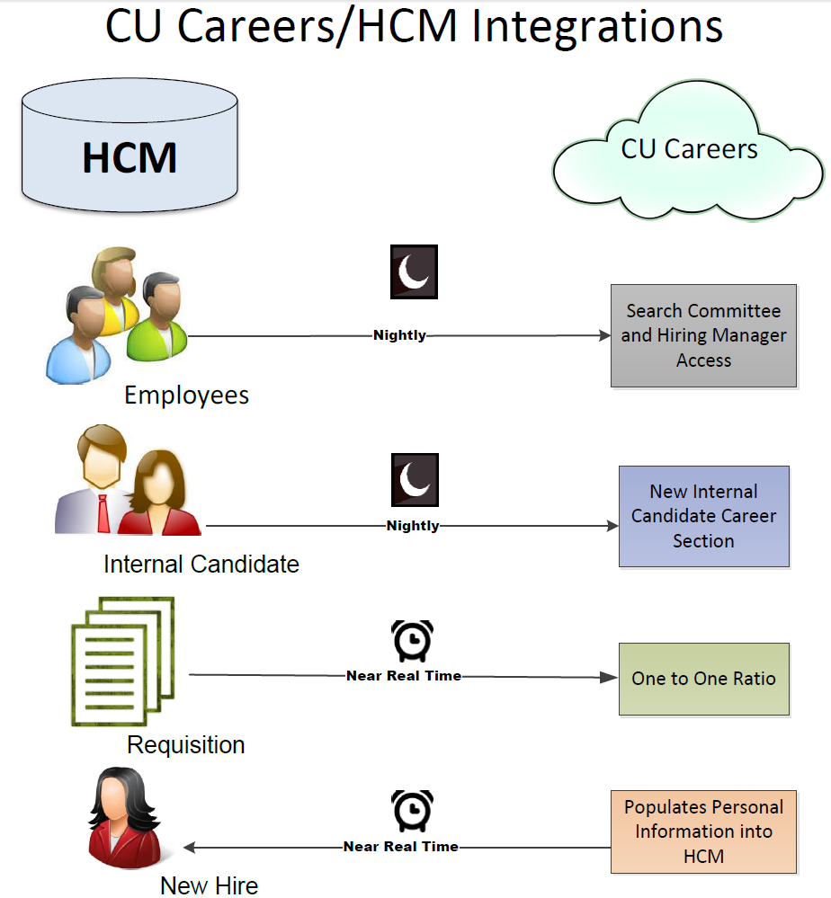
1)

Slide 24
Which HCM/CU Careers feeds are near real-time?
Requisition
New Hire
Requisition and New Hire
Users/Employees
None

Slide 25
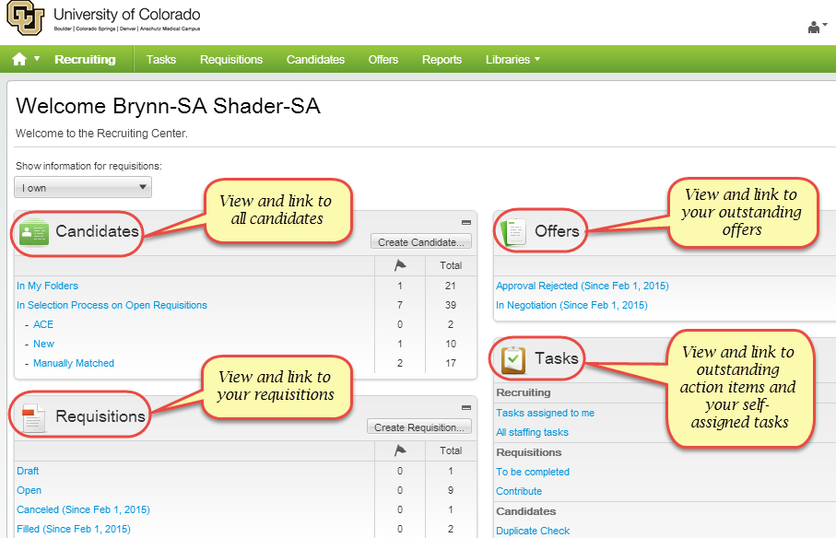
2) Welcome Dashboard

Slide 26
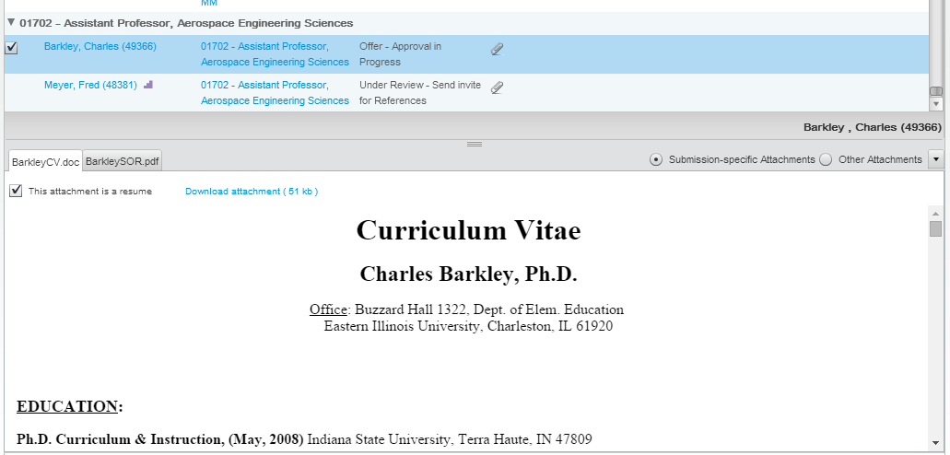
3) Attachment Preview
Notes:
Attachment preview
Easy way to view applicant attachments without clicking into or downloading them

Slide 27
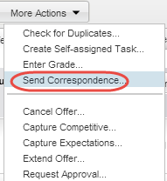
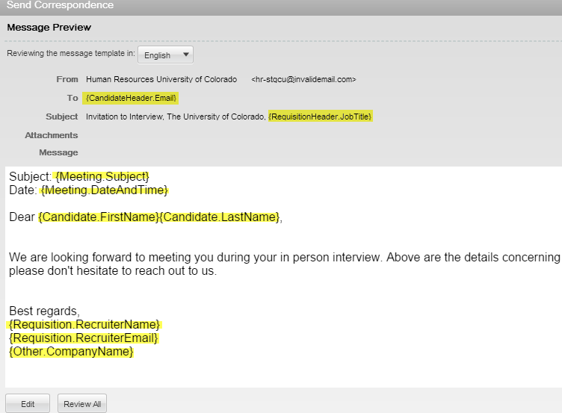
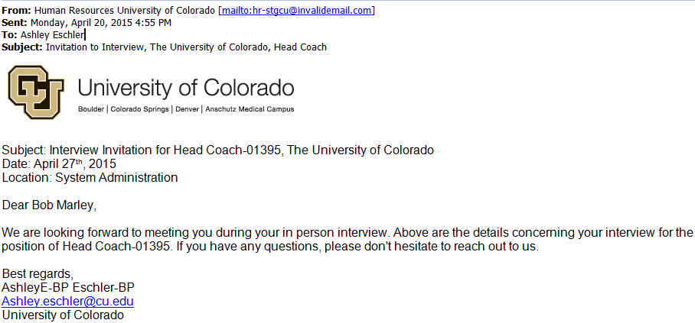
4) Campus Specific Templates
Notes:
Campus specific templates: SA managed templates can be customized to campus and department.
Templates can pull data from the candidate profile and/or requisition to make sending correspondence faster and easier.

Slide 28
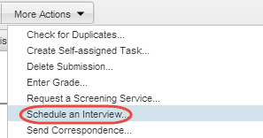
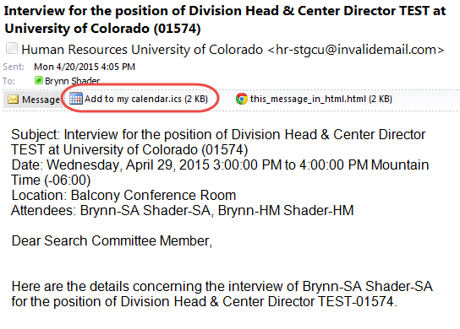
5) Interview Scheduling
Notes:
Interview Scheduling
Outlook integration creates ability to send Search Committee Members and POIs interview invitations that can be added directly to their Outlook calendars
Invite candidates to interviews directly from CU Careers

Slide 29
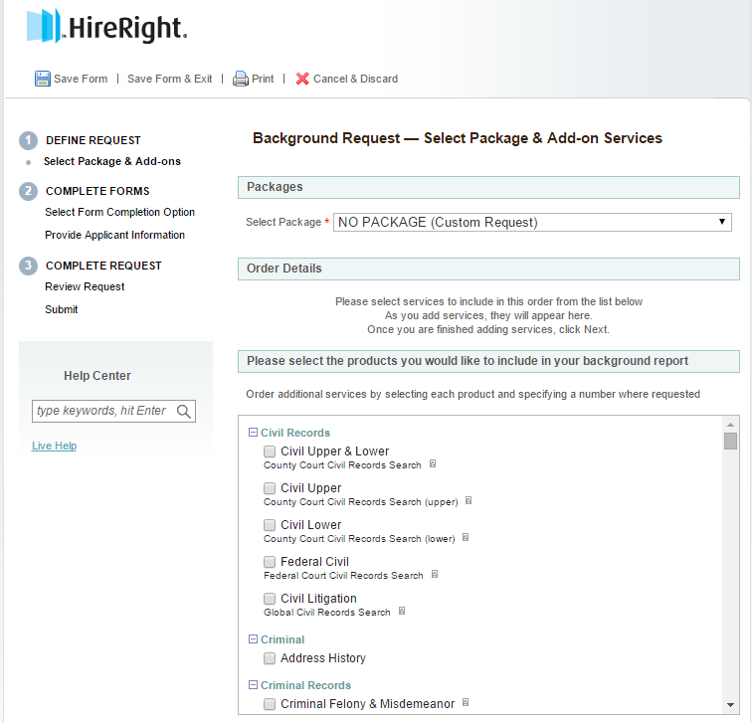
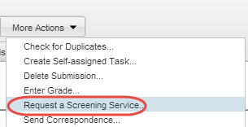
6) Background Check Integration
Notes:
Background check integration
Background checks can be initiated and processed through CU Careers
Background check completion dates will flow back to HCM

Slide 30
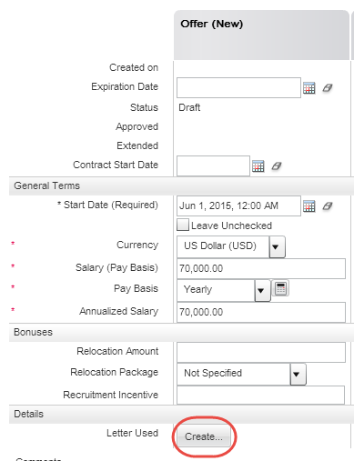
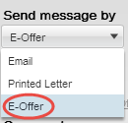
7) E-Offers
Notes:
Input required information even if they don’t do an e-offer so information feeds correctly into HCM
Campus and department specific templates are auto-populated with key job data to quickly generate an offer letter
E-offer option now available allowing candidates to electronically sign offer letters

Slide 31
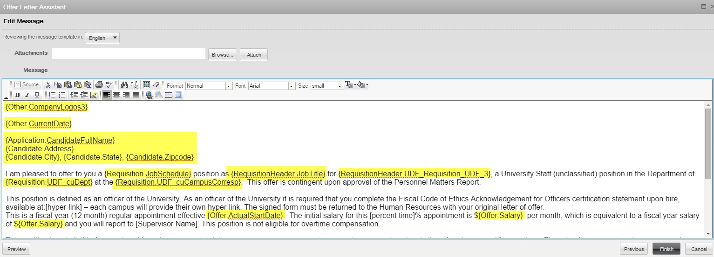
7) E-Offers
Notes:
E-offer option now available allowing candidates to electronically sign offer letters

Slide 32
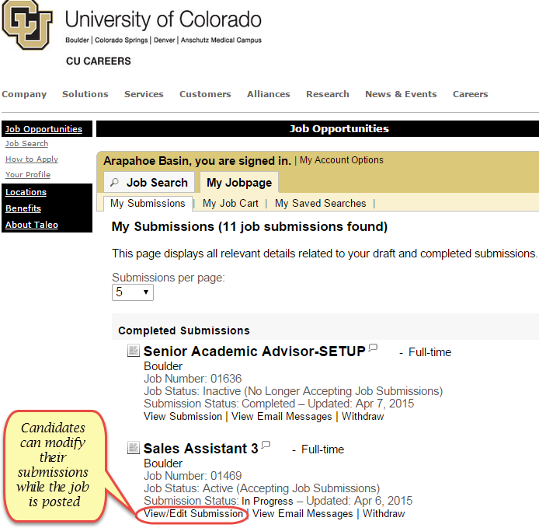
8) Candidate Experience
Notes:
Candidate experience
The new candidate experience puts the control back into their hands.
They now have the ability to modify their job submissions and application materials prior to the posting close date. This is instead of contacting JobsatCU Help.
Visible application progress map they can follow during the process.
There is a separate internal career site in addition to the external site.

Slide 33
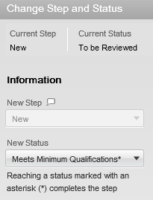
9) Simplified Candidate Selection Workflow (CSW)
Notes:
Simplified candidate selection workflow
Structured workflow helps simplify the selection process
Please note: This is a sample workflow and that the campus HR is reviewing all processes.

Slide 34
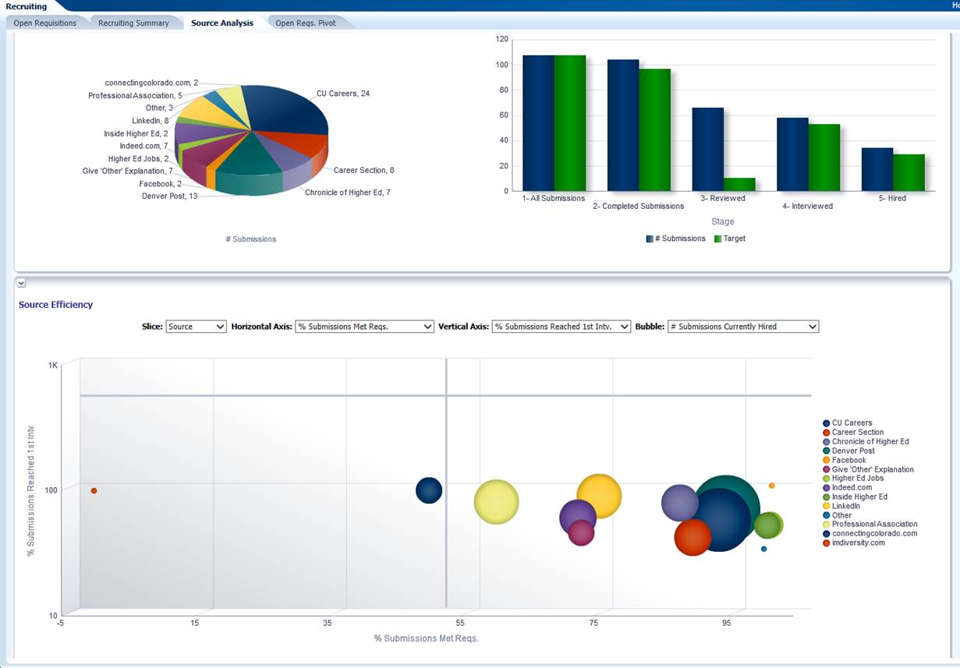
10) Reporting and Dashboards

Slide 35
Where are new requisitions now created?
JobsatCU
HCM
HRMS
In Santa’s workshop

Slide 36
What is the new way you can send an offer to a finalist?
By messenger pigeon
E-Offer
Through teleportation
Snail Mail

Slide 37
Questions

