Slide 1
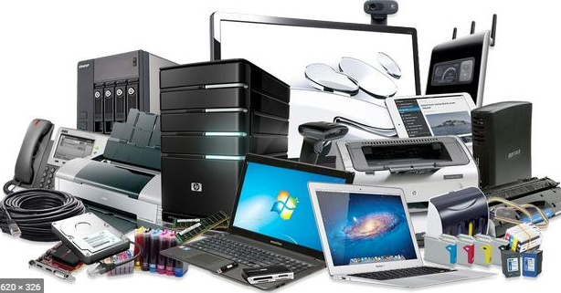
Workstation Standardization
Updated July 1, 2020
University of Colorado
Boulder I Colorado Springs I Denver I Anschutz Medical Campus
UNIVERSITY INFORMATION SERVICES

Slide 2
Table of Contents
Why Should We Standardize
Dell Laptop
Dell Desktop
Dell 2-in-1 Laptop
Monitor
Dock
Mac Laptops
Mac Adapter and Dock

Slide 3
Why Should We Standardize
Allows Service Desk to quickly troubleshoot common problems
Better / Faster Support
Save Time
Compatibility with Docks, Peripherals, and Cables
Reduce Support Costs
Reduced Order Turnaround Times

Slide 4
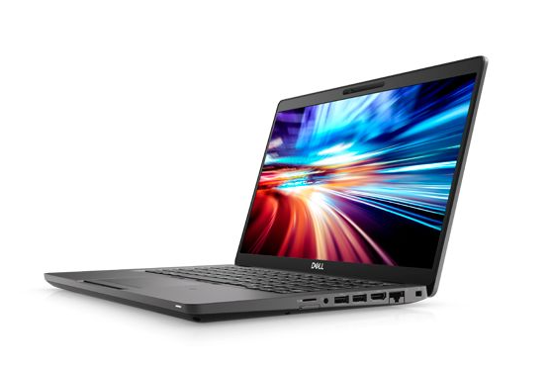
Dell Laptop
Dell Latitude 5400
14” Anti-Glare, Non-Touch Screen
Camera, Mic, Privacy Shutter
Intel Core i7-8665U (4 Core)
16GB DDR4 RAM
M.2 512GB PCIe NVMe Class 35 SSD
4-Year Dell Warranty with Accidental Damage

Slide 5
Dell Desktop
Dell Optiplex 7070
Intel Procesrors: i5- i9 (6 - 8 Cores)
8 - 64GB DDR4 RAM
M.2 128-2TB SSD
Additional Graphics Processing Power
Optional DVD Disk Drive
Optional Video Ports
4-Year Dell Warranty with Accidental Damage
* Can be fully customized to meet any need.

Slide 6
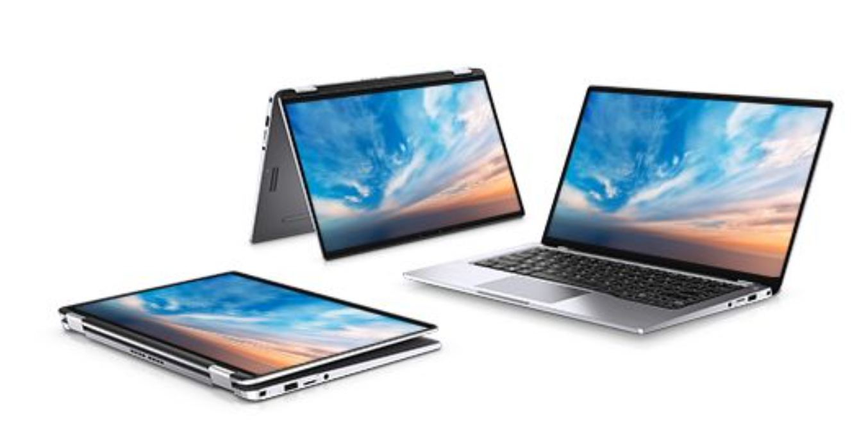
Latitude 7400 2-in-1 Business Laptop
Dell Latitude 7400 2-in-1
Intel Core i5-8350U
8GB RAM
M.2 256GB PCIe NVMe SSD
Supports WD19 Dock
4-Year Dell Warranty with Accidental Damage

Slide 7
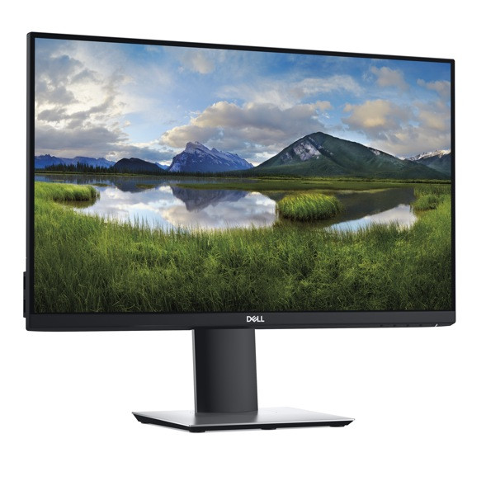
Monitor
Dell 24” Monitor – P2419H

Slide 8
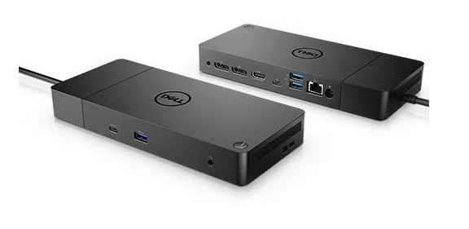
Dock
Dell Dock WD19
(standard for Dell laptop 5400)

Slide 9
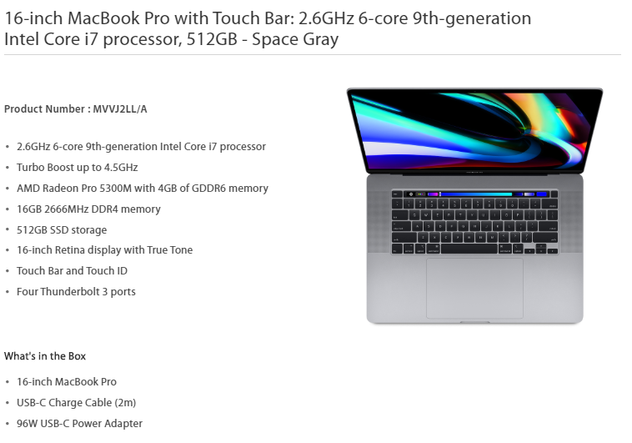
16” MacBook Pro

Slide 10
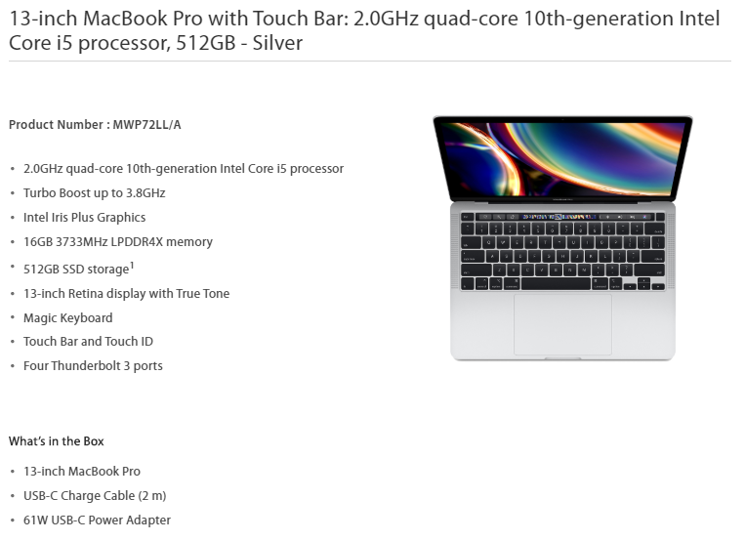
13”MacBook Pro
* Can be upgraded to an Intel Core i7 processor.

Slide 11
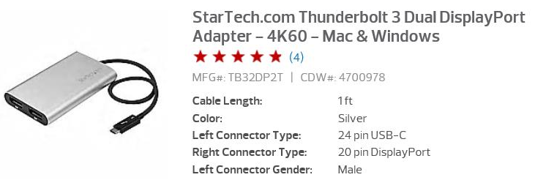
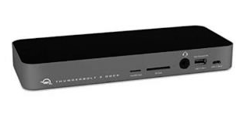
Mac Adapter and Dock
OWC 14 port Thunderbolt 3 dock with cable. Compatible with Windows PC and Mac. Space Grey. OWCTB3DK14PSG

