Slide 1
Welcome to Grant Street Virtual Event
“The only way to make sense out of change is to plunge into it, move with it, and join the dance.” – Alan Watts

Slide 2
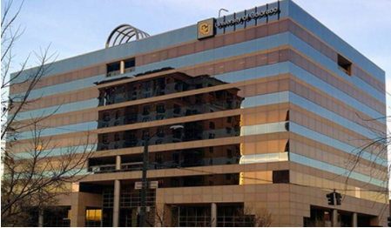
Agenda
1800 Grant Street Updates
Brief Department Overviews
Uptown Fun Facts

Slide 3
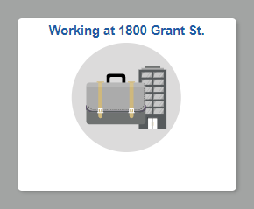
1800 Grant Street Updates
Portal Resources
my.cu.edu
Resources for coming to the office and hybrid work

Slide 4
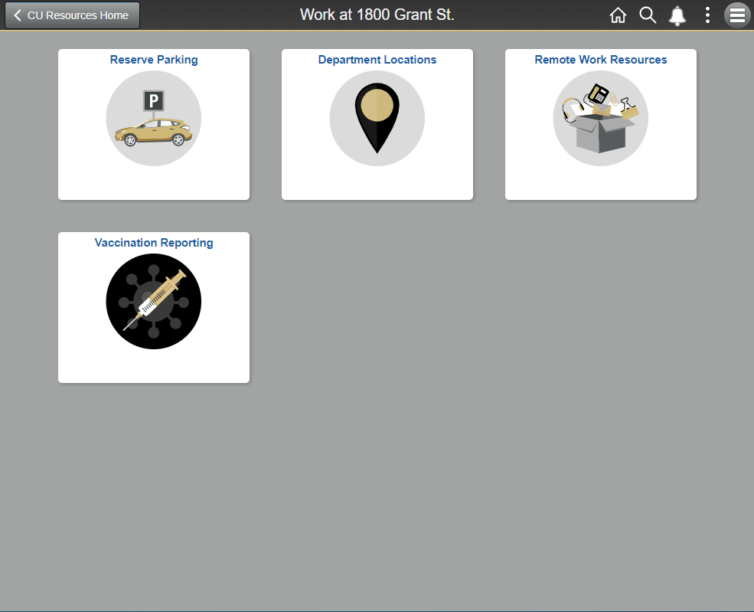
1800 Grant Street Updates
Current items
Parking
Department locations and maps
Remote Work Resources
Vaccination Reporting

Slide 5
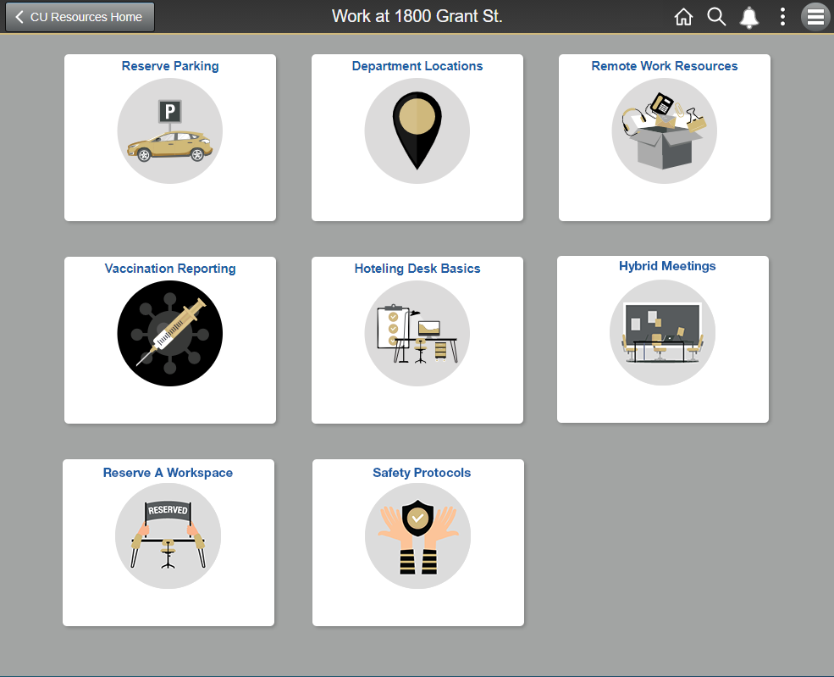
1800 Grant Street Updates
Future items
Hoteling Desk Basics
Hybrid Meetings
Reserve a Workspace
Safety Protocols

Slide 6
1800 Grant Street Updates
What to expect at a hoteling station

Slide 7
1800 Grant Street Updates
What to bring with you
Laptop
Badge
Personal items

Slide 8
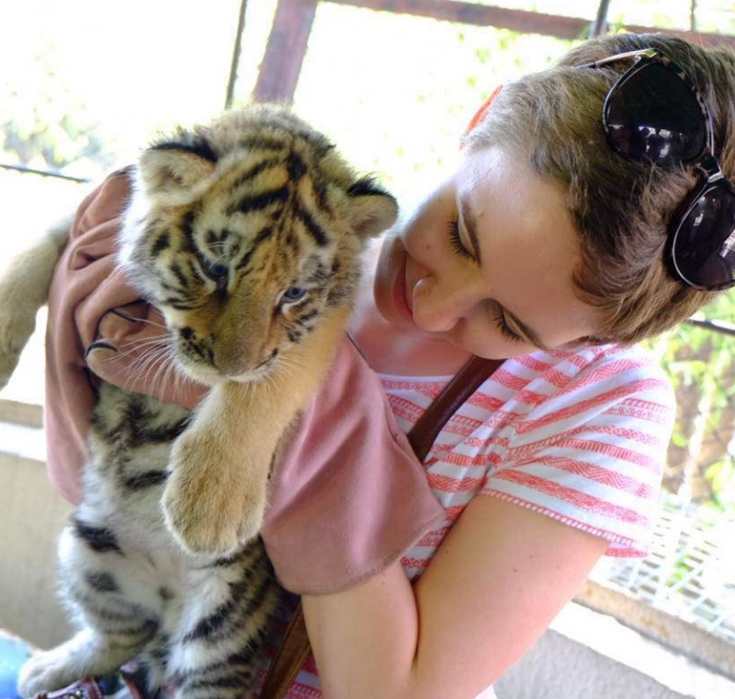
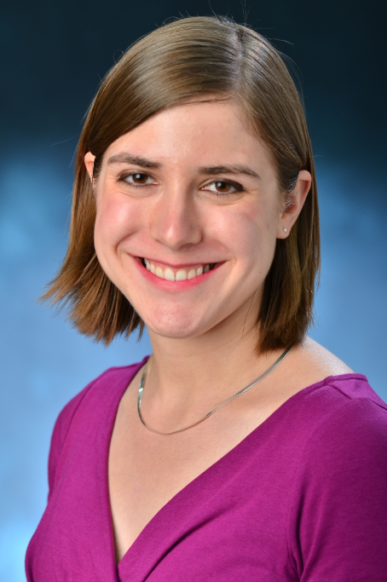
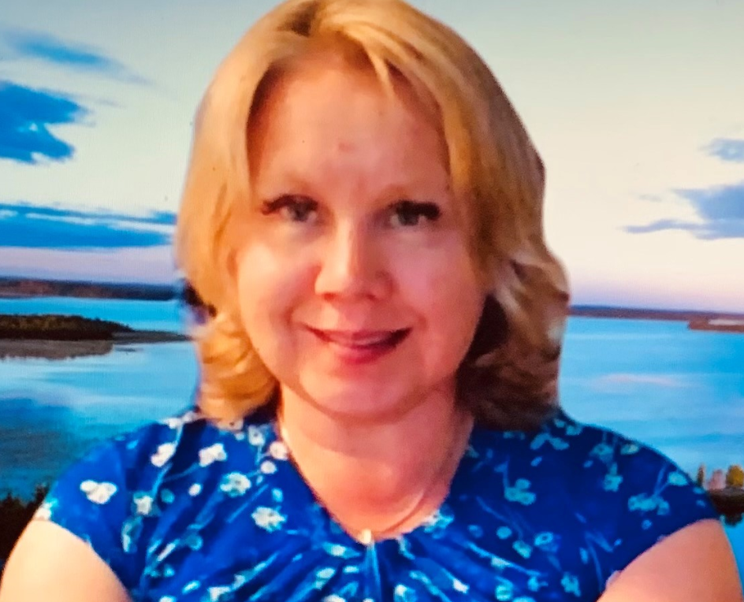
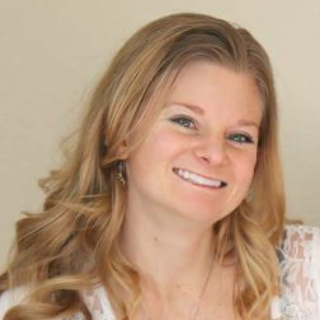
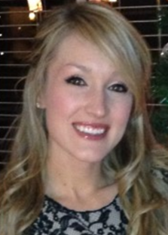
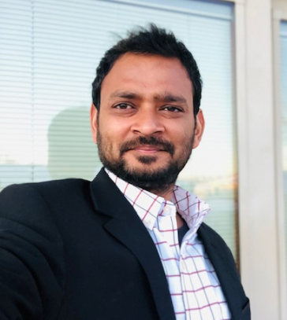
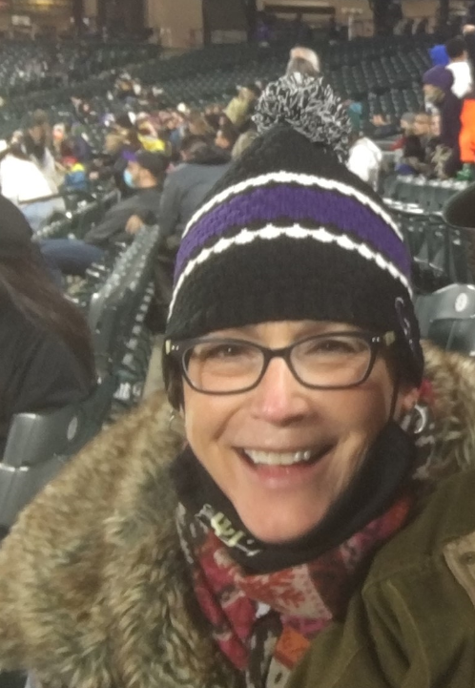
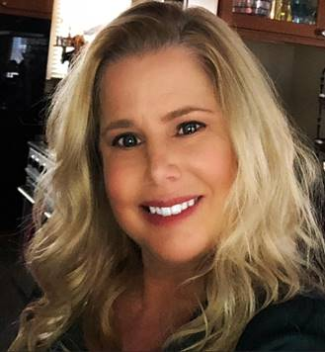
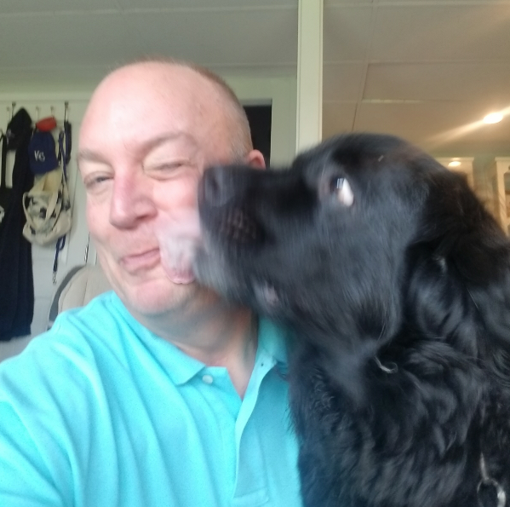
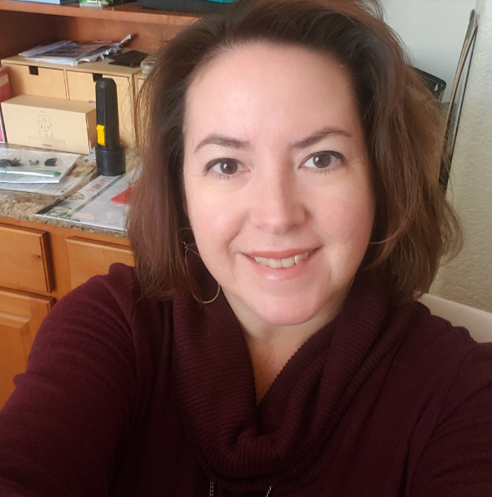
System Staff Council

Slide 9
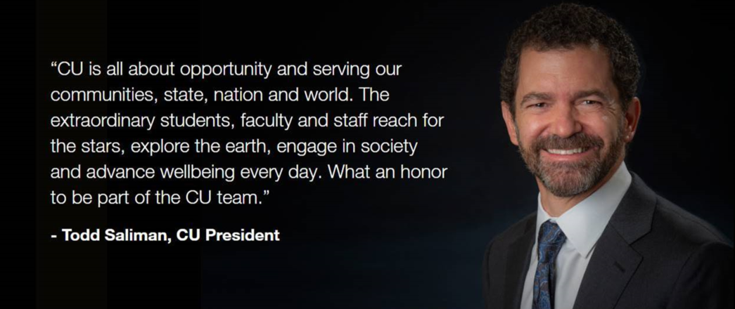
Office of the President

Slide 10
Budget & Finance
The Office for the Vice President for Budget and Finance and the Chief
Financial Officer has the primary responsibility of planning and coordinating the university-wide budget and capital construction process.
In addition to working closely with the campus budget offices, the office works with communication offices, faculty budget committees, the CCHE, and the state legislature, in particular the Joint Budget Committee and the Capital Development Committee.
The office also produces and maintains multiple databases and information including things like CU Fast Fact and the CU Compensation database.

Slide 11
Treasurer & Controller
The Treasurer's Office has a dual report to the Board of Regents and the Vice President for Budget and Finance and is responsible for overall cash management, debt management and property management. It provides support and assistance to the campuses on financing strategies, real estate issues, banking relationships, and other investment-related issues.
The Office of University Controller (OUC) is responsible for managing the university’s system of record – the Financial System – and its interfaces with purchasing, payables, human resources, and other subsystems, including the Cognos Reporting System. It works closely with the campus controllers, the state controller, and the state auditor’s office to ensure that fiscal practices comply with external and internal rules and regulations and generally accepted accounting principles.
The OUC communicates fiscal policies and procedures to the university community through its news blog, website, and training programs, and provides direct assistance to faculty, staff, and other individuals through the Finance & Procurement Help Desk. The office also administers a Continuing Professional Education program and the CU Shared Practices (CUSP) employee recognition program.

Slide 12
University Information Services & Information Security
University Information Services (UIS) provides technical services and enterprise applications to the University of Colorado campuses and the CU system administration.
UIS is committed to excellence in customer service and empowering CU through university-wide IT services. These services facilitate admirable and varied work – from HR and finance functions to enabling students to register for classes and complete their degrees to allowing researchers to apply for grants that may fund the next major technological or medical breakthrough.
The Office of Information Security (OIS), operations and compliance, oversees both CU System and CU Boulder campuses. OIS offers guidance on security measures and incident response in compliance with information-related privacy and security laws and regulations.
Notes:
UIS speaker: Scott Munson
OIS speaker: Dan Jones

Slide 13
Academic Affairs
The Office of Academic Affairs performs university-wide leadership and coordination of CU’s academic and research programs.
In collaboration with campus executives, the office coordinates the development and review of academic programs for board and state agency approval and serves as liaison to faculty governance groups.
The office also oversees the Coleman Institute for Cognitive Disabilities whose mission is to catalyze and integrate advances in science, engineering and technology to promote the quality of life and independent living of people with cognitive disabilities.
Slide during event

Slide 14
Academic Affairs Administration
OFFICE OF ACADEMIC AFFAIRS
APSs
Certificates, Degrees, Tenure
Awards & Grants,
Pre-collegiate,
MOOCs, SARA
Academic Innovation Programs
Coleman Institute for Cognitive Disabilities
General Education Council
Academic Council
CCHE
UA committee
Laws & Policies
Individual meetings
Analyses, as requested
FY22 - Innovation & Entrepreneurship Initiative
Campuses
CDHE
Regents
The Office of Digital Education
President
&
VPs
OAA
Reports, legislation
3rd level reviews, projects
Academic voice in
President’s Cabinet
National
NASH
SHEEO
EDUCAUSE
President’s Teaching Scholars Program
Faculty
Council
Other IHE
Faculty Council Administration
Reports to FC
Staff several committees
Budget for FC staff, P&T
Staff President on FC/FAs
Partnerships
in Pre-collegiate
Joint positions - legislative
and CCHE matters
Faculty Senate Grievance Committee Administration
UPDATED

Slide 15
Advancement
CU Advancement aspires to unite donors with their passions, elevate grand ideas and prudently manage philanthropy—all to spark enduring support of a university that creates transformative impact in our communities and around the world.
Across the university’s four campuses, the CU System and the CU Foundation, a team of about 350 collectively engage donors, alumni and other constituents to promote the university’s mission and success.

Slide 16
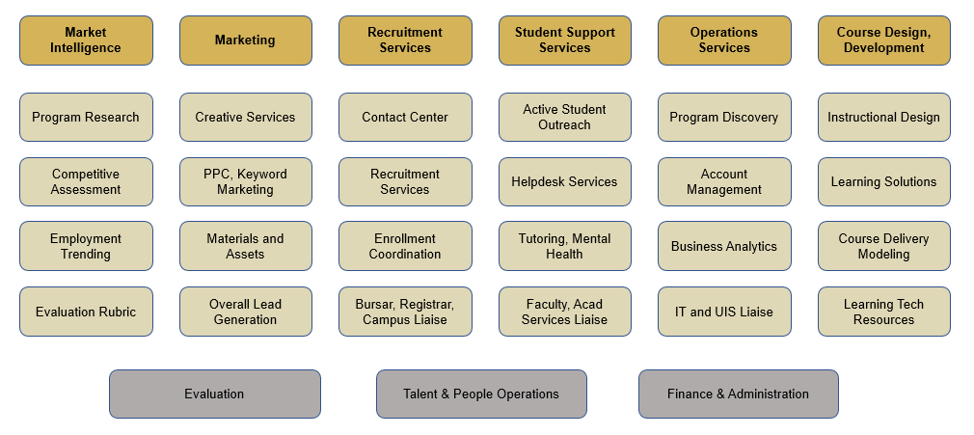
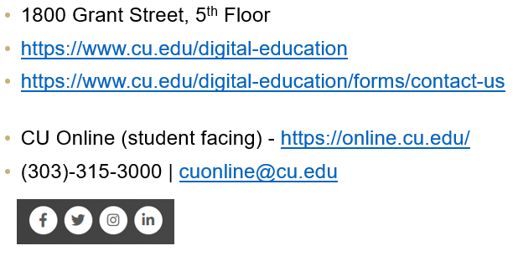
OFFICE OF DIGITAL EDUCATION
Office of Digital Education
OUR GOALS
OUR HISTORY
Created July 2018 as Denver | Anschutz department
Moved to System Administration in November 2020
Expanded services and support to all four CU campuses
52 employees + 9 UIS-dedicated partners and growing!
“We are reimagining the ways a university supports online
learning, faculty development and the implementation of
technology”
OUR SERVICES
HOW TO FIND US

Slide 17
Procurement Service Center
The Procurement Service Center (PSC) provides leadership to the University of Colorado in the procurement of goods and services and in paying debts to vendors and travelers by combining sound business controls with efficient and timely service.
The functional areas of the PSC include Purchasing Services, Strategic Sourcing, Supplier Relationship Management, Payable Services, Commercial Card Program, Travel Program, Small Business Program, Contract Services, and Procurement Systems.
PSC is the system owner of CU Marketplace and Concur Travel and Expense.
image

Slide 18
Government Relations
The Office of State and Federal Government Relations is charged with developing and implementing a public affairs strategy to address the legislative goals of the university.

Slide 19
Employee Services
Employee Services has the primary responsibility of bringing together:
Benefits, Payroll, Employee Learning and Development, Human Resources, Business Operations and HRIS and Communications to System administration employees as well as regularly collaborating with all four CU Campuses.
Exceptional Service
Every Employee
Every time
Contact Employee Services
Mailing Address:
Employee Services
University of Colorado
1800 Grant St., Suite 400
Denver, CO 80203
Interoffice Mail: 400 UCA
Main Number: 303-860-4200
1-855-216-7740 (toll-free)
Opt. 2: Payroll and HCM
Opt. 3: Benefits
Opt. 5: CU Careers
Website: www.cu.edu/es
Email: EmployeeServices@cu.edu

Slide 20
Internal Audit
Internal Audit reports directly to the Board of Regents, and contributes to the
university’s objectives by helping the CU community understand and apply sound business practices, through independent examination and evaluation of current processes and internal controls, and providing counsel and education to those responsible for them.

Slide 21
Office of Policy & Efficiency (OPE)
https://www.cu.edu/ope/ssc
OPE facilitates the ongoing review, approval and maintenance of 90+ universitywide APSs.
OPE acts as the official repository and point-of-contact regarding universitywide APSs.
OPE supports the formal review of the Regent Laws and Policies.
OPE oversees the records retention policy and retention guidelines for CU.
OPE administers the Boettcher Webb-Waring Biomedical Research Awards Program (BFWW).
APSs
Currently Under Review:
Equal Pay, Equal Work
Key Resources:
OPE Website
A-Z Listing
Search Tool
Currently Under Review
Latest APS Changes
Policy “One-Stop Shop”
State & Federal Laws, Regs
Regent Laws & Policies
APSs
CU Service Center Policies
Campus Policies
System Administration P&P
Shared Governance
Outreach:
OPE Policy Blog
Shared Governance
Stakeholder Updates
Regent L&Ps
Formal Review of L&Ps:
Dedicated website
Charge
Status and Latest News
List of L&Ps Under Review
List of Approved Changes
85% of Reviews Done
Currently Under Review:
Policy 3.C: Searches and Appointment of Chief Officers of the University
Regent Governance Committee – September 1
Opportunity for feedback
Equal Pay, Equal Work
Key Resources:
Article 1.C: University Policy Framework
Records Retention
Key Resources:
APS2006-Retention of University Records
FAQs
System Administration Records Retention Schedule
Laid out by Subject Area
Includes:
Document Type
Repository Location
Retention Period
BFWW
About the Program
CU Partnership with Boettcher Foundation
$235,000 awards to early-career biomedical researchers
$12.5M awarded to CU since 2010

Slide 22
University Counsel
University Counsel has a dual report to the Board of Regents and the President of the University and includes several legal functions that provide an array of services to the University of Colorado system. The Office of the University Counsel provides legal advice to the Board of Regents, the president, system administration and the campuses.

Slide 23
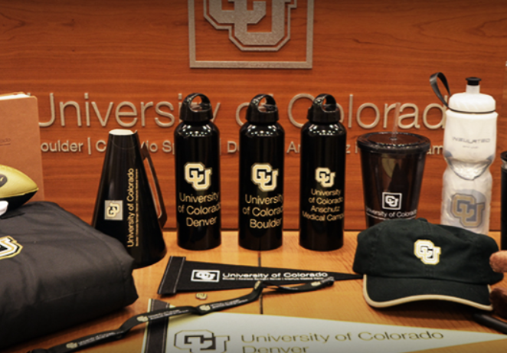
University Relations
The Office of University Relations works closely with the president and Board of Regents on all official public communication for the University of Colorado System. The Office is responsible for all communications, marketing and branding for the CU system administration.
University Relations works closely with the communication teams on the four campuses to tell the CU story and build awareness for the university internally and externally. The Vice President serves as a spokesperson for the system and oversees a team that manages a number of communication tools and events that help inform our community and increase knowledge about the University of Colorado.

Slide 24
Risk Management
The Office of University Risk Management is responsible for affirmative control and minimization of risk, promoting a strong proactive loss prevention program, and using aggressive leading edge concepts to insure the safety of students, employees and others as well as protecting the assets and income of each system campus.

Slide 25
Uptown Restaurants
D-Bar

Slide 26
Uptown Coffee

Slide 27
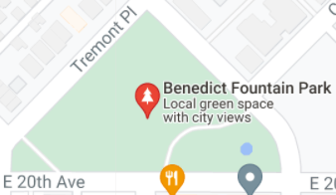
Uptown Gyms & Parks
Mini Gym

Slide 28
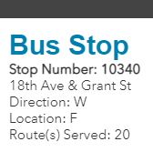
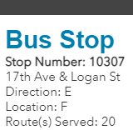
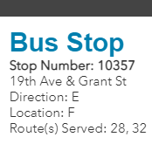
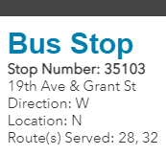
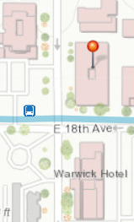
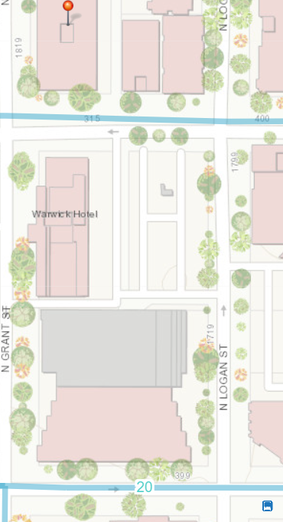
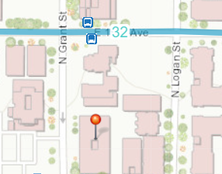
Uptown Bus Stops

