Slide 1



Managing Projects When Your Title Isn’t Project Manager
We’ll get started soon...
Do you hear music playing?
If not, take a moment to adjust your audio settings

Slide 2
Managing Projects When Your Title Isn’t Project Manager

Slide 3
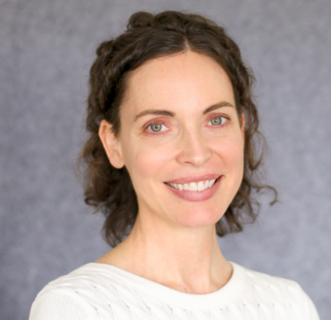
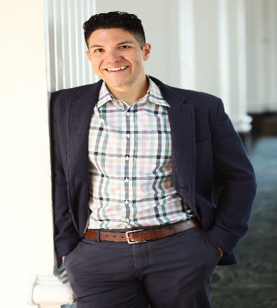
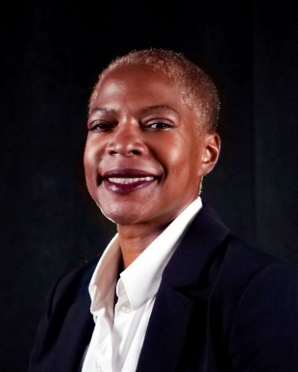
Cindy Kraft
Manager, Project Management
University Information Services
Steven Linenberger
Principal Project Manager
University Information Services
Kenyetta Rose
Financial Training & Support Specialist
Financial Services and Solutions
Office of University Controller

Slide 4

WE WILL HAVE SOME
POLL QUESTIONS

Slide 5

WE WILL SHARE A
RECORDING

Slide 6

QUESTIONS?​
Use the Q&A Button​
Q&A Button

Slide 7

CPE Reminder
Email fss@cu.edu to request CPE credit

Slide 8
Session Agenda
Signs you might be an unofficial Project Manager
What is a “project?”
Basic project terminology
Leading teams (without formal authority)
Using milestones and creating timelines
Get help from your PM/PMO colleagues

Slide 9

Are you (sometimes) a Project Manager?
Signs you know you might be an unofficial Project Manager:
Colleagues/leaders look to you for updates on a project/work effort, including timelines, progress made, documentation, etc.
You are the primary person scheduling and/or running relevant meetings
Anything else you have experienced?
What is a project?
In short, a project is a work effort that is temporary (has an estimated start and end date), some definition of scope (what you are going to do), and a fairly defined team of people who will regularly spend time on the effort.
The timeline might shift, but the effort won’t go on forever.
The work (scope) may shift somewhat, but there is some defined “list” of work.
The team may also be assigned to other work or projects, but the team is often relatively consistent throughout the effort (unless there are multiple phases).

Slide 10

POLL QUESTION #1

Slide 11
Project Terminology: Top terms to know
Scope: | The work you plan to do and/or the content or product you will deliver.
Scope creep: | New or additional work being added to the project.
Waterfall: | A linear/sequential project framework that intends to plan the full project out before starting the work. Initiation > Planning > Execution > Closing.
Gantt chart: | A bar-type visual of the project work/tasks, showing the work in a linear fashion against the timeline (mostly used w/waterfall).
Agile: | An iterative approach that emphasizes flexibility and customer feedback, using small incremental cycles/releases. Often uses 1-4 week “sprints.”
Sprints: | A fixed, time period in which a team completes/releases a set amount of work. 1-4 week sprints are most common.
Milestones: | A significant point or event that marks progress toward completion. It’s not a task but a checkpoint/achievement of a major deliverable.
Project charter: | A document that outlines the major aspects of the project and is typically used to formally “approve” the project to begin work.

Slide 12
POLL QUESTION #2

Slide 13
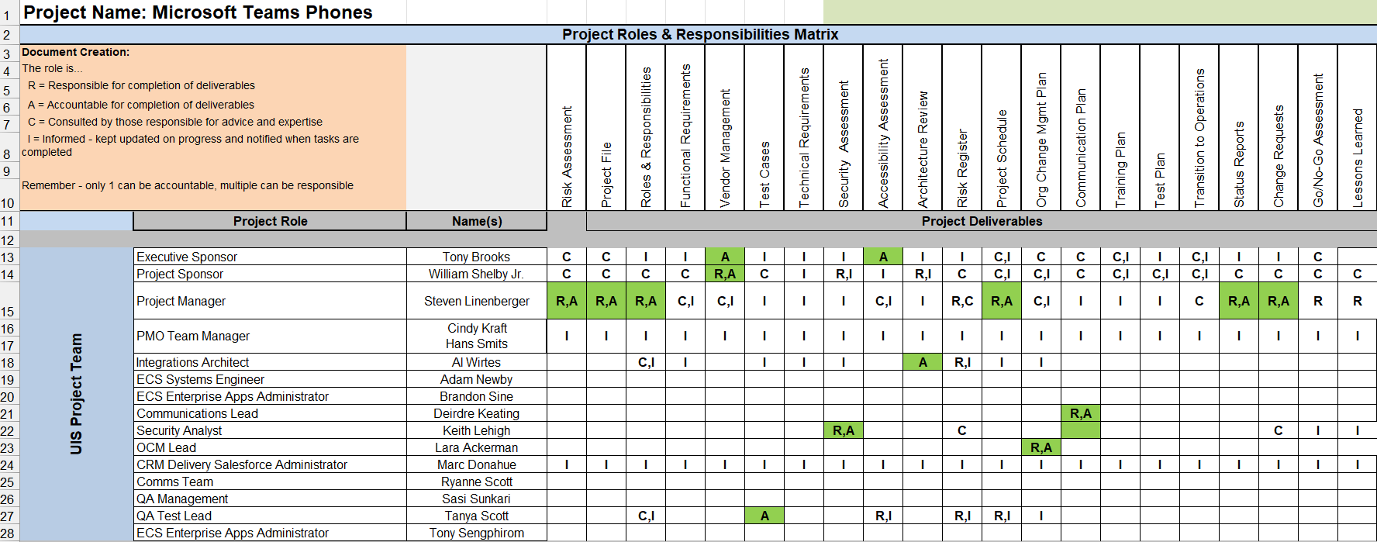
Leading Teams: Principles & Practices
Key Leadership Principles
Communicate clearly and often
Foster accountability and trust; build relationships with key people
Align on roles and Responsibilities (RACI)
Motivate, collaborate, remove impediments
Ensure leadership alignment early
Practical Actions
Encourage open dialogue & feedback
Consider ice breaker activities
Recognize contributions
Proactively manage risks
Document and escalate risks
Be flexible and adaptive
Build and maintain relationships

Slide 14
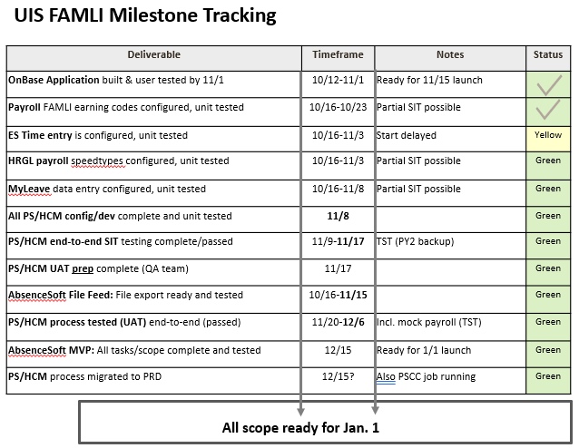
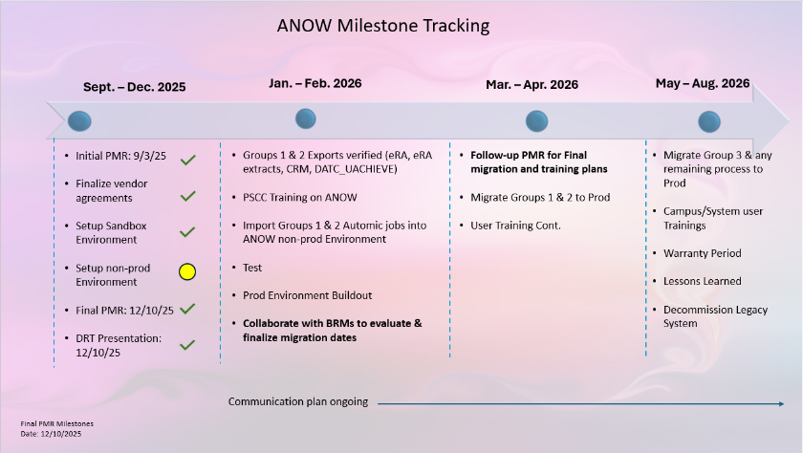
Identifying and Using Milestones
What is a Milestone?
A significant checkpoint
Achievement of a major deliverable or phase
Why Milestones Matter
Visibility for stakeholders
Alignment across teams
Decision points
Risk management
Timeline anchors
How to Identify & Use Milestones
Review phases and deliverables
Include dependencies
Validate with stakeholders
Assign ownership
Communicate and update
Use visual tools

Slide 15
POLL QUESTION #3

Slide 16
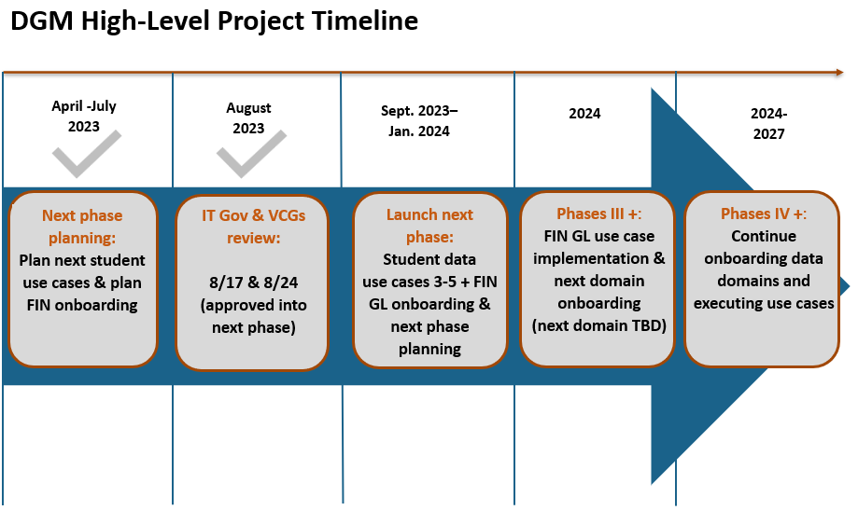
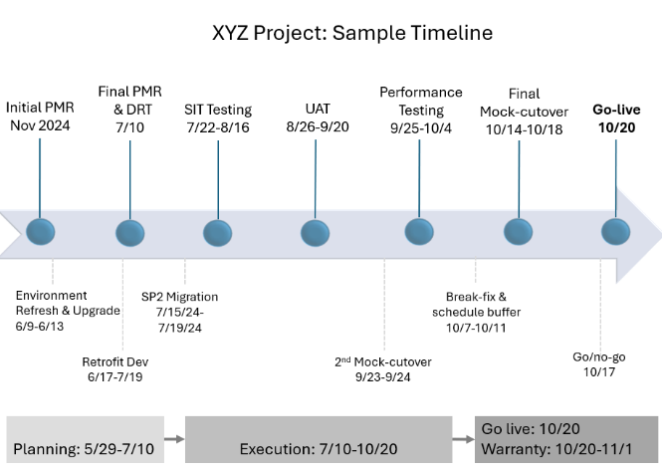
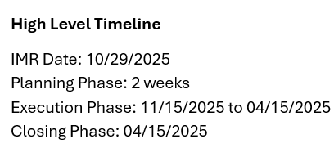
Creating a Timeline
Tip #1: Have a timeline (fancy or simple) and show it frequently
Once you know major dates/milestones, create a timeline
Show the timeline frequently in meetings/discussions (repetition makes it stick)
Tip #2: Know the level of detail for your audience when presenting information
The core team may want more details in a timeline and other documentation
For leadership, keep visuals/docs high-level and quickly “digestible”

Slide 17

Get Help from your PMO/PM Colleagues
Reach out to people who are formal Project Managers
Reach out to “official” PMs in your department, campus, etc. We are nerds and typically love talking shop and helping others
Ask for templates (timelines, work plans/WBS, meeting notes, etc.)
Do some training, attend a local conference/event, etc.
Read a book (try “Project Management for the Unofficial Project Manager”)
Watch videos on LinkedIn Learning, webinars, etc.
Attend a local conference (try: PMI Mile High Symposium April ‘26)
Aim for general/broad content, vs. specific methodologies in most cases
Use Generative AI as a supporting tool
Use Generative AI tools like Copilot to help you with project visuals/deliverables
Review any AI-generated content before sharing with a broader audience
Take small steps to evolve your PM skills/approach. Clear but simple goes a long way.

Slide 18
POLL QUESTION #4

Slide 19
Questions and discussion

Slide 20
Appendix

Slide 21
Appendix I: Timeline Template Options

Slide 22
Sample Timeline
High-level milestones up top: Choose 5-7
The PM may choose to create a more detailed version for the core project team
Add’l milestones or detail below OR use for customer-specific milestones
Quick glance of phases running along bottom
Final PMR & DRT
7/10
Performance Testing
9/25-10/4
Final Mock-cutover 10/14-10/18
Initial PMR
Nov 2024
SIT Testing
7/22-8/16
UAT
8/26-9/20
Go-live
10/20
Environment Refresh & Upgrade
6/9-6/13
SP2 Migration
7/15/24-7/19/24
Break-fix & schedule buffer
10/7-10/11
Retrofit Dev
6/17-7/19
2nd Mock-cutover
9/23-9/24
Go/no-go 10/17
Planning: 5/29-7/10
Execution: 7/10-10/20
Go live: 10/20 Warranty: 10/20-11/1

Slide 23
Sample Timeline
Go / No-Go
11/10
Steering Project Plan
5/19
Environment Released
5/20
Campus testing 1.1 5/31-6/10
Campus testing 1.2
7/18-7/27
Mock cutover 10/3
UAT
10/10-10/19
Go Live
11/11-11/12
 | April | May | June | July | August | September | October | November
Governance, General
UIS
Campuses - Business
Campuses - IT
InfoEd
Finalize project plan
Environment Set-up
Performance testing, Data compares & validations
Mock Cut-over
Analysis, Reporting, Performance Testing, Gen Support
Manifest review
UAT
UAT
UAT, Training
Testing, Campus Support
Mock Cut-over
Fix Issues
InfoEd Dedicated Support
6/1-6/2
InfoEd Dedicated Support
7/21
Campus Training
10/26-10/27
Back-up Go Live 1/6-1/7 (2023)

Slide 24
Sample Timeline
Scope | Sept. ’23 | Oct. ’23 | Nov. ’23 | Dec. ’23 | Jan. ‘24
Nov. 15: OnBase App
Finish build & unit test
SIT
UAT
Training, Comms, Go-live
Mods based on state’s form release
PS/HCM Scope: • Employee time entry • Payroll •ES Time Entry • Funding & HRGL
Planning: Determine approach ✓, capture requirements
Config & Unit testing
SIT**
UAT** (incl. mock payroll)
KT, Docs, Training, Comms
Post-rollout support TBD
**End-to-end testing
AbsenceSoft Limited MVP*
Assess limited scope and timeline with vendor and UIS ✓
Install & Limited Config
Test file feed
ES UAT
Training, Comms
AbsenceSoft Full Implementation
Planning: Assess scope
and timeline. Set final PMR date
ES scope related to policy, change management, vendor mgmt., comms, etc.
*Limited, tight scope for MVP

Slide 25
Sample Timeline
Mid-late Aug. ‘23 | Sept. ’23 | Oct. ’23 | Nov. ’23 | Dec. ’23 | Jan. ‘24
Student UCs 3-4 Prep: UIS team, Stewards mtgs.
S t u d e n t s c o p e
Student UC5: Prep UIS Team
UC 5 Execution: UIS team
Onboard new SMEs UCs 3&4 OCM team
facilitates
UC 3 Execution: UIS team, Stewards, Working Groups/SMEs
UC 4 Execution: UIS team, Report Writers, others as needed
Onboard Student Early Adopters
Ongoing Support to Student Early Adopters. Assess adoption in Dec.
Onboard FIN GL Leaders & Identify SMEs & Stewards
Onboard SMEs & Stewards
F I N GL s c o p e
Determine FIN GL Use Cases and Plan Next Phase
DG/DGEXs: Socialize DG policy procedure statement and standards
DG/DGEXs: Socialize issue management process, directive process, reporting process, etc. Publish DG documentation after socialization
Implement new DG processes
Ongoing Project Management and OCM Best Practices

Slide 26

Sample Timeline
April -July 2023
August 2023
Sept. 2023– Jan. 2024
2024
2024- 2027
Next phase planning: Plan next student use cases & plan FIN onboarding
IT Gov & VCGs review: 8/17 & 8/24 (approved into next phase)
Launch next phase: Student data use cases 3-5 + FIN GL onboarding & next phase planning
Phases III +: FIN GL use case implementation & next domain onboarding (next domain TBD)
Phases IV +: Continue onboarding data domains and executing use cases

Slide 27
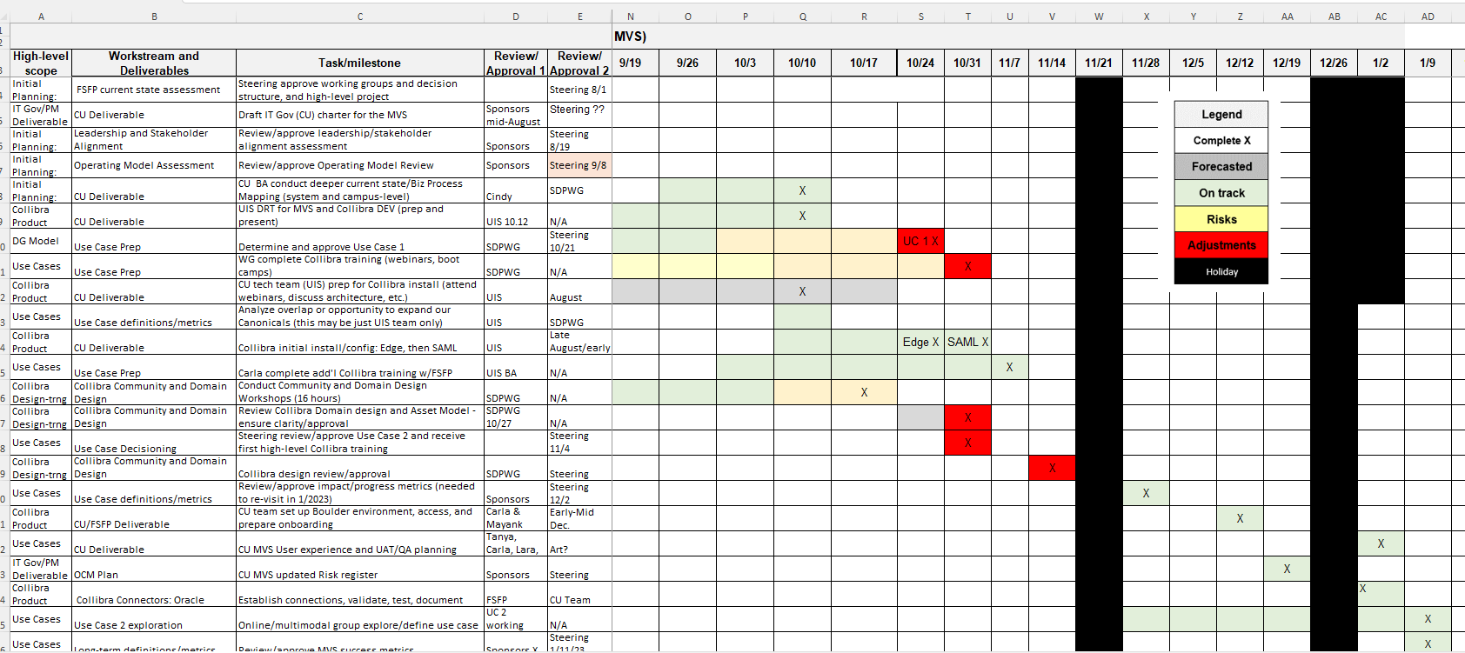
Sample Gant-Chart Project Plan

Slide 28
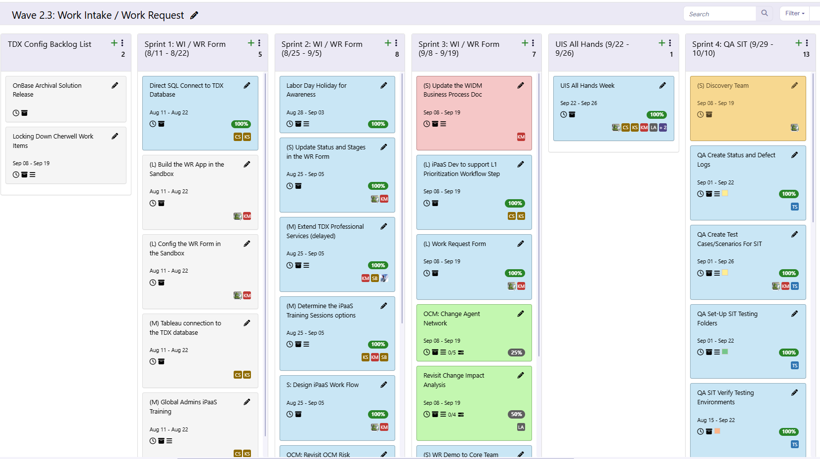
Sample Card Wall (Agile Methodology)

Slide 29

UIS FAMLI Milestone Tracking
Deliverable | Timeframe | Notes | Status
OnBase Application built & user tested by 11/1 | 10/12-11/1 | Ready for 11/15 launch
Payroll FAMLI earning codes configured, unit tested | 10/16-10/23 | Partial SIT possible
ES Time entry is configured, unit tested | 10/16-11/3 | Start delayed | Yellow
HRGL payroll speedtypes configured, unit tested | 10/16-11/3 | Partial SIT possible | Green
MyLeave data entry configured, unit tested | 10/16-11/8 | Partial SIT possible | Green
All PS/HCM config/dev complete and unit tested | 11/8 |  | Green
PS/HCM end-to-end SIT testing complete/passed | 11/9-11/17 | TST (PY2 backup) | Green
PS/HCM UAT prep complete (QA team) | 11/17 |  | Green
AbsenceSoft File Feed: File export ready and tested | 10/16-11/15 |  | Green
PS/HCM process tested (UAT) end-to-end (passed) | 11/20-12/6 | Incl. mock payroll (TST) | Green
AbsenceSoft MVP: All tasks/scope complete and tested | 12/15 | Ready for 1/1 launch | Green
PS/HCM process migrated to PRD | 12/15? | Also PSCC job running | Green
All scope ready for Jan. 1

Slide 30
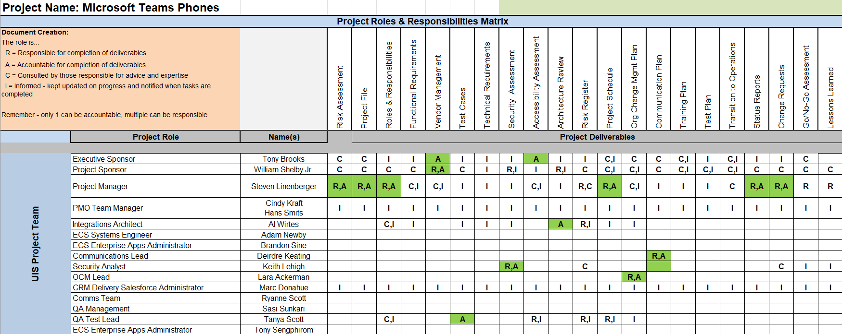
Microsoft Teams Phone RACI Chart

Slide 31
cu.edu/controller/course-catalog
Resources

Slide 32

Thank you!
CPAs should email fss@cu.edu to request CPE credit.

