Slide 1

Responding to Challenges in a Volatile, Uncertain, Complex and Ambiguous Environment
Patrick T. O’Rourke
Vice President, University Counsel and
Secretary of the Board of Regents
University of Colorado
Patrick.orourke@cu.edu

Slide 2
Me
Chair
VC
Regent
Regent
Regent
Regent
Regent
Regent
Regent
President
Chancellor
Chancellor
Chancellor
Chancellor
VP
VP
VP
VP
VP
VP
Lawyer
Lawyer
Lawyer
Lawyer
Lawyer
IA
FC

Slide 3
Objectives
Here’s What I Hope to Do Today
Identify and address ethical issues that arise in university leadership;
Define an analytic approach to addressing legal and ethical issues;
Integrate professional ethics, principles of cultural competence and accountability in all professional conduct.

Slide 4
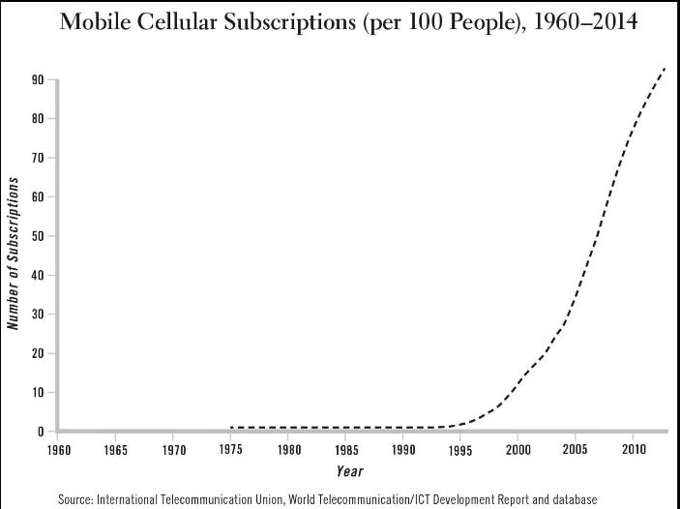
Photo - Horizontal

Slide 5
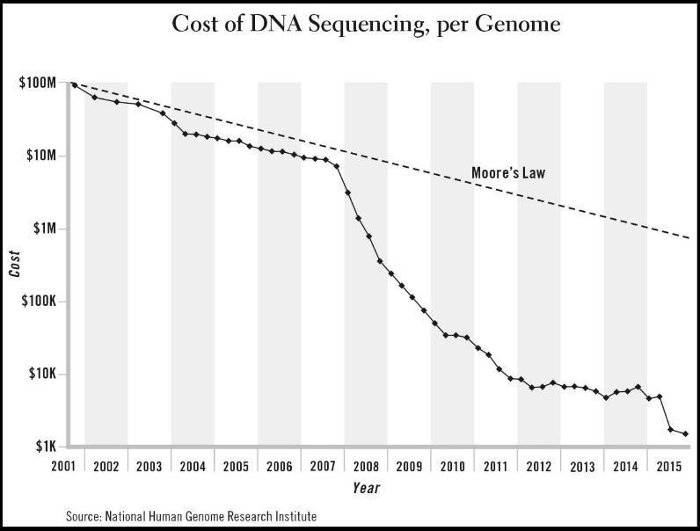
Photo - Horizontal

Slide 6
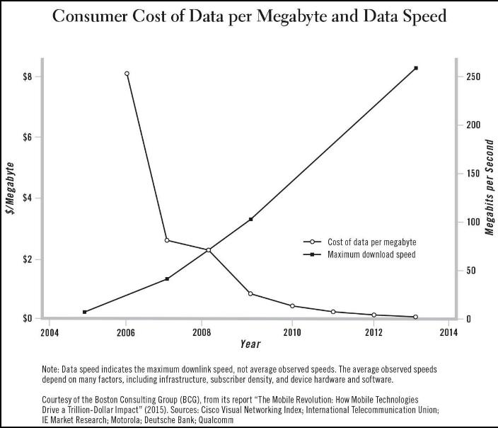
Photo - Horizontal

Slide 7
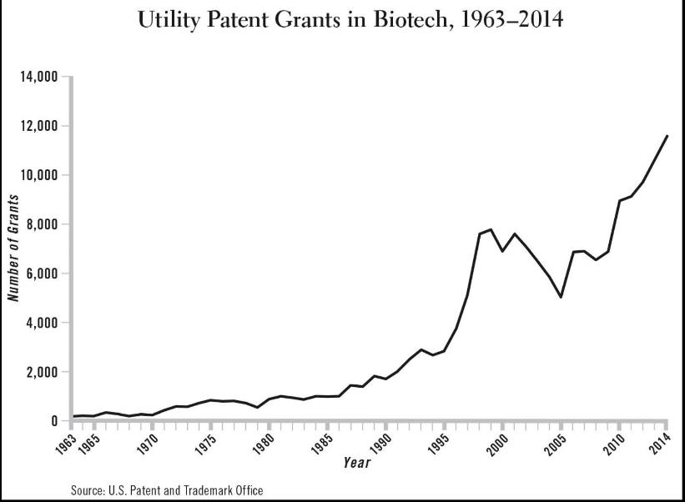
Photo - Horizontal

Slide 8
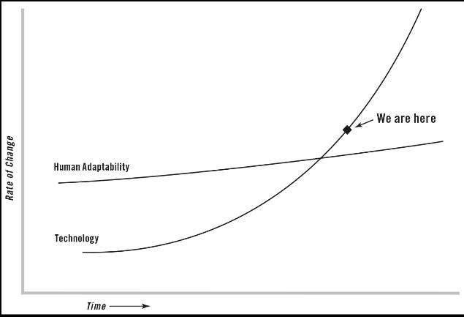
Photo - Horizontal

Slide 9

It took centuries for the longbow to go from development into military use in Europe in the late thirteenth century . . . But by 1900 . . . this process of technological and scientific change “started to speed up” . . . [I]t was taking twenty to thirty years for technology to take one step big enough that the world became uncomfortably different. . . Now, in 2016,. . . it’s on the order of five to seven years from the time something is introduced to being ubiquitous and the world being uncomfortably changed

Slide 10
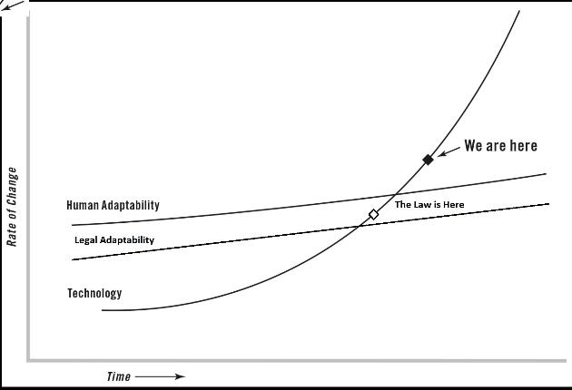
Photo - Horizontal

Slide 11
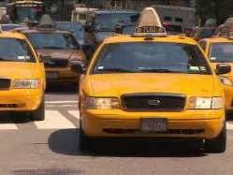

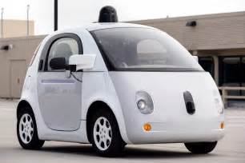


Slide 12
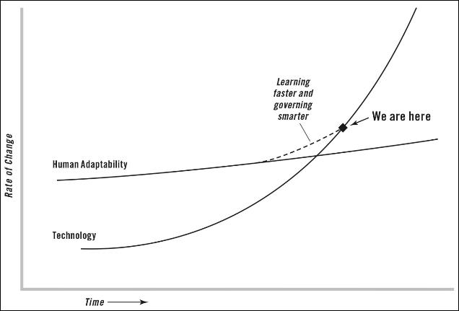
Photo - Horizontal

Slide 13
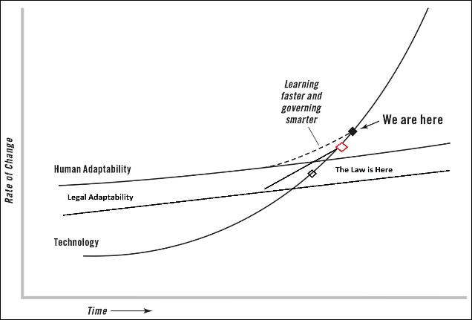
Photo - Horizontal

Slide 14


In the world we are in now, acceleration seems to be increasing. [That means] you don’t just move to a higher speed of change. The rate of change also gets faster … And when the rate of change eventually exceeds the ability to adapt you get ‘dislocation.’
Dislocation is when the whole environment is being altered so quickly that everyone starts to feel they can’t keep up.

Slide 15
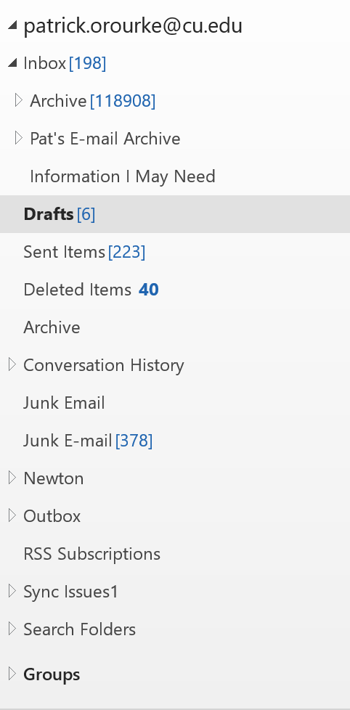

Slide 16
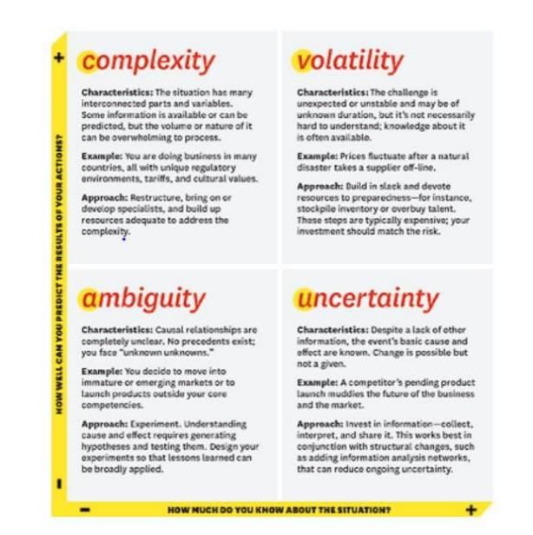

Photo - Horizontal
Nathan Bennett & G. James Lemonine, What VUCA Really Means for You, Harvard Business Review (Jan-Feb 2014)

Slide 17
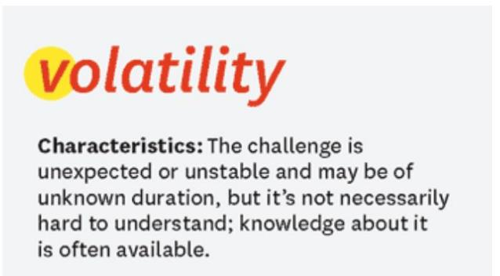

Notes:
Translate Data into Information
Formulate Clear Intent
Communicate Clearly

Slide 18
Translate Data into Information
Formulate Clear Intent
Communicate Clearly

Slide 19
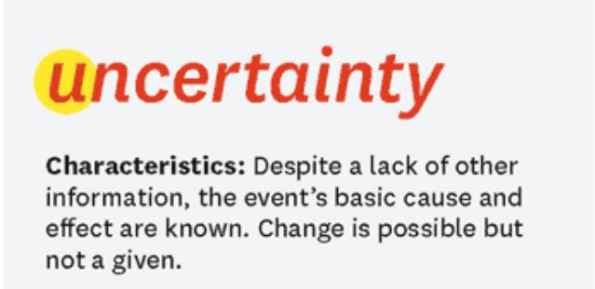

Notes:
Consider Past Practices, but Don’t Rely on Them
Expand Places to Seek Input
Flexibility and Contingency Planning

Slide 20
Consider Past Practices, but Don’t Rely on Them
Expand Places to Seek Input
Flexibility and Contingency Planning

Slide 21
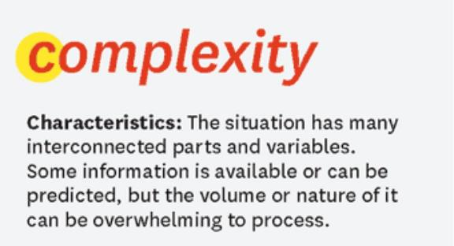

Notes:
Develop Subject Matter Experts
Determine Essentials

Slide 22
Develop Subject Matter Experts
Determine Essentials

Slide 23
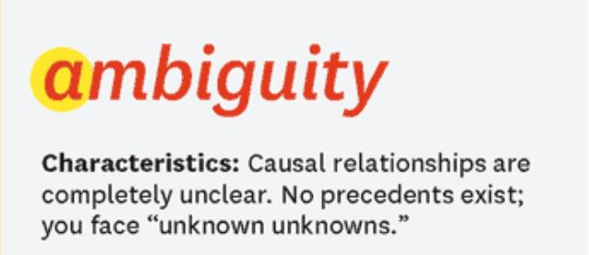

Notes:
Define goals
Continual Reassessment
Expand Listening

Slide 24
Define goals
Continual Reassessment
Expand Listening

Slide 25

Today’s Compliance Environment
VUCA?
High
Disability Accommodation
Fraud and Abuse
Title IX
Distance Learning
Business Risk
NCAA Compliance
Title IV
Export Control
Low
Low
Legal Risk
High

Slide 26


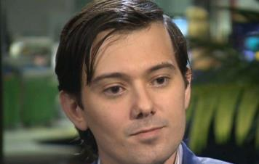

What’s the Context?
Erosion in confidence of public and private entities’ ability to safeguard their own behaviors.

Slide 27


Two Different Spheres
Operational v. Governance
Operational
Governance
Doing what needs to be done to ensure that employees are complying with applicable legal requirements.
Providing the mandate, resources, and oversight for the operational aspects to be effectively performed.

Slide 28
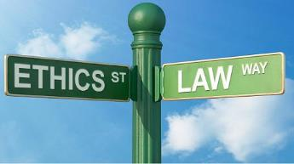

Law v. Ethics
They are not the same
Law - The regime that orders human activities and relations through systematic application of the force of politically organized society, or through social pressure, backed by force, in such a society.
Ethics - A system of moral tenets or principles; the collective doctrines relating to the ideals of human conduct and character.

Slide 29
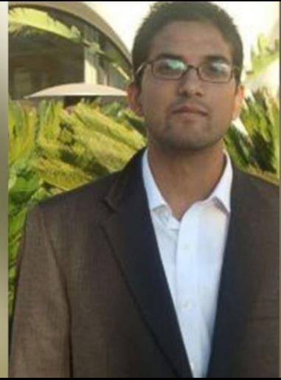
A Not So Hypothetical
What Would You Do?
What’s Your Framework for Assessing this Issue?
Notes:
Syed Farook

Slide 30

The first line of defense for any society is always going to be its guardrails—laws, stoplights, police, courts, surveillance, the FBI. . . . All of those are necessary, but they are not sufficient for the age of accelerations. Clearly, what is also needed. . . is to think more seriously and urgently about “sustainable values”: honesty, humility, integrity, and mutual respect. This is opposed to . . . “situational values”—“ just doing whatever the situation allows.”

Slide 31
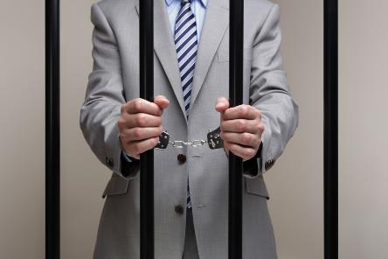

Federal Sentencing Guidelines
.
Apply to organizations
Effective ethics and compliance program
Code of Conduct

Slide 32
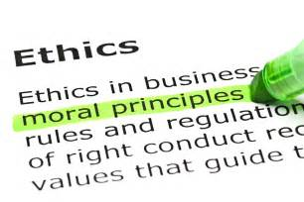

Principles of Ethical Behavior
Conducting fair and principled business transactions
Acting in good faith; being personally accountable for individual actions
Conscientiously fulfilling obligations towards others; and
Communicating ethical standards of conduct through instruction and example.

Slide 33
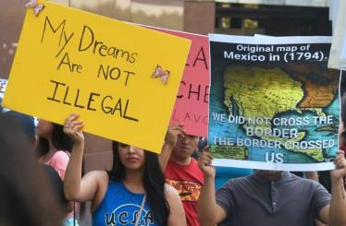

A Not So Hypothetical
DACA
Deferred Action on Childhood Arrivals
Rescinded
March 6, 2018 – Work Authorizations Begin to Expire
Skilled labor: Time to hire and retrain

Slide 34

Start at the End
Each institution has different issues.
Good policies are imperative.
Good policies don’t substitute for good people.

Slide 35
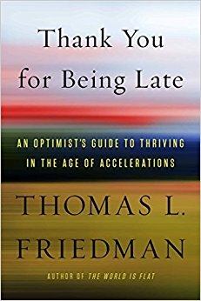

Slide 36


