Slide 1
Tableau Enterprise
Stakeholder Update Meeting
4.5.21

Slide 2
Agenda
Project status & timeline update
Update on hiring process for Tableau Analyst
Update on Licenses
Review of project requirements and specs
Change Management updates

Slide 3
Project Status & Timeline
The project remains behind schedule due to delays with the HIPAA compliance set up and the initial unsuccessful search for the Tableau analyst.
The consulting engagement kick-off with AWS will be held within the next week.
If the HIPAA compliance work remains blocked, UIS will consider contingent plans with an on-prem server. UIS will discuss options with you before pursuing an alternate path.
The UIS team still hopes that migrations will be conducted this summer and we will coordinate with your business calendars. Your migration timeframe will not be a surprise. ☺
Status reports will be sent to stakeholders bi-weekly.

Slide 4
Project Status & Timeline: Q&A
Is an on-prem server (as a back-up option) really our best approach? Can’t we strip out the NIST/HIPAA data?
  We *could* strip out NIST/HIPAA, but this leaves some of the Denver/Anschutz groups behind and we still need to migrate them before the end of the year. So this approach doesn’t buy us that much time.
  If we put the non-NIST/HIPAA data into AWS, we still need to ensure that we are on the right path for eventual NIST/HIPAA compliance. In other words, we need to enusure that we don’t have to completely re-do our AWS set-up once we bring in NIST/HIPAA.
  The UIS team has not definitively determined an alternate approach in the scenario when our AWS consulting engagement doesn’t not resolve our blockers. But we are brainstorming possible options and would discuss them with project stakeholders before making any decisions.

Slide 5
Tableau Analyst Hiring Update
Second round of recruiting is in the final phase and qualified candidates have been identified.
Next steps will follow the hiring standard process.
If successfully hired, the new resource will initially be 100% focused on this project.

Slide 6
Tableau Licenses
Key updates from Milap regarding licenses…

Slide 7



Tableau CU Public
Embedded Web Sites
Embedded Web Sites
Embedded Web Sites
Embedded Web Sites
Tableau Public URL
extracts

Slide 8
Features and Requirements: Tableau CU Public
A new enhancement – not currently available to campuses
End users aren’t required to login
Any Dashboard and Reports are available from Web
Users are able to embed to their websites
Similar to Tableau Public - but CU hosted and managed
A limited number of authorized developers can publish
1 server with 8 cores (may expand in future)
No HA – there will be downtime
Housed within AWS, so during outages there will be no maintenance pages
Not HIPAA compliant
Can only contain public data
SAML authentication not included (separate account via Tableau for select developers)

Slide 9
Tableau CU Public: Q&A
What is the purpose of Tableau public? What advantages can we cite to users?
  Boulder confirmed that the approach proposed by UIS is the best fit for their users. Robert Stubbs will provide information about this.
Can SSO for Tableau Public be moved into project scop?
  The UIS team will mark this as a “nice to have” and make efforts to include it.

Slide 10

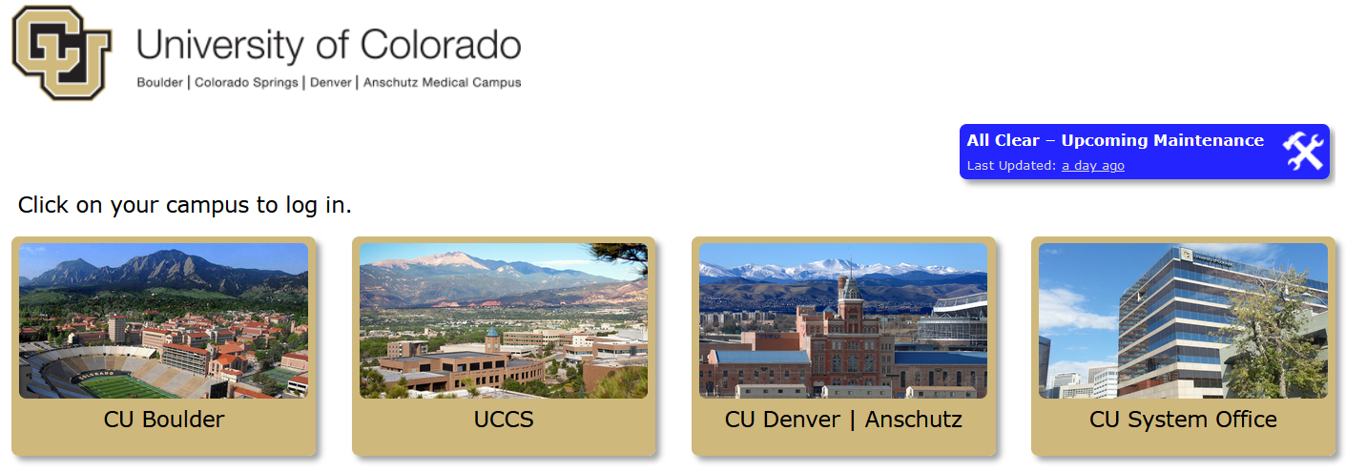
Tableau CU Private
CU Network
Tableau Private URL
extracts

Slide 11
Features and Requirements: Tableau Private
Requirements based on current functionality of campus servers
Available to CU Network Only (i.e. VPN)
Users will log in thru their campus credentials
Current site owners will continue to manage Sites, Groups and Extracts
Current authorized developers can publish
The server will be HIPAA and FERPA Compliant
Campuses are accountable for adhering to HIPAA/FERPA processes and policies
UIS will create a new site for cross-campus usage – details TBD
See detailed tech specs for all other requirements

Slide 12
Tableau Private: Q&A
Does the CU Network include affiliates?
  Not by default, but the UIS team clarified that this is possible and will take as an action item for the UIS team to discuss.
  Anshcutz would include CU Medicine, UCH and Children’s

Slide 13
Other Key Project Requirements
Tableau Enterprise for CU will be managed, owned and supported by UIS
CU Tableau Enterprise will be created on the latest release available at time of migration
Campuses will follow the UIS upgrade schedule, to be determined and discussed in advance with campuses (similar to upgrades for other UIS-managed systems)
Campuses/depts. are responsible for purchasing desktop licenses
Campuses/departments will continue to follow their existing process for requesting Tableau access
CU Enterprise desktop licenses follow a renewal cycle of January to January

Slide 14
Other Requirements: Q&A
Tableau Prep: Is the scheduling conductor indeed out of scope?
  Yes, the overall budget was not able to include this in our contract.
  There are some work-arounds to help users achieve some of the same functionality: https://interworks.com/blog/dsteinmetz/2018/12/13/tableau-prep-workflow-automation-made-simple/

Slide 15





Tableau Change Management Approach
Communications
Education/Training
Pulse Surveys
Change is a Process… not an Event!

Slide 16
Change Agent Roster
Denver: Budget | David Doig | david.doig@ucdenver.edu
Denver: Budget | Erik Welker | ERIK.WELKER@CUANSCHUTZ.EDU
Denver: CLAS | Mary Lovit | MARY.LOVIT@UCDENVER.EDU
Denver: CLAS | Rich Allen | richard.allen@ucdenver.edu
Denver: Finance | Nara Shagdar | nara.shagdar@ucdenver.edu
Denver: Human Resources | Paul Joyce | paul.joyce@ucdenver.edu
Denver: OIRE | Dave Deffenbacher | dave.deffenbacher@ucdenver.edu
Denver: OIRE | Ian Whitman | ian.whitman@ucdenver.edu
Denver: OIRPA | Irma Peralta | Irma.Peralta@ucdenver.edu
Denver: OIT | Sharon Grant | sharon.grant@cuanschutz.edu
Denver: Denver: SEHD | Tony Romero | tony.romero@ucdenver.edu
Denver: SOM IT | Dalen Jensen | dalan.jensen@cuanschutz.edu
Denver: SOM IT | Micheal Miller | michael.g.miller@cuanschutz.edu
Denver: LETTS | Brad Hinson | brad.hinson@ucdenver.edu
Denver: LETTS | Troy Butler | troy.butler@ucdenver.edu
Denver: Student Success/Provost | Erika Larsen | erika.larson@ucdenver.edu
Denver: CLAS Research | Carol Achzinger | carol.achziger@ucdenver.edu
Denver: CLAS Research | Elizabeth Lee | elizabeth.lee@ucdenver.edu
System: PSC | Kelly Richter | Kelly.richter@cu.edu
Boulder | Mari Dark | Mari.dark@Colorado.edu

Slide 17
Change Agents: Q&A
Has any one on the Denver team reached out to (or heard from) CSPH?
  No. Sharon will reach out.

