Slide 1

CU eComm
July 9, 2015
www.cu.edu/ecomm
Notes:
Welcome to the CU eComm Salesforce Implementation Town Hall
My name is Kim Egan
Spend about 40 minutes talking about the eComm project.
Housekeeping items
Listen only mode
Post your question – answered at the end
Any questions that aren’t answered will be answered on our website at www.cu.edu/ecomm

Slide 2
PROJECT UPDATE
What’s been going on?
Data
Salesforce, Marketing Cloud and Community
Testing
Salesforce sandbox migration
www.cu.edu/ecomm
Notes:
Kim

Slide 3

Project Update | DATA
HRMS
MDM
ADVANCE
SF
CS
www.cu.edu/ecomm
Notes:
Kim

Slide 4


Project Update | SALESFORCE
eComm 1.0
www.cu.edu/ecomm
Notes:
Kim

Slide 5
Project Update | TESTING
Unit
ACF
Functional
eComm team
User
Power Users
Regression
CU CRM team
www.cu.edu/ecomm
Notes:
Kim

Slide 6

Project Update | SANDBOX MOVES
eCommDev
Where ACF built everything
Unit testing done here during build
Stage
Exact replica of Production
Production
ACTION!
DevIntgr
Test
Where all the source systems come together for testing
Where regression, functional and user testing is conducted
Unit, regression, functional and user testing also conducted here
Training will take place here
Sample data sets loaded here
All data loaded here
Where users will go to do their jobs
1.
2.
3.
4.
5.
www.cu.edu/ecomm
Notes:
Kim

Slide 7

Salesforce 101
www.cu.edu/ecomm
Notes:
Kim

Slide 8

Email lists…
www.cu.edu/ecomm
Notes:
Kim

Slide 9

User Acceptance Testing (UAT) results
www.cu.edu/ecomm
Notes:
Kim

Slide 10
What still needs to be done
Testing / validation of data
Development of a data dictionary
eComm website update
Training of core eComm team (MECs)
Provisioning
Security
Harris data migration (email preferences)
www.cu.edu/ecomm
Notes:
Kim

Slide 11
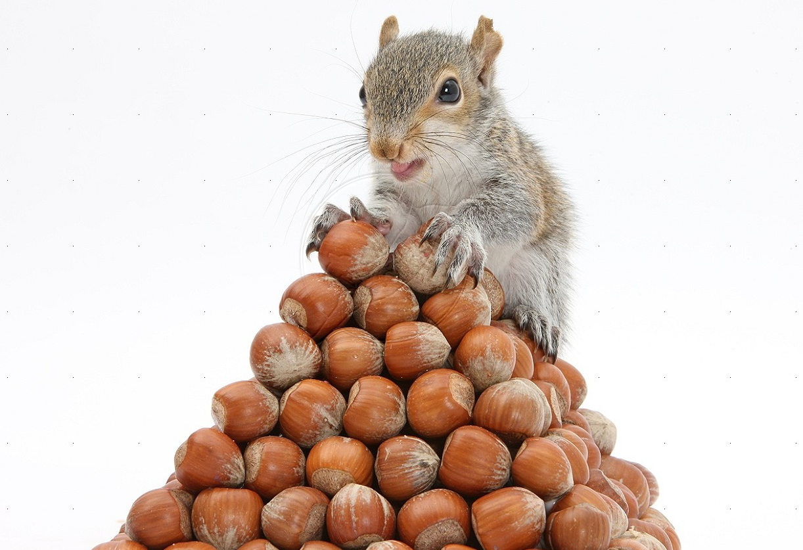
Harris Archive Project (HAP)
http://www.cu.edu/ecomm/harris-archive-project
Save your Stuff!
www.cu.edu/ecomm
Notes:
Kim to intro
Melanie Jones, University Relations

Slide 12
TIMELINE
eComm team access to production
Power Users / UAT group access to production
Online community
All User Training
All users in Production & Harris email turns off
Harris goes dark
Aug 24
Sept 28
Oct 5
Oct 19
Oct 26
Feb 2016
eCommference
www.cu.edu/ecomm

Slide 13
Q & A and Contact Us
Post your questions. Webinar will remain open until 3:00
Find your eComm specialist
www.cu.edu/ecomm
www.cu.edu/ecomm
Notes:
Kim to intro
Melanie Jones, University Relations

