Slide 1
CU System
National Cybersecurity Awareness Month
Career Discussion
Gretchen Bliss
Director of Cybersecurity Programs

Slide 2

Who am I?
  Russian Linguist
  HUMINTer
  Planner
  Communicator
  Cybersecurity Director

Slide 3
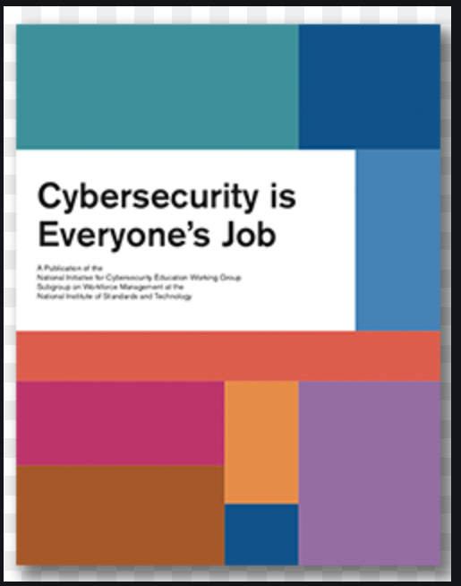
Cybersecurity is Everyone’s Job
Work
School
Phone
Car
Computer
Accounts
Doorbells
Refrigerators
Video communications
Social media

Slide 4
Cybersecurity

Slide 5

National Initiative for Cybersecurity Education Framework
People, Process, Technology
  Workforce who can provide cybersecurity awareness training, write policies, negotiate contracts or process procurements, design and build secure technologies, administer technologies, and recover and respond to or investigate incidents
  IT sector - “service provider” for cybersecurity products and services
    Sales, marketing, and business process roles
Enhance opportunities for curriculum development, resource sharing, and connecting research-to-practice
Business
Public Policy
Social Science
Behavioral Science
Criminal Justice
Education
Disciplinary PhDs
Law
Medicine
Information Systems
Engineering
Computer Science
Notes:
NICE program committee/ monthly working groups collegiate, industry and workforce
NSA CAE evaluator

Slide 6







NICE Cybersecurity Framework
NICE facilitates change and innovation and brings leadership and vision to increase the number of skilled cybersecurity professionals helping to keep our nation secure and economically competitive.
Securely Provision
Operate and Maintain
Oversee and Govern
Protect and Defend
Analyze
Collect and Operate
Investigate
Risk Management
Software Development
System Architecture
System Development
System requirements Planning
Technology R&D
Test and Evaluation
Engineers
Architects
Software Developers
Data Analysts
Program Managers
Auditors
Risk Managers
Policy developers
Workforce Managers
Compliance officers
Contract and Procurement officers
Data Administration
Knowledge Management
Network Services
Customer Feedback
Technical Support
System Administration
System Analysis
Data Analyst
Incident Response
Digital Forensics
All source, Language, Exploitation Analysis
Targets
Threat Analysis
Collection Operations
Cyber Operations/ Planning
Partner integration planner
Digital Forensics
Law Enforcement
Legal
Policy
Notes:
NICE has divided the large topic of Cybersecurity into 7 areas – and identified the types of jobs and you can see they are not all technical. Cybersecurity can cut across the academic disciplines and is a fomplimentary element of any curriculum or profession.

Slide 7
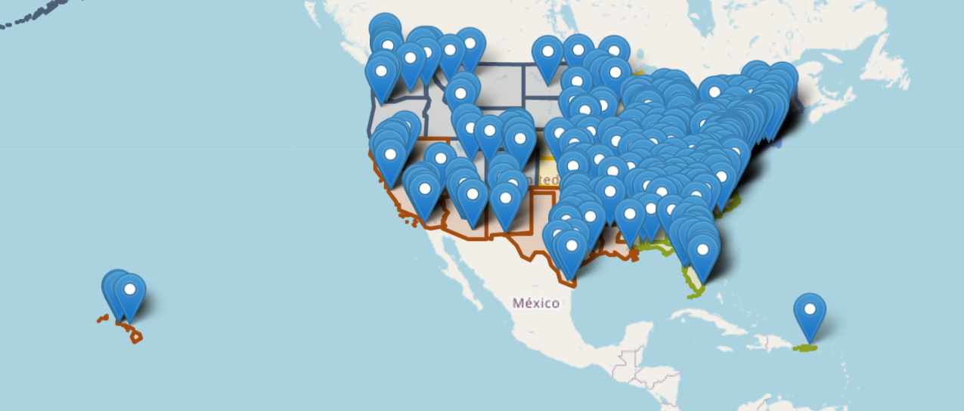
Centers of Academic Excellence in Cybersecurity
Colorado has 11 CAE institutions - 5 in COS
UCCS, USAFA, CTU, Regis, PPCC

Slide 8
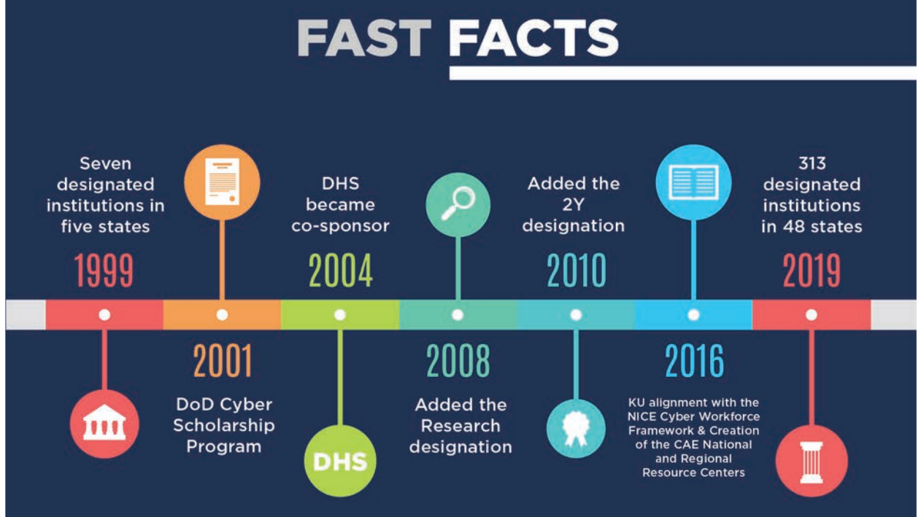
Colorado has 11 CAE institutions - 5 in COS
UCCS, USAFA, CTU, Regis, PPCC

Slide 9
Today
Advanced Algorithms (AAL) | Fraud Prevention and Management (FPM) | Operating Systems Hardening (OSH)
Advanced Cryptography (ACR) | Hardware Reverse Engineering (HRE) | Operating Systems Theory (OST)
Advanced Network Technology and Protocols (ANT) | Hardware/Firmware Security (HFS) | Penetration Testing (PTT)
Algorithms (ALG) | Host Forensics (HOF) | Privacy (PRI)
Analog Telecommunications (ATC) | IA Architectures (IAA) | QA/Functional Testing (QAT)
Basic Cyber Operations (BCO) | IA Compliance (IAC) | Radio Frequency Principles (RFP)
Cloud Computing (CCO) | IA Standards (IAS) | Secure Programming Practices (SPP)
Cyber Crime (CCR) | Independent/Directed Study/Research (IDR) | Software Assurance (SAS)
Cybersecurity Ethics (CSE) | Industrial Control Systems (ICS) | Software Reverse Engineering (SRE)
Data Administration (DBA) | Introduction to Theory of Computation (ITC) | Software Security Analysis (SSA)
Data Structures (DST) | Intrusion Detection/Prevention Systems (IDS) | Supply Chain Security (SCS)
Database Management Systems (DMS) | Life-Cycle Security (LCS) | Systems Certification and Accreditation (SCA)
Databases (DAT) | Low Level Programming (LLP) | Systems Programming (SPG)
Device Forensics (DVF) | Media Forensics (MEF) | Systems Security Engineering (SSE)
Digital Communications (DCO) | Mobile Technologies (MOT) | Virtualization Technologies (VTT)
Digital Forensics (DFS) | Network Forensics (NWF) | Vulnerability Analysis (VLA)
Embedded Systems (EBS) | Network Security Administration (NSA) | Web Application Security (WAS)
Forensic Accounting (FAC) | Network Technology and Protocols (NTP) | Wireless Sensor Networks (WSN)
Formal Methods (FMD) | Operating Systems Administration (OSA)
Foundational CDE Knowledge Units
 | Cybersecurity Foundations (CSF)
 | Cybersecurity Principles (CSP)
 | IT Systems Components (ISC)
Core Technical CDE Knowledge Units
 | Basic Cryptography (BCY)
 | Basic Networking (BNW)
 | Basic Scripting and Programming (BSP)
 | Network Defense (NDF)
 | Operating Systems Concepts (OSC)
Core Non-Technical CDE Knowledge Units
 | Cyber Threats (CTH)
 | Cybersecurity Planning and Management (CPM)
 | Policy, Legal, Ethics, and Compliance (PLE)
 | Security Program Management (SPM)
 | Security Risk Analysis (SRA)
Notes:
.

Slide 10
Colorado Cybersecurity Industry Growth 2015-2020
*2020 data only through August 31
Job data from burningglass
Data Courtesy of: UCCS Economic Forum Tatiana Bailey

Slide 11
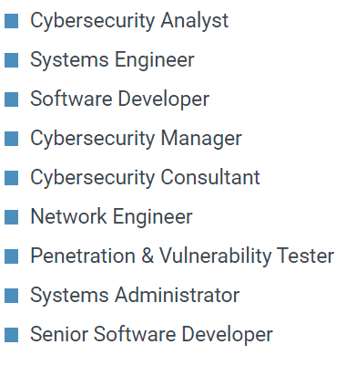
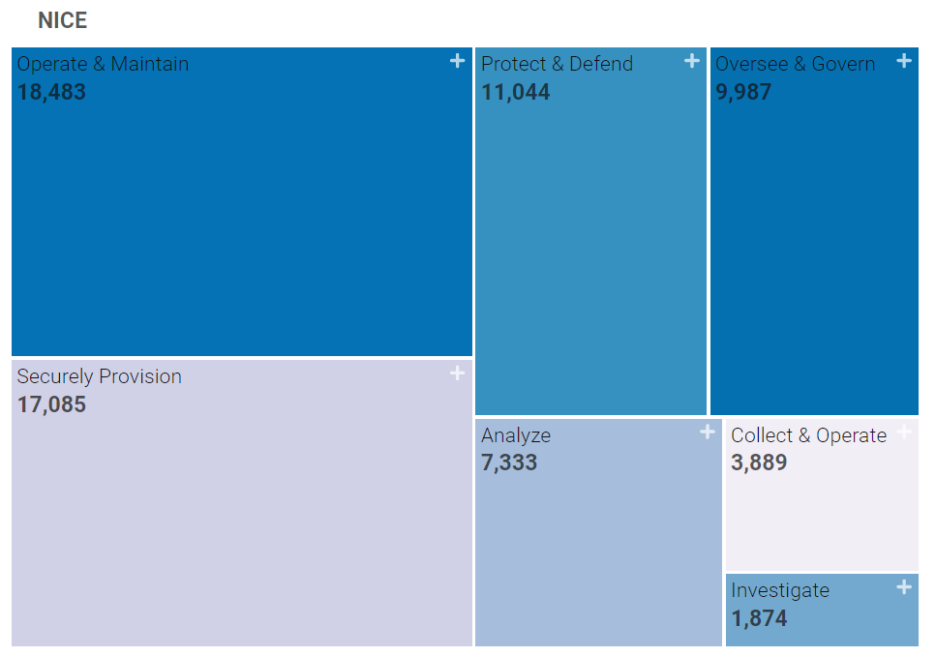
cyberseek
  Total open jobs as of 10/13/2021 – 17,271
  Total employees in Cybersecurity 26,448
  Supply is ranked very low
  Certifications
    CISSP
    Sec +
    GIAC
    CISP
    CISM
https://www.cyberseek.org/index.html

Slide 12
Education
  Degrees
    Community College
    University
  Certificates
    EC Council – CEH CISSP
    CompTIA – Sec+, CySA, CPT+
    Cisco – CCNA, CCNA – Security
  Hands on
    Cross functional training
    Military experience

Slide 13
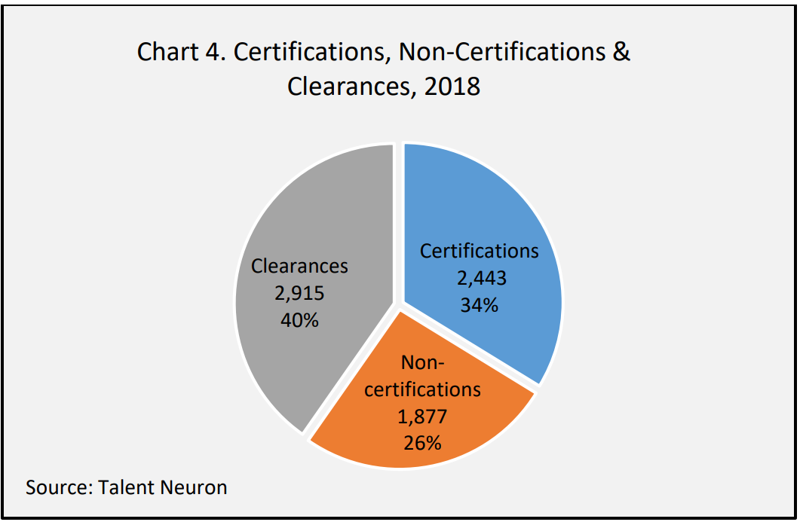
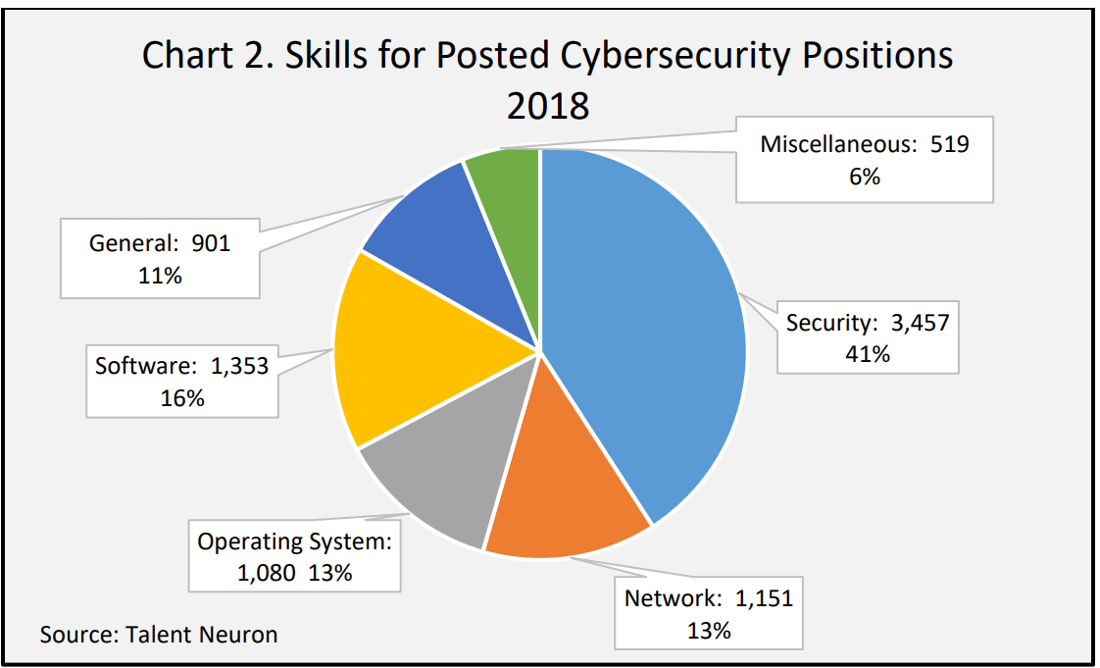
Cybersecurity Job requirements
  Ranking
    Degree
    Certificate
    Hands on
    Clearance

Slide 14
Monthly CU wide Cybersecurity meeting
  Last Friday of the Month
  CU Boulder
    Mike Traxler - NSI
    Dr. Bruce Montgomery – TCP
    Dr. Jim Curry – Applied Mathematics/TCP
    Dr. Ryan Edgington – TCP
  CU Denver
    Dr. Haadi Jafarian – Engineering
    Joe Murdock – Business
  UCCS
    Dr. Gurivender Tejay – Business
    Dr. Shouhuai Xu – Endowed Gallogly Cybersecurity Chair
    Mr. Dan Olson – School of Public Affairs
    Dr. Jugal Kalita - Engineering

Slide 15
UCCS Programs
  Engineering and Applied Science – BACS, BI, BSCS, MS, MA, ME, and PhD (ONLY CU system bachelor’s degrees)
  College of Business – BSB, MBA, and DBA Cybersecurity Management
  School of Public Affairs – concentration
  Letters Arts and Sciences – Interdisciplinary Bachelor’s Degree cybersecurity
    Technical Communications and Interface Design

Slide 16
Events for all in CU system
Ethics in Cybersecurity – 5 Nov
  Registration in cvent
    Ethics in Cybersecurity Event
CU-Wide Cyber Club Summit – 3 December
  WiCyS Student Chapter providing food
  USAFA Planetarium
  Mandiant Fireye – Solar Winds
Rocky Mountain Cyber Challenge – 5 Dec
  Deloitte and AFCEA Sponsoring
  All Colorado Universities and Colleges
  Registration
    https://web.cvent.com/event/39d7f8e4-e3f0-46e6-828c-23a4f2911257/summary

Slide 17
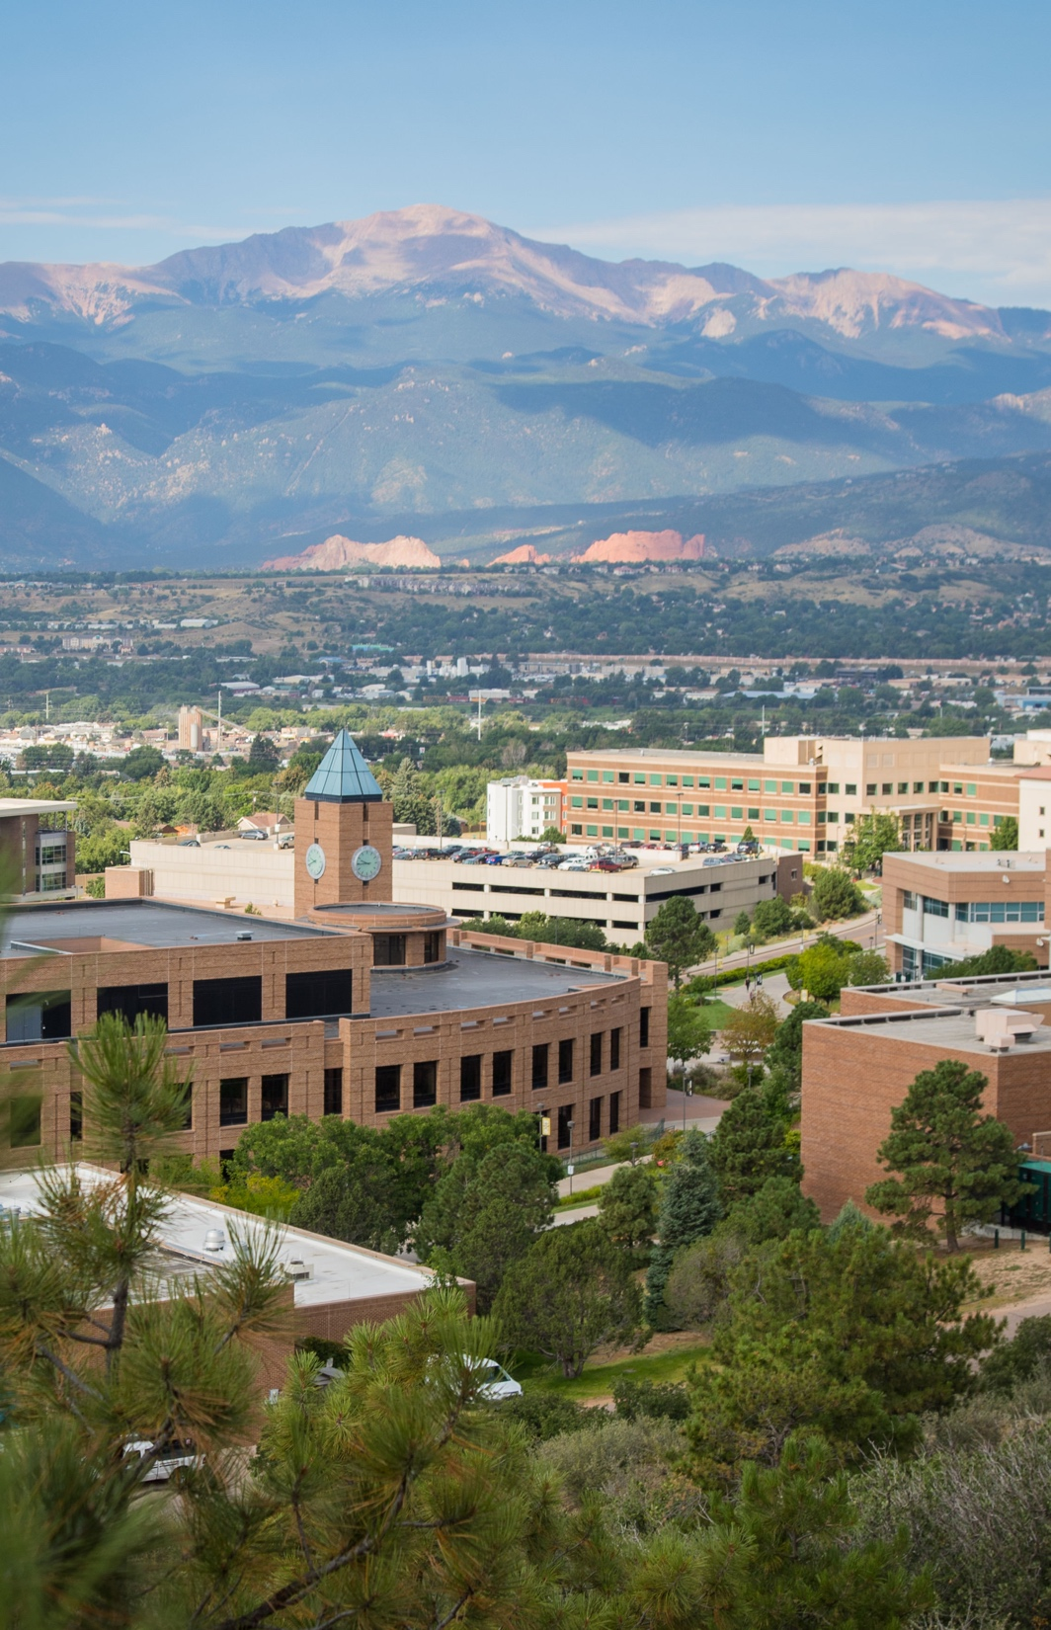
Thank You!
Open for Questions

